Slide 1


TAVI with ACURATE neo2 vs. Sapien/Evolut: A SWEDEHEART Target Trial Emulation Study
Andreas Rück
Karolinska University Hospital, Stockholm, Sweden
andreas.ruck@ki.se

Slide 2
Andreas Rück, MD PhD
Conflicts of interest
Boston Scientific: Institutional research support, Consulting
Edwards Lifesciences: Consulting
Anteris: Consulting

Slide 3
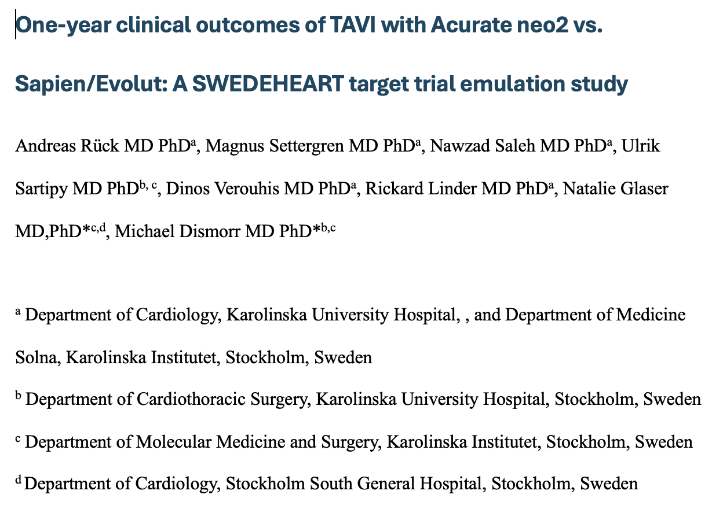
Submitted for publication

Slide 4
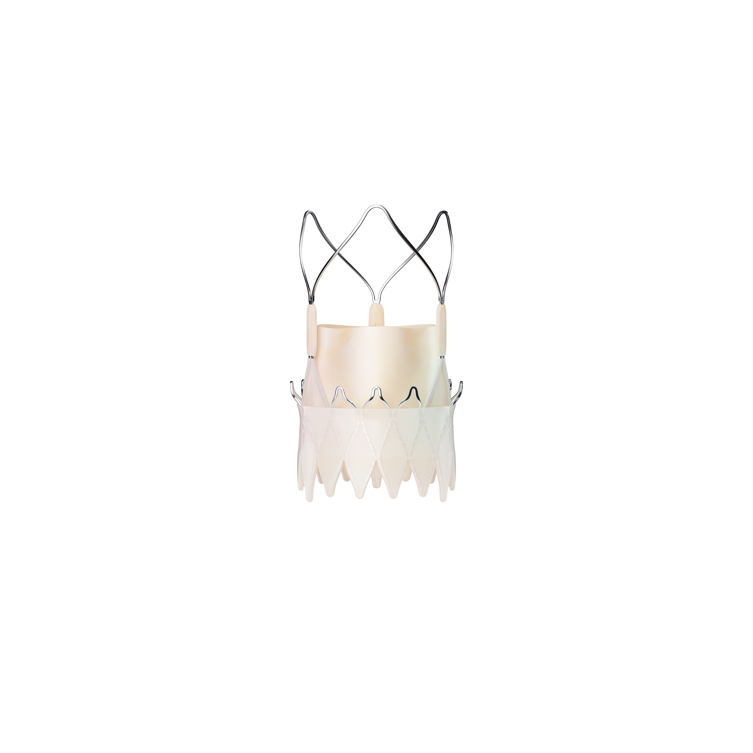
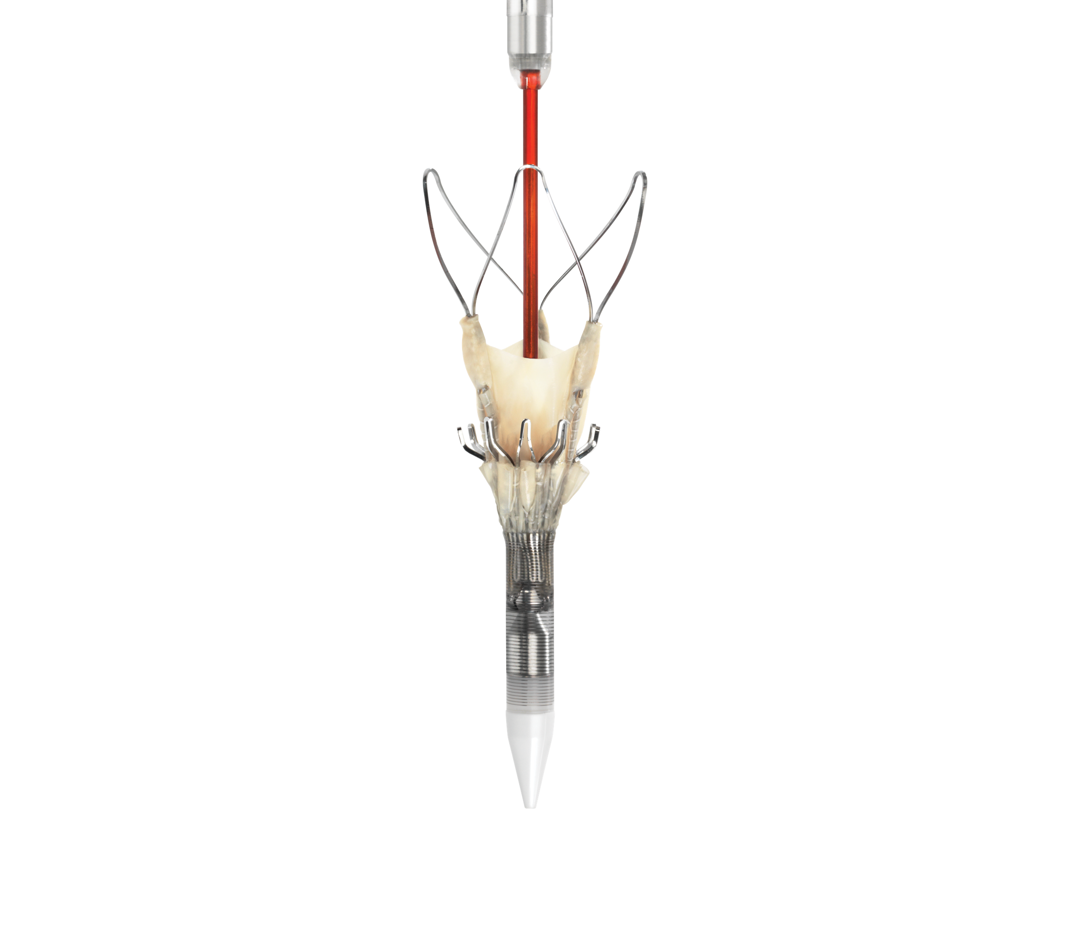

ACURATE neo2: Nitinol Self-expanding TAVI
Open upper frame
Supra-annular leaflets
ACTIVE PVseal™
Accurate positioning
Top-down deployment with upper- and lower- crown anchoring provides first-time precise procedures²
Boston Scientific
Investigational in US
Next gen ACURATE Prime now in Europe
Annulus treatment range
Treats 20 mm to 27 mm annulus diameters

Slide 5
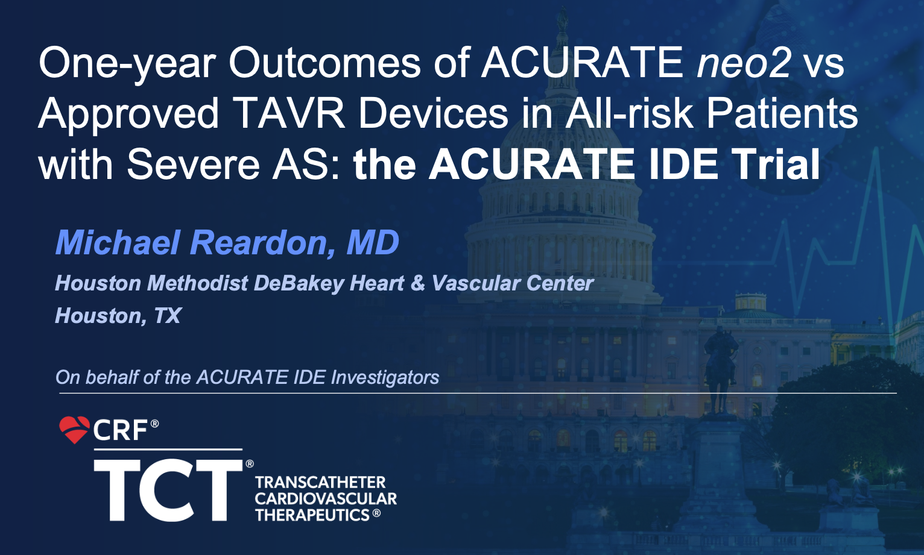
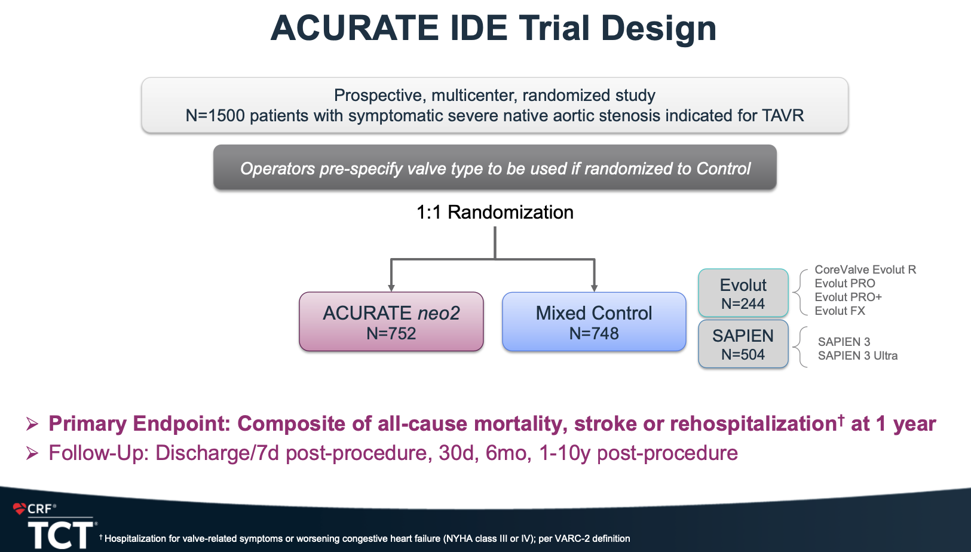

Slide 6
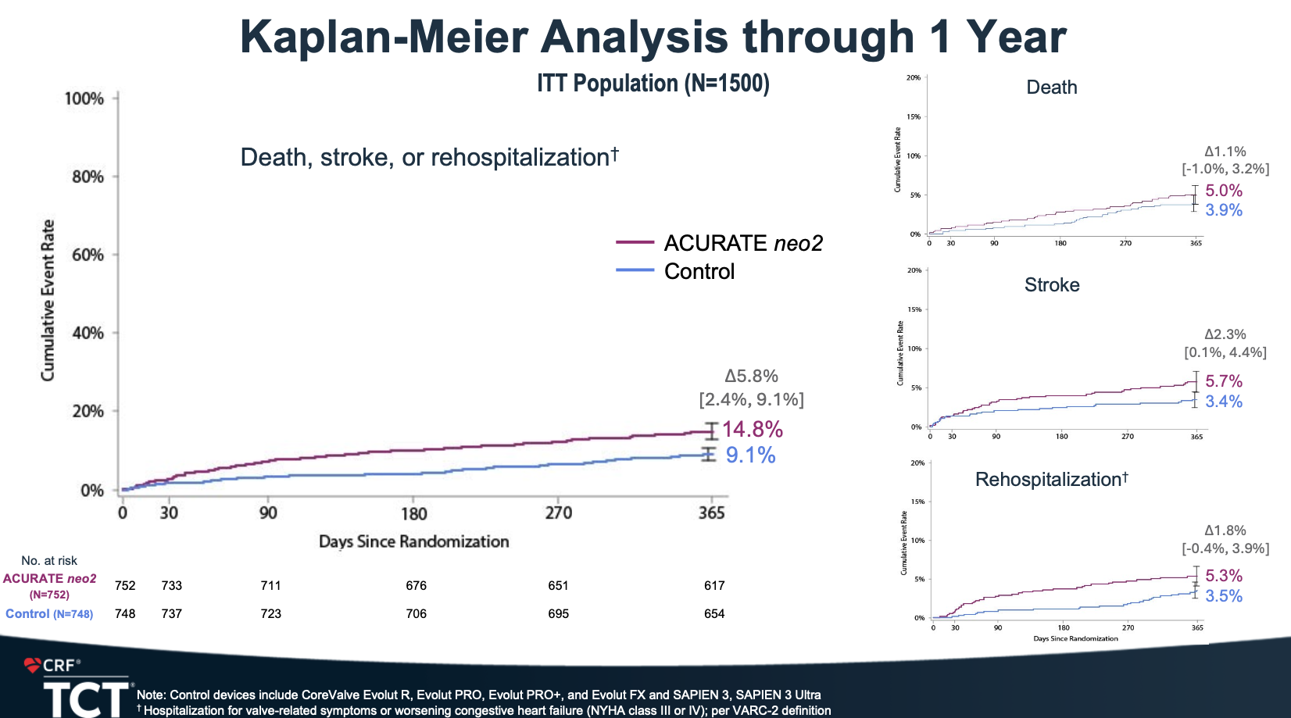
21% of ACURATE underexpanded by fluoroscopy

Slide 7

Target trial emulation

Slide 8
Study flowchart
Total 1943 TAVI
644 ACURATE neo2
826 Edwards Sapien3
473 Medtronic Evolut

Slide 9
Baseline data (crude)
Variable | Overall | ACURATE neo2 | Control | p
No. | 1943 | 644 | 1299
Age, years, median [IQR] | 81.2 (6.1) | 82.1 (5.8) | 80.8 (6.2) | <0.001
Female sex | 49.8 % | 53.9 % | 47.7 % | 0.012
LVEF |  |  |  | 0.409
>50% | 81.9 % | 83.4 % | 81.1 %
40-49% | 12.2 % | 10.9 % | 12.9 %
30-39% | 5.9 % | 5.7 % | 5.9 %
Aortic mean pressure gradient, mmHg, mean (SD) | 47.7 (13.0) | 47.9 (12.1) | 47.6 (13.4) | 0.644
NT-proBNP, ng/L, mean (SD) | 2323.2 (4072.2) | 1811.2 (2586.1) | 2518.7 (4498.0) | 0.003
eGFR, mL/min/1.73 m² |  |  |  | 0.404
15-29 | 3.1 % | 3.6 % | 2.9 %
30-44 | 14.3 % | 14.9 % | 13.9 %
45-59 | 26.7 % | 28.3 % | 25.9 %
>60 | 55.9 % | 53.3 % | 57.2 %
Hypertension | 91.7 % | 91.0 % | 92.1 % | 0.470
COPD | 17.1 % | 17.5 % | 16.9 % | 0.785
Previous myocardial infarction | 17.2 % | 13.8 % | 18.9 % | 0.006
Previous stroke | 20.8 % | 23.1 % | 19.7 % | 0.091
Diabetes | 29.8 % | 29.8 % | 29.8 % | 1.000
Previous atrial fibrillation | 38.7 % | 39.4 % | 38.3 % | 0.650
Previous pacemaker/ICD | 10.2 % | 11.5 % | 9.6 % | 0.231
Previous PCI | 30.1 % | 25.0 % | 32.6 % | 0.001

Slide 10
Acurate vs control per hospital

Slide 11
Adjusted by balancing weighting (Love plot)

Slide 12






Procedural data
Variable | Overall | ACURATE neo2 | Control | p
Prosthesis size, mm |  |  |  | <0.001
≤23 | 21.9 % | 18.3 % | 23.6 %
24-26 | 39.7 % | 37.4 % | 40.9 %
≥27 | 38.4 % | 44.3 % | 35.5 %
Annulus diameter, mm, mean (SD) | 24.1 (1.7) | 24.0 (1.5) | 24.1 (1.8) | 0.059
Pre-dilatation | 60.9 % | 99.8 % | 41.6 % | <0.001
Pre-dilatation balloon undersizing, mm, mean (SD) | 2.3 (1.6) | 1.2 (0.8) | 3.6 (1.4) | <0.001
Annulus diameter and pre-dilatation balloon size difference |  |  |  | <0.001
≤1mm | 27.4 % | 47.3 % | 3.7 %
1-2mm | 30.4 % | 45.6 % | 12.4 %
>2mm | 42.2 % | 7.2 % | 83.9 %
Post-dilatation | 22.7 % | 44.7 % | 11.8 % | <0.001
Post-dilatation balloon undersizing, mm, mean (SD) | 0.8 (1.0) | 0.8 (0.7) | 0.8 (1.3) | 0.911
Annulus diameter and post-dilatation balloon size difference |  |  |  | 0.001
≤1mm | 71.2 % | 74.3 % | 65.4 %
1-2mm | 23.1 % | 22.9 % | 23.5 %
>2mm | 5.7 % | 2.8 % | 11.1 %

Slide 13
Primary Endpoint

Slide 14
Components

Slide 15
Additional endpoints
Weighted cumulative incidence of acute myocardial infarction, percutaneous coronary intervention and major bleeding event at 3 and 12 months.
 | Events / PY | HR (95% CI) | 3 months | 12 months
Acute myocardial infarction
ACURATE neo2 | 3 / 481 | 0.66 (0.20-1.55) | 0.3 (0.0-2.4) | 0.6 (0.2-2.2)
Control | 17 / 1005 | NA | 0.4 (0.2-0.9) | 1.5 (1.0-2.5)
Percutaneous coronary intervention
ACURATE neo2 | 4 / 481 | 0.85 (0.25-2.02) | 0.1 (0.0-0.8) | 0.7 (0.3-2.0)
Control | 9 / 1009 | NA | 0.3 (0.1-0.8) | 0.9 (0.4-1.7)
Major bleeding event
ACURATE neo2 | 27 / 468 | 1.03 (0.67-1.49) | 2.4 (1.4-3.9) | 4.2 (2.8-6.3)
Control | 47 / 989 | NA | 2.1 (1.4-3.0) | 4.2 (3.1-5.5)
Cardiovascular death
ACURATE neo2 | 23 / 642 | 0.54 (0.30-0.88) | 0.5 (0.2-1.6) | 2.6 (1.5-4.4)
Control | 57 / 1477 | NA | 1.6 (1.1-2.5) | 4.3 (3.5-6.0)
Acute myocardial infarction, percutaneous coronary intervention major bleeding event and cardiovascular death outcomes estimated using Aalen-Johansen to account for the competing risk of death. PY = person-years

Slide 16















Postdilatation - not dangerous
Variable | Overall | No post-dilatation | Postdilatation | p
No | 644 | 356 | 288
Peri-procedural tamponade % | 0.2 | 0.3 | 0.0 | 1.000
Peri-procedural valve embolization % | 0.5 | 0.8 | 0.0 | 0.327
Major vascular complication % | 1.2 | 0.8 | 1.7 | 0.509
VARC2 major bleeding % | 2.5 | 2.0 | 3.1 | 0.489
Aortic mean pressure gradient, mmHg, mean (SD) | 9.1 (3.9) | 9.5 (4.2) | 8.6 (3.5) | 0.019
Paravalvular leakage |  |  |  | 0.012
Moderate % | 2.8 | 2.3 | 3.5
Acute kidney injury % | 2.8 | 2.2 | 3.5 | 0.486
In-hospital stroke % | 0.6 | 1.1 | 0.0 | 0.195
In-hospital TIA % | 0.2 | 0.3 | 0.0 | 1.000
In-hospital myocardial infarction % | 0.2 | 0.3 | 0.0 | 1.000
Pacemaker implantation within 30 days % | 5.6 | 7.0 | 3.8 | 0.113
30-day mortality % | 0.5 | 0.6 | 0.3 | 1.000
Analysis of ACURATE group
Crude data

Slide 17
Comparison IDE vs SWEDEHEART (ACURATE group)
 | IDE trial | SWEDEHEART
Age, years | 78.0 | 82.1
Preop AS mean gradient, mmHg | 44.7 | 47.9
Predile done (%) | 99.6% | 99.8%
Predil balloon within 1mm of anular size (%) | 19% | 47%
Postdil done (%) | 26.1% | 44.7%
Postdil balloon within 1mm of anular size (%) | 49% | 74%
Postop mean gradient, mmHg | 9.0 | 9.1
New pacemaker 30d (%) | 11.2% | 5.6%

Slide 19
Limitations
Observational data
No imaging (frame underexpansion could not be estimated)

Slide 20
Conclusions
Mortality, heart failure hospitalization and stroke was not different between ACURATE and Sapien/Evolut TAVI in Swedish observational data
Rigorous pre- and postdilatation was used
Not difficult – most often same balloon for pre/postdilatation
Post-dilatation was not associated with adverse events
🇸🇪 🇪🇺 Europe 🇺🇸 USA – can learn from each other

