Slide 1

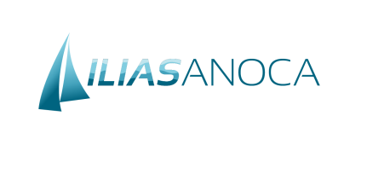




A randomised trial of coronary function testing- guided treatment versus standard care in ANOCA
On behalf of the ILIAS ANOCA investigators:
Tim P. van de Hoef
University Medical Center Utrecht The Netherlands

Slide 2
Potential conflicts of interest
Speaker's name: Tim Van De Hoef
ILIAS ANOCA was funded through a restricted institutional grant from Philips
☑ I have the following potential conflicts of interest to report
Receipt of grants / research supports - Philips
Receipt of grants / research supports - Abbott
Receipt of grants / research supports - Shockwave Medical
Receipt of grants / research supports – Vahaticor

Slide 3
Angina: a disease in need of a diagnosis
Angina with no obstructive coronary artery disease (ANOCA) is documented in up to 70% of patients undergoing invasive coronary angiography
Coronary function testing (CFT) allows to identify coronary vasomotor disorders as the origin of angina pectoris in the majority of ANOCA patients
Current guidelines recommend CFT in ANOCA whom remain symptomatic on medical therapy, but early diagnosis may improve quality of life

Slide 4
Hypothesis
An early CFT-guided treatment strategy significantly improves disease-related quality of life in patients with ANOCA compared to standard care without the information provided by CFT

Slide 5
Eligibility Criteria
Inclusion criteria
  18 years or older
  Clinical indication for invasive coronary angiography in the work-up of chronic coronary syndrome
Exclusion criteria
  Obstructive epicardial coronary artery disease
    Diameter stenosis >50% and/or abnormal NHPR/FFR
  Non-coronary indication for coronary angiography
  Significant valvular heart disease
  Significant renal impairment (eGFR <30ml/min)

Slide 6







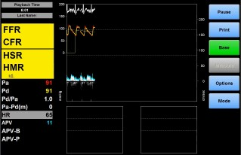



Trial Design and Key Aspects
Invasive Coronary Angiography
- NHPR/FFR as clinically indicated
Embedded in Routine Practice
- No interruption of medical therapy
Radial cocktail per operator preference
Manual acetylcholine infusion protocol
Exclude if CAD
Coronary Function Test
- Coronary Flow Reserve (CFR)
- Microvascular Resistance (HMR)
- Acetylcholine provocation
Doppler Velocity Assessment
- ComboWire / FloWire (Philips)
Randomize 1:1
Intervention
- CFT results
- Disease-specific treatment
Control
Blinded to CFT results
Standard care
Follow-up @ 6 months
Seattle Angina Questionnaire

Slide 7







Coronary function test diagnosis
Coronary Spasm Epicardial and/or microvasular spasm per COVADIS criteria
Coronary Microvascular Dysfunction
- CFR <2.5
- HMR >2.5 mmHg/cm/s
Non-Cardiac Chest Pain
Normal CFT result
Mixed Spasm and CMD any form of coronary spasm as well as presence of CMD
Functional Angina Inconclusive acetylcholine test
Normal CFR and HMR
Intervention
- Disease-specific treatment
Control
- Blinded and Standard care

Slide 8
Primary endpoint
Primary Endpoint
  Difference in the change in SAQ Summary Score (SAQSS) from baseline to 6-month follow-up between the intervention and control arm
Statistical Considerations
  140 patients provide 80% power to detect a difference of 9±19 SAQSS
units
  Plan to enroll 150
  Mixed effects linear regression model accounting for baseline values of the SAQ scores.

Slide 9

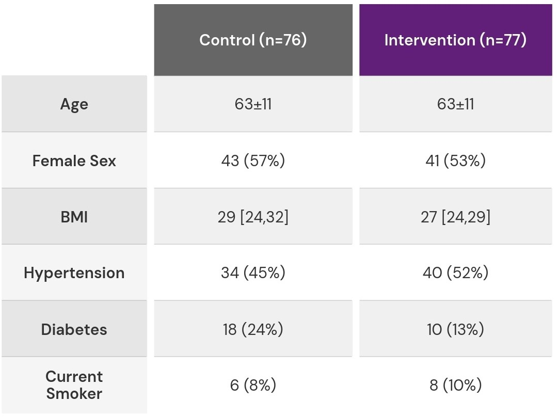









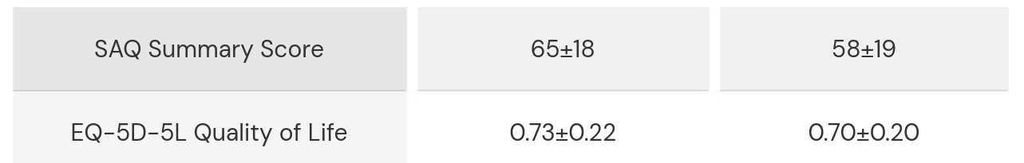


Baseline Characteristics
Consented (n=255)
Obstructive CAD
(n=102 (40%))
CFT performed (n=153)
Randomized (n=153)
Control (n=76)
Intervention (n=77)
Declined follow-up
(n=2)
Declined follow-up
(n=2)
FU complete (n=74)
FU complete (n=75)

Slide 10
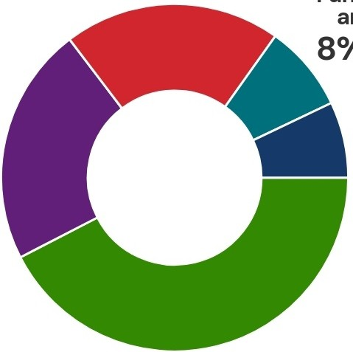
CFT-derived diagnosis
Mixed spasm and CMD 20%
Functional angina
8%
Coronary vasomotor dysfunction
was documented in
78% of ANOCA patients
Non-cardiac chest pain 22%
Isolated CMD 7%
Isolated coronary spasm 42%

Slide 11
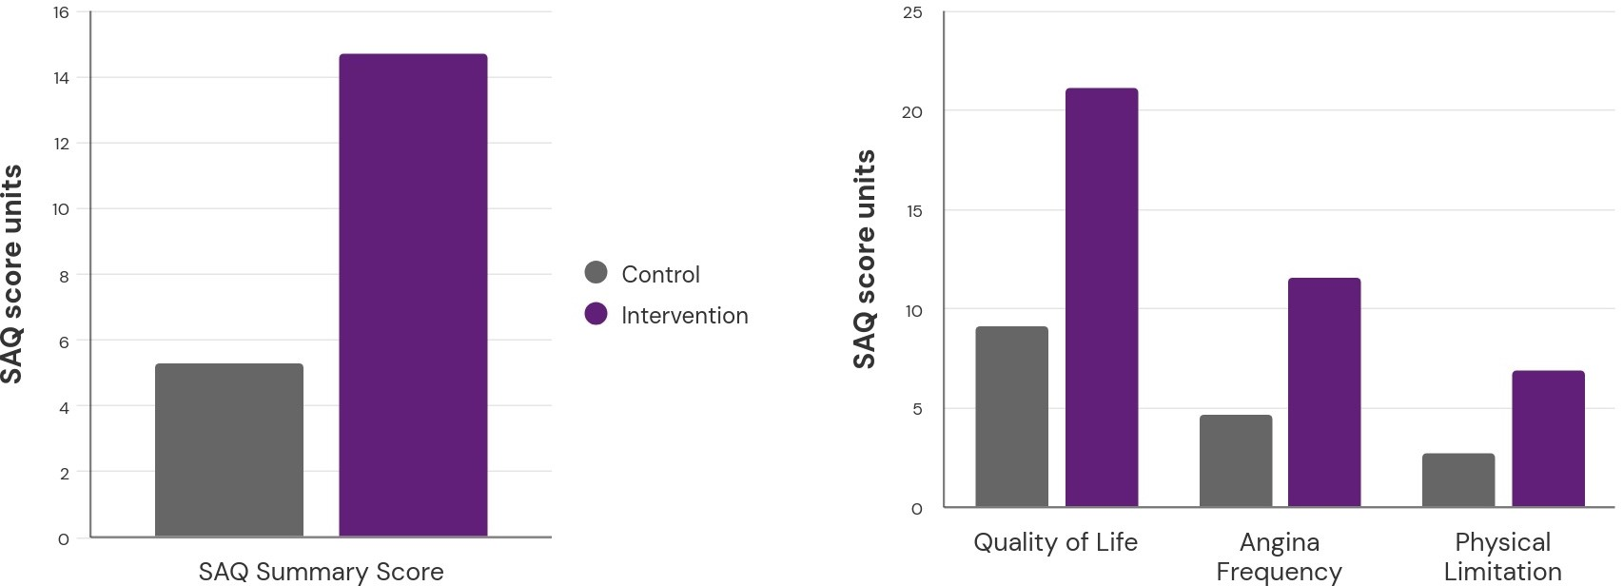
Primary Endpoint: SAQ Summary Score
ΔSAQSS: +9.4 Units
(95% CI: 3.9 to 14.9)
p=0.001
+11.3U
(95% CI: 4.6 to 19.4)
p=0.001
Change in SAQ Summary Score
Change in SAQ Summary Score
+11.6U
(95% CI: 5.3 to 19.5)
p=0.001
+4.2U
(95% CI: -2.6 to 11.0)
p=0.226

Slide 12
Safety and Feasibility
100% of CFT procedures were completed successfully
Average of 21±6 minutes for CFT completion
No procedural adverse events
No major adverse cardiac events up to 6-month follow-up

Slide 13
Conclusions
Ad-hoc coronary function testing in ANOCA using a pragmatic CFT protocol during the initial coronary angiogram was safe and feasible, and identified coronary vasomotor disorders in 78% of patients
CFT-guided treatment improves angina-related quality of life and angina frequency compared with standard care in ANOCA patients presenting to the cath lab.
ILIAS ANOCA strengthens the evidence supporting early coronary function testing to improve quality of life in patients with ANOCA.

Slide 14

Acknowledgements
Study Coordinators
Coen Boerhout, MD, and Hanae Namba, MD
UMC Utrecht
dr. Tommy Liu
prof. Pim van der Harst
Amsterdam UMC
prof. Jan Piek
dr. Marcel Beijk
dr. Ronak Delewi
dr. Yolande Appelman
Steering Committee
prof. Colin Berry
prof. Javier Escaned
prof. Amir Lerman
prof. Timothy Henry
Radboud UMC
- dr. Peter Damman
Robert Bosch Krankenhaus
prof. Peter Ong
prof. Udo Sechtem
Amphia Hospital
- dr. Martijn Meuwissen

Slide 15

pcronline.com

