Slide 1
A case of a giant pulmonary artery aneurysm
Nadia Abelhad, B.S., M.D.; Katia Bravo-Jaimes, M.D.;
Abhijeet Dhoble, M.D.; Salman Arain, M.D.
University of Texas Health Science Center at Houston

Slide 2
HPI
66 yo F with PMH COPD (not on home O2)
CC: worsening dyspnea and exercise tolerance
ROS: +cough, +abdominal distension, +palpitations

Slide 3
Physical Exam
Vitals: BP 96/60, HR118, RR 25, Sp02 88% 5L NC
Weight 40 kg, BMI 16.5
Gen: +cachexia, +scleral icterus
Resp: +tachypnenic, +rales
CV: + JVD, +RV heave, irregularly irregular heart sounds, fixed split S2, multifocal grade V/VI holosystolic murmur
Abd: +fluid wave, +hepatojugular reflux

Slide 4
Notes:
CXR: increased convexity of the right side of the heart (arrowheads). There is a large pulmonary outflow tract (arrow) and increased pulmonary vascularity.

Slide 5
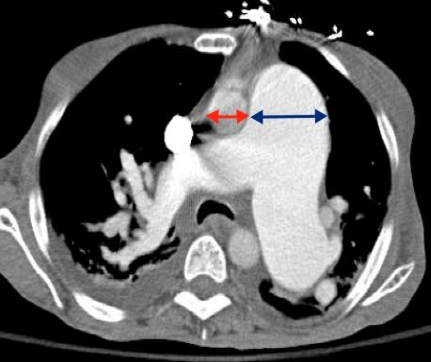
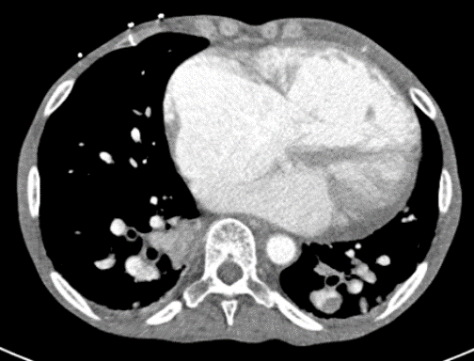
Notes:
Computed tomography displayed a massively dilated central pulmonary trunk, measuring 50 mm with PA to aortic root ratio greater than 3:1 (Axial Image 1) and RV:LV ratio>1 (contrast image 1). Contrast was noted to reflux into the hepatic vasculature, there was no evidence of pulmonary emboli.

Slide 6
Notes:
Mitral valve prolapse, biatrial enlargement, severe RV dilatation and dysfunction

Slide 7
Notes:
Severe RV dilatation, septal flattening

Slide 8
Notes:
Bubble study demonstrating interatrial shunt

Slide 9
RHC
BP | 111/75 (89)
RA | 16
PA | 60/21 (35)
PCWP | 13
CO | 6.5
CI | 4.8
Oxymetry
Ao | 95.8%
SVC | 87.5%
RA | 89.6%
IVC | 76.4%
RV | 90.1%
PA | 93.3%
LA | 91.6%
Qp:Qs | 6.9
MAP/mPAP | 2.5
PVR | 3.3
SVR | 11.6

Slide 10
Notes:
No CAD

Slide 11
What would you do next?
A. Start nitric oxygen challenge
B. Cardiac magnetic resonance imaging to better assess the RV and mitral valve
C. Transesophageal echocardiogram to evaluate for structural abnormalities
Notes:
This patient’s pulmonary hypertension is secondary to Group 2 (L-->R shunt, worsened with severe MR) and 3 (COPD). Computed tomography showed a pulmonary artery aneurysm (PAA) and TTE showed IV bowing with severe MR suggesting a structural abnormality.

Slide 12
Procedures
Notes:
To better evaluate MR and interatrial shunting a TEE was performed.
TEE with doppler revealed two ASD’s with left to right intra-arterial shunting.

Slide 13
ASDs: 28mm
16mm
Qp/Qs: 6.9
Notes:
3D recreation approximated these ASDs to measure 28mm and 16mm in diameter with pulmonary-to-systemic (shunt) flow ratio Qp/Qs 6.9. Based on these results, surgical ASD closure was recommended.

Slide 14
ASD
Class I indications for ASD closure
Impaired functional capacity
RA or RV enlargement
Qp/Qs ratio >1.5
No cyanosis at rest or w/exertion
Systolic PAP < 50% SBP
PVR < 1/3 SVR
Notes:
This case demonstrates an unusual underlying diagnosis to one of the most common chief complaints- dyspnea. There were multiple physical exam findings suggesting possible RV failure such as hepatojugular reflux and scleral icterus. The most common cause of RV failure is L sided heart failure, however in this case the normal pulmonary capillary wedge pressure and preserved LV systolic function rule this out. At this point, one should be prompted to think of a ddx that encompasses structural heart disease and possible left to right shunting.

Slide 15
PA aneurysm
Definition: >29mm, increased PA:A ratio
50% caused by congenital heart disease
ASD: third congenital cause after PDA and VSD
Surgical correction: PAA >55 mm, symptoms, pHTN, valvular pathology
Notes:
Pulmonary artery (PA) aneurysm is defined by main PA diameter exceeding 29 mm by computed tomography [1]. Congenital heart diseases account for 50% of etiology of this condition and atrial septal defects (ASD) represent the third congenital cause of PA aneurysm [1]. The left to right shunting of blood leads to increases in pulmonary pressures and volumes thus causing PA aneurysm and right ventricular failure. Clinical manifestations widely vary, including dyspnea, palpitations, syncope, compressive symptoms, hemoptysis and sudden death.
Surgical correction is recommended in different situations, including (a) PA aneurysm measuring 55 mm or more, (b) progressive diameter increase, (c) symptoms, (e) pulmonary hypertension or valvular pathologies or (d) signs of rupture or dissection [2]. In our patient, it is possible that PA aneurysm may stabilize after ASD correction since these patients experience regression of PA and right ventricular pressures [3].

