Slide 1





The British Heart Foundation SENIOR-RITA Trial
Invasive Treatment Strategy for Older Patients with Myocardial Infarction
Professor Vijay Kunadian
MBBS, MD, MRCP, FRCP, FACC, FESC, PG Dip (Clinical Trials)
Study Chair and Chief Investigator THE BHF SENIOR-RITA Trial
Personal Chair and Clinical Professor of Interventional Cardiology Honorary Academic Consultant Interventional Cardiologist Newcastle upon Tyne, United Kingdom

Slide 2
Take Home Messages
The SENIOR-RITA trial is the largest trial to date in older adults with heart attacks than all previous trials combined.
Among older adults with type I NSTEMI, an invasive strategy is safe.
An invasive strategy did not significantly reduce the combined risk of cardiovascular death or non-fatal myocardial infarction as compared with a conservative strategy.
Treatment with an invasive strategy did reduce the risk of non-fatal myocardial infarction and subsequent revascularization.
The results provide a foundation for older heart attack patients and their clinicians to make an informed decision about whether to undergo invasive coronary angiography or not.

Slide 3







Background: Optimal care underutilised in older patients
50% of NSTEMI occurs in patients aged ≥70years!
Frequency distribution of STEMI
Questions:
Older adults undertreated?
What about the rest- 86%?
Fear of complications?
Futility?
Care is diverse
and NSTEMI in 2013/14
Aspirin 18 – <65
65 – <75
75 – <85
85+
ACEi 18 – <65
65 – <75
75 – <85
85+
Statin 18 – <65
65 – <75
75 – <85
85+
Angiogram 18 – <65
65 – <75
75 – <85
85+
30
STEMI NSTEMI
25
Percentage (%)
20
15
10
5
0
20–29 30–39 40–49 50–59 60–69 70–79 80–89 90+
Age
0 0.2 0.4 0.6 0.8 1.0
Odds ratios for receipt of treatment by age group
Only 14% of those ≥85 years receive angiography
Zaman J et al. Eur Heart J 2014;35(23):1551–1558.

Slide 4

























STUDY FLOW
Patients were recruited from EDs, MAU, cardiology wards, medical wards, geriatric wards at PCI and non-PCI centres
75+ NSTEMI
Formal assessment of frailty, cognition, co- morbidity at baseline and follow-up
Randomise: N=1518
Salient features:
45% Female
72% ≥80 years
Oldest 103 years
80% Prefrail/Frail
60% MoCA <26
Median CCI = 5
Invasive treatment: N=753
Conservative treatment: N=765
Follow-up: 4.04 years (4.01-4.88)
Follow-up: 4.06 years (4.02-4.31)**
ITT Primary Analysis: N=753
ITT Primary Analysis: N=765
ED-emergency department; MAU-medical admissions unit; PCI-percutaneous coronary intervention MoCA-Montreal cognitive assessment; CCI-Charlson co-morbidity index; ITT-Intention to treat

Slide 5
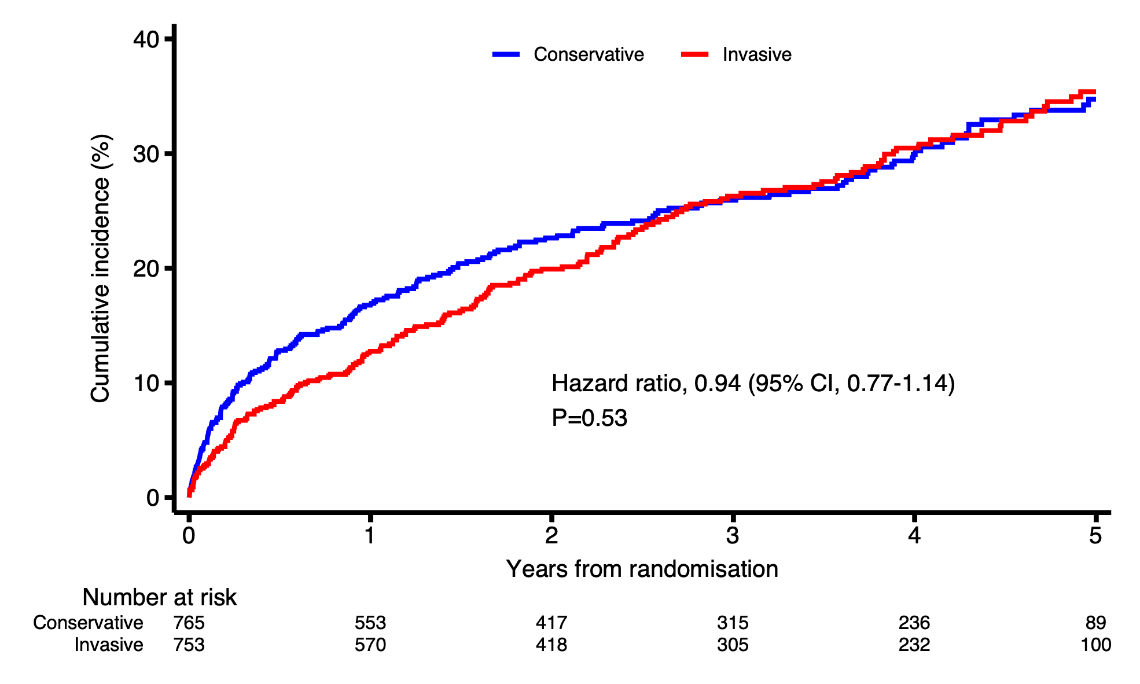
PRIMARY OUTCOME:
COMPOSITE OF CV DEATH OR NON-FATAL MI
Hazard ratio 0.94; 95% CI 0.77 - 1.14 P=0.53
CV-Cardiovascular; MI Myocardial infarction; CI-Confidence interval

Slide 6
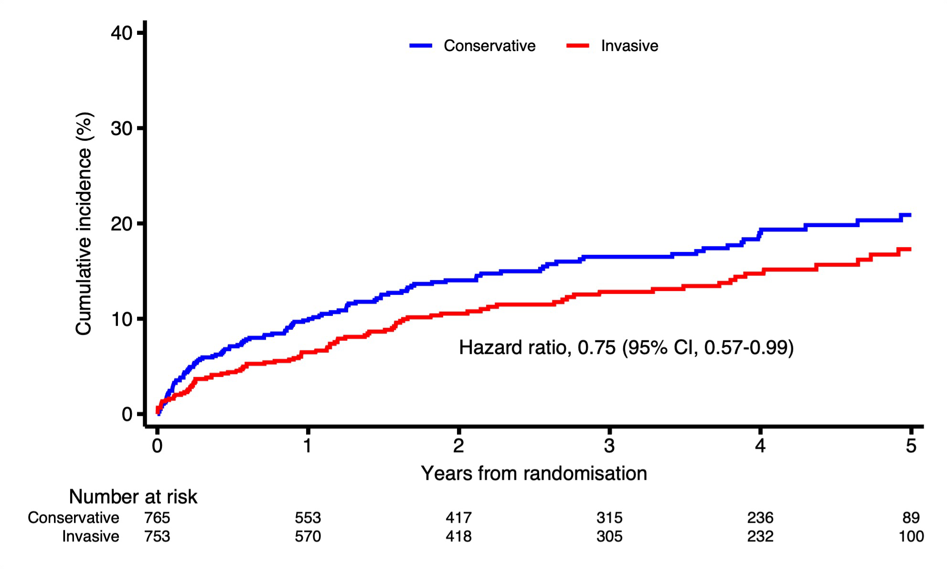
NON-FATAL MYOCARDIAL INFARCTION
Hazard ratio 0.75; 95% CI 0.57-0.99

Slide 7
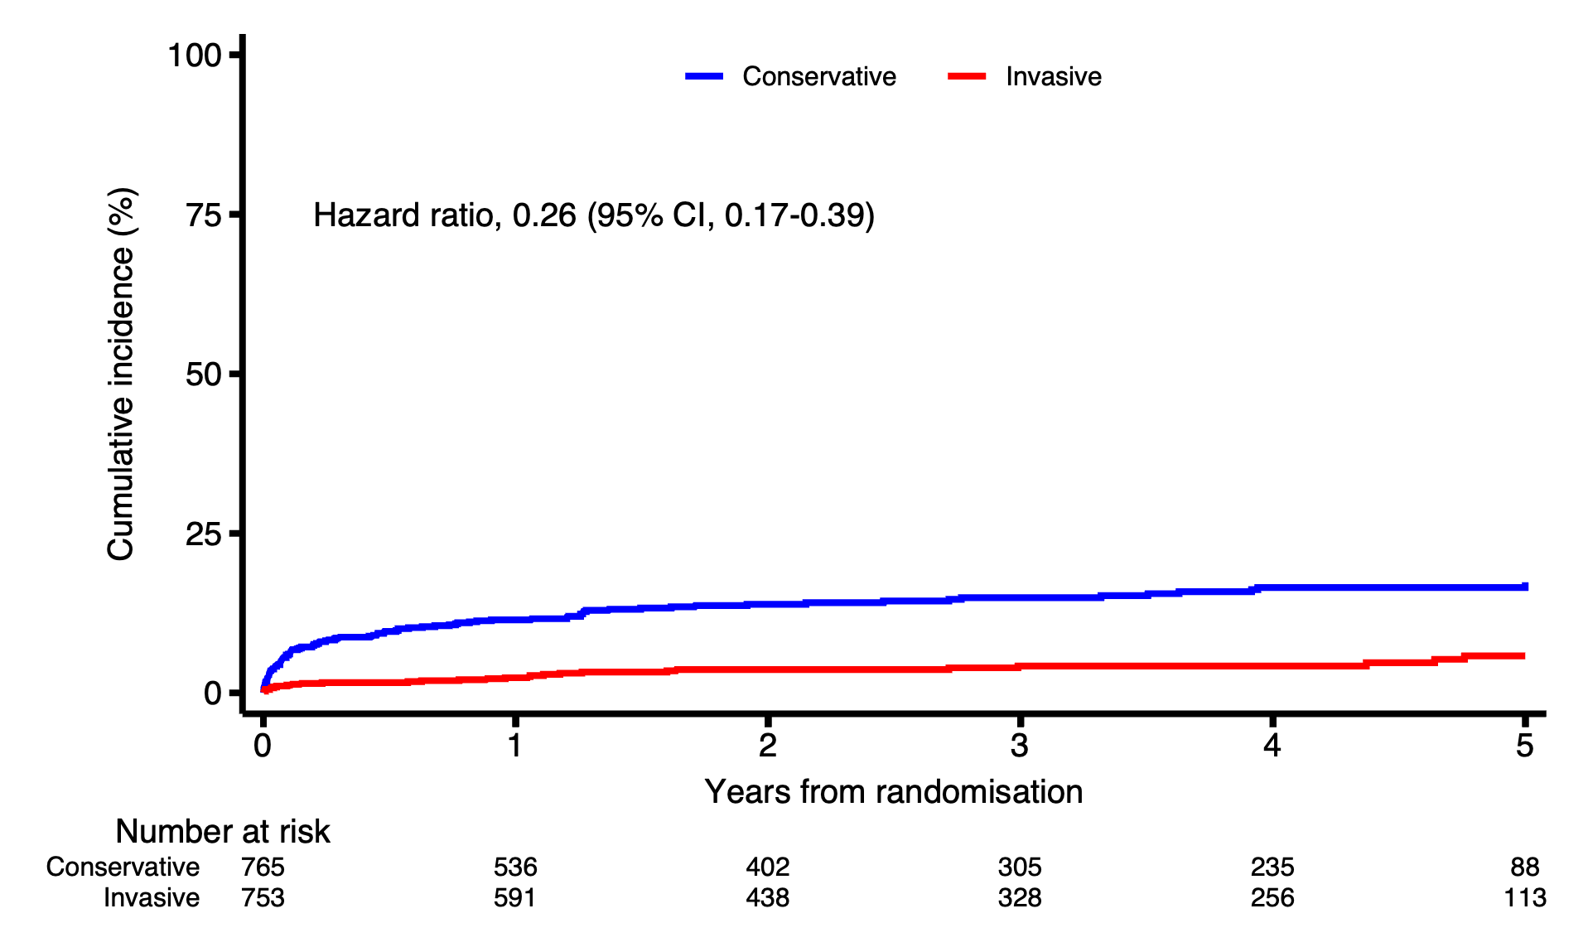
SUBSEQUENT REVASCULARISATION
Hazard ratio 0.26; 95% CI 0.17-0.39

Slide 8
Key messages
Among older adults with type I NSTEMI, an invasive strategy is safe.
An invasive strategy did not significantly reduce the combined risk of cardiovascular death or non-fatal myocardial infarction as compared with a conservative strategy.
Treatment with an invasive strategy did reduce the risk of non-fatal myocardial infarction and subsequent revascularization.
The results provide a foundation for older heart attack patients and their clinicians to make an informed decision about whether to undergo invasive coronary angiography or not.

