Slide 1
Contrast Induced Encephalopathy Case Report
Kartik Shatagopam MD
M. Ayoub Mirza MD
Carilion Clinic Virginia Tech School of Medicine
Roanoke, Virginia

Slide 2
Kartik Shatagopam, MD
I have no relevant financial relationships

Slide 3
History
80 year old male with prior history of coronary artery bypass graft presented to our clinic with typical angina
Nuclear stress test revealed a large fixed lateral and antero-anterolateral perfusion abnormalities with evidence of mild peri-infarct ischemia
Due to ongoing symptoms despite guideline directed medical therapy, he was scheduled for a coronary angiogram
Angiogram revealed severe in-stent restenosis of a previously placed stent in saphenous vein graft to right coronary artery
This was intervened by placement of another drug eluting stent

Slide 4
Cath Images

Slide 5
Cath Images

Slide 6
Cath Images

Slide 7
Hospital course
Two hours post procedure, patient developed acute symptoms of expressive aphasia and significant delirium
CT scan of the brain revealed no acute pathology
MRI revealed subacute infarctions in the upper and posterior aspect of the right middle frontal gyrus that normalized with apparent diffusion co-efficient (ADC)

Slide 8
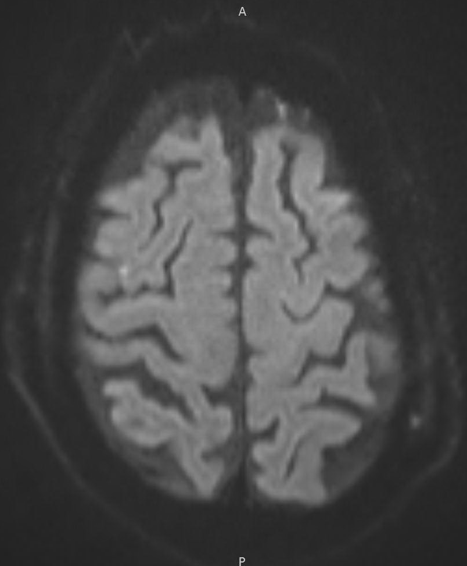
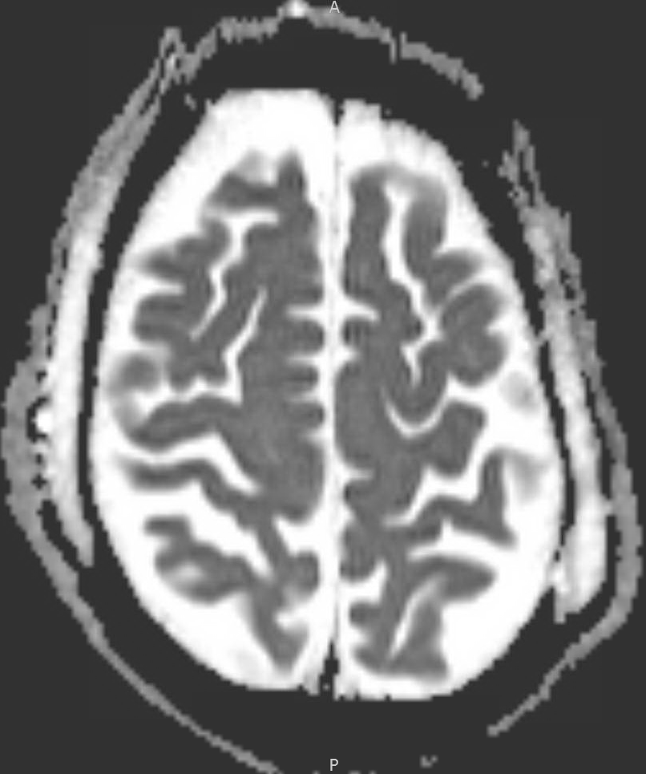
MRI
Diffusion weighted images revealing small, punctate infarct in right middle frontal gyrus.
ADC mapping revealing normal water diffusion in the suspected infarct area, NOT suggestive of true infarct.

Slide 9
Hospital course
Symptoms completely resolved within 48 hours
Upon further discussions with family and a comprehensive chart review, patient had a similar neurological event during previous cardiac catheterization several years ago
Based on history, clinical presentation and radiological findings, the diagnosis of Contrast Induced Encephalopathy (CIE) was made

Slide 10
Discussion
CIE is rare
Incidence varies from 0.3% to 1%
Typically occurs in patients receiving intra-arterial contrast, especially in coronary or carotid arteries
Neurologic symptoms develop within hours of contrast exposure and clinical manifestations vary greatly
Symptoms include cortical blindness, hemiparesis, aphasia, loss of coordination, confusion/delirium, seizures/coma

Slide 11
Discussion
Precise mechanism remains unclear, but a possible explanation is that the chemical and physical properties of the contrast media cause osmotic disruption of the blood-brain barrier with subsequent direct neurotoxicity of extravasated contrast
Occipital cortex is one of the regions with a higher permeability of the blood brain barrier and is most effected
Risk factors associated with CIE include hypertension, diabetes, renal impairment, male gender, history of previous cerebrovascular accident, injection of large volumes of iodinated contrast and angiography with PCI of internal mammary grafts

Slide 12
Discussion
Diagnosis is based clinical features MRI findings
The ADC component of MRI can be very useful in differentiating between acute infarction and CIE
ADC provides a quantitative measure of water diffusion in the brain and reveals no abnormality in intensity in patient with CIE
In acute ischemic CVA with cytotoxic edema, decreased water diffusion in infarcted tissues causes a decreased ADC
Treatment is usually supportive and involves hydration with IV crystalloids
Neurologic deficits typically last from few minutes to several days with complete recovery in most cases

Slide 13
Take home messages
CIE is a rare but important clinical entity to consider and be aware of in the differential diagnosis of CVA following coronary angiography and PCI
Symptoms occur a few hours after the procedure, mimic CVA and can lead to rapid neurologic decline
MRI with ADC is a useful tool in diagnosis and can exclude CVA
Treatment is supportive and prognosis is generally excellent with complete neurologic recovery within days

