Slide 1


5-Year Outcomes After Transcatheter or Surgical Aortic Valve Replacement in
Evolut Low Risk Trial
Low-Risk Patients With Aortic Stenosis
Michael J. Reardon, MD¹ and John K. Forrest, MD² On behalf of the Evolut Low Risk Trial Investigators
¹Methodist DeBakey Heart and Vascular Center, Houston, TX
²Yale University School of Medicine, New Haven, Connecticut, USA

Slide 2
Disclosure of Relevant Financial Relationships
Within the prior 24 months, I have had a relevant financial relationship with a
company producing, marketing, selling, re-selling, or distributing healthcare products used by or on patients:
Nature of Financial Relationship | Ineligible Company
Grant/Research Support | Abbott, Boston Scientific, WL Gore Medical, and Medtronic
All relevant financial relationships have been mitigated.
Faculty disclosure information can be found on the app

Slide 3






Study Administration
Principal Investigators
Executive Committee
Michael Reardon, MD
Methodist DeBakey Heart and Vascular Center
John Forrest, MD Yale University School of Medicine
Michael Reardon, MD
Methodist DeBakey Heart and Vascular Center
John Forrest, MD Yale University School of Medicine
G. Michael Deeb, MD
University of Michigan Health Systems
Steven Yakubov, MD OhioHealth Riverside Methodist Hospital
Steering Committee
David Adams, Stanley Chetcuti, G. Michael Deeb, John Forrest, John Heiser, William Merhi, Mubashir Mumtaz, Daniel O’Hair, Jon Resar, Joshua Rovin, Michael Reardon, Paul Teirstein, Steven Yakubov, George Zorn
Screening Committee: Michael Reardon, G. Michael Deeb, Steven Yakubov, Robert Stoler, Thomas Gleason
Echo Core Laboratory: Mayo Clinic
Clinical Events Committee: BAIM Institute CT Core Laboratory: St. Paul’s Hospital Statistical Analyses: Medtronic
Sponsor: Medtronic

Slide 4
Background
Transcatheter aortic valve replacement (TAVR) has emerged as the leading procedure for treating symptomatic severe aortic stenosis in the United States, irrespective of the patient's surgical risk
The Evolut Low Risk Trial (NCT02701283) is a multinational, prospective, randomized, interventional study comparing the safety and efficacy of TAVR with Evolut to surgery in low- risk patients with severe aortic stenosis with a 10-year follow-up
  We recruited patients at a predicted surgical mortality of 3% or less, with anatomy
suitable for both TAVR and surgery
  Since these are low risk patients, we have committed to reporting our data frequently
The availability of intermediate- and long-term data assessing TAVR against surgery in low surgical risk aortic stenosis patients is limited

Slide 5
Objective
To evaluate 5-year outcomes with Evolut vs surgery in patients from the Evolut Low Risk trial

Slide 6
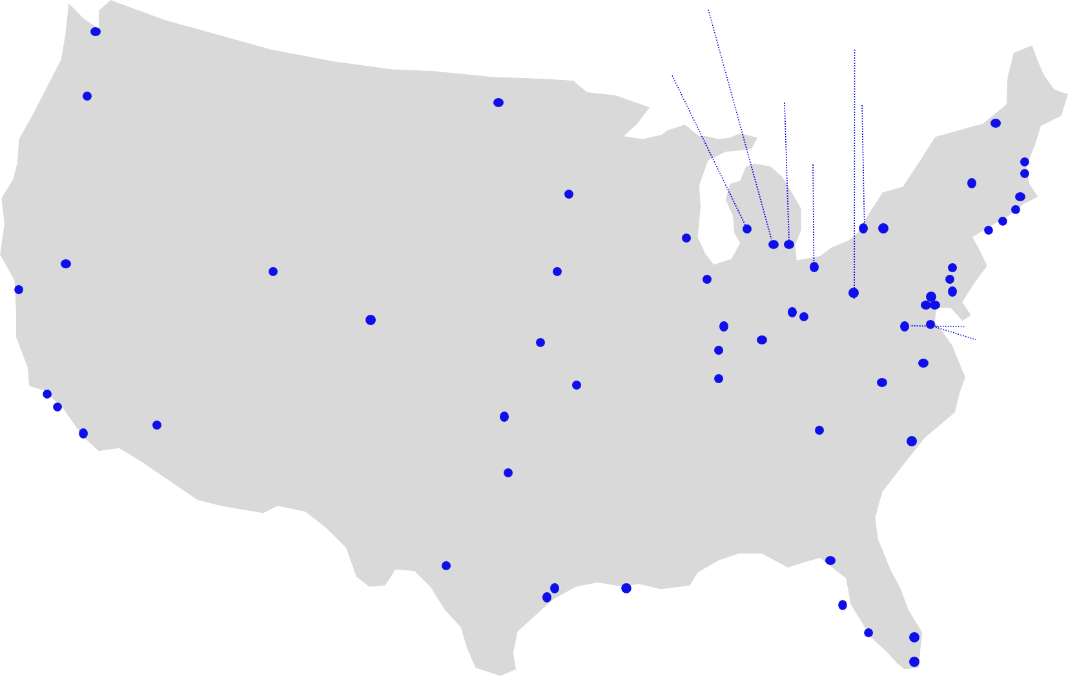
US Study Sites (N = 61)
Univ. of Michigan
Univ. of
Pittsburgh
Swedish MC
Spectrum Health
St. John Hospital_{Strong}
Memorial
Oregon Health & Science Univ.
Sanford MC
Case
MC
Univ. Vermont MC
Baystate MC
Mass General
Beth Israel Deaconess
Yale New Haven Hospital North Shore Univ. Hospital
St. Francis Hospital
Abbott NW
St. Joseph’s
Hospital
St. Lukes/Aurora
The Mount Sinai MC Geisinger MC
Mercy General Hospital
Univ. of Utah
Mercy Medical Ctr
Riverside Methodist & OSU
El Camino
Loyola
U Pittsburg Pinnacle Health
Lehigh Valley Hospital
Johns Hopkins, MedStar Union, & Univ. of Maryland MC Winchester MC
Bon Secours Heart & Vascular Institute Duke Univ.
Wake Forest Baptist MC
Univ. of Colorado Hospital
St. Vincent
Jewish Hospital
Mercy Hospital Vanderbilt
Univ. of Kansas
Good
Samaritan
Keck Hospital Scripps Hospital
Los Robles Hospital
Abrazo Arizona
Heart Hospital
Integris Baptist MC
Piedmont Heart Institute
Medical Univ. of South Carolina
Baylor Heart & Vascular
Methodist DeBakey
& Baylor College of Medicine
CV Institute
of the South
Tallahassee Research Institute
Methodist Hospital
Morton Plant
Lee Memorial
Health System
Delray Medical Center Univ. of Miami

Slide 7
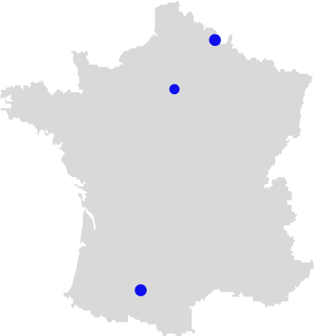


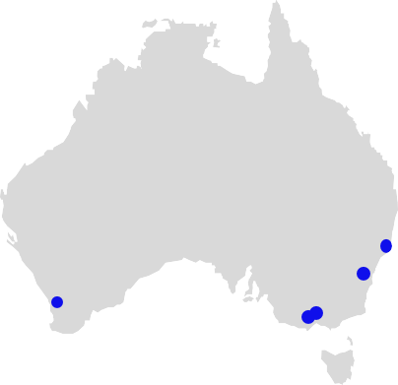
International: Canada, Europe, Japan, Australia, New Zealand (N = 25)
CHRU de Lille
Jacques Cartier
St. Antonius Hospital
Erasmus
Catherina Hospital
Sapporo Higashi Tokushukai
Hospital
Clinique Pasteur
IUCPQ
McGill University &
Montreal Heart Institute
Sendai Kousei Hospital
Toronto General Hospital, Sunnybrook Health & London Health Sciences
Sakakibara Heart Institute
Shonan Kamakura General Hospital
Teikyo University Hospital
Kokura Memorial Hospital
Osaka University Hospital National Cerebral and Cardiovascular Center
Waikato Hospital
Royal North Shore
St. Vincent’s Hospital
Fiona Stanley Hospital
The Alfred Hospital
& MonashHeart

Slide 8

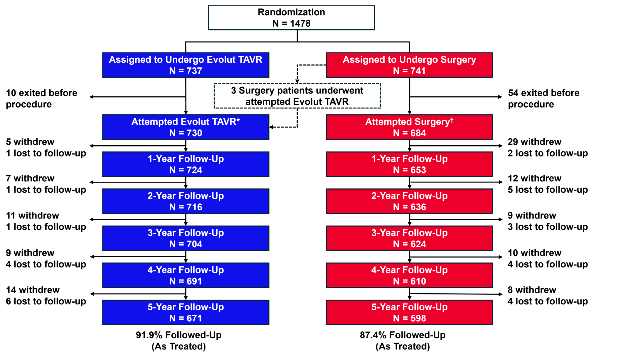
Patient Flow
*Evolut R: 73%; Evolut Pro: 23.4%; CoreValve: 3.6%. †Edwards: 56.9%; Abbott: 18.7%; %; LivaNova: 13.7% ; Medtronic: 10.8%.

Slide 9
Baseline Characteristics
 | Evolut (N=730) | Surgery (N=684)
Age – yr | 74.1 ± 5.8 | 73.7 ± 5.9
Age <70 yr | 21.4% | 24.0%
Age <65 yr | 5.8% | 7.0%
Female sex | 36.4% | 34.1%
STS-PROM score | 2.0% ± 0.7 | 1.9% ± 0.7
NYHA functional class
III | 24.8% | 27.8%
IV | 0.1% | 0.4%
Hypertension | 84.8% | 82.6%
Chronic lung disease, COPD | 15.1% | 18.0%
Previous coronary artery bypass graft | 2.5% | 2.0%
Previous percutaneous coronary intervention | 14.1% | 12.9%
Previous myocardial infarction | 6.7% | 4.8%
Atrial fibrillation/atrial flutter | 15.4% | 14.4%
Pre-existing permanent pacemaker or defibrillator | 3.3% | 4.0%
Left ventricular ejection fraction | 61.7% ± 7.9 | 61.9% ± 7.7
Continuous variables reported as mean ± standard deviation and categorical variables were presented as percentages. There were no significant differences (P<0.05) in baseline characteristics between trial groups.

Slide 10
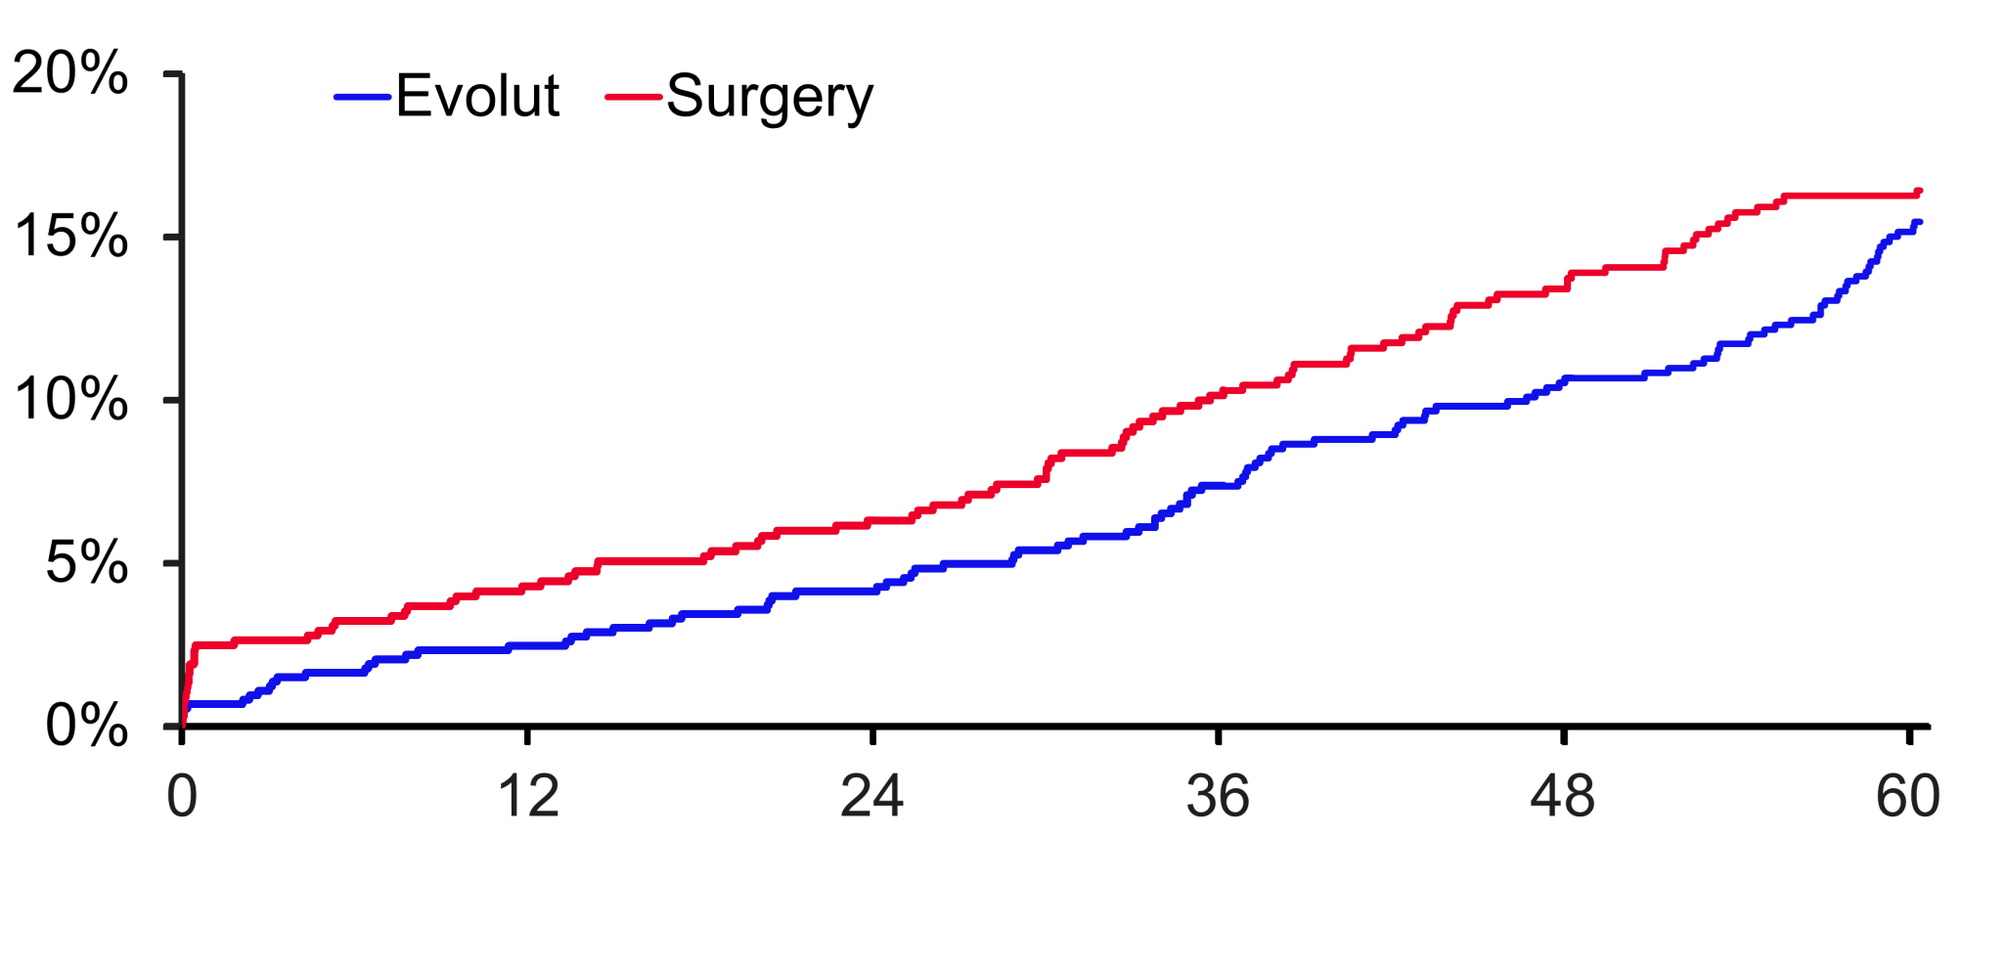
Primary Endpoint: All-cause Mortality Or Disabling Stroke
All-Cause Mortality or
Disabling Stroke
16.4%
15.5%
Log-rank p-value at 5Y = 0.47
Months Since Procedure
Evolut | 730 | 715 | 706 | 685 |  | 651 | 615 |  | 542
Surgery | 684 | 648 | 627 | 595 |  | 558 | 520 |  | 475

Slide 11
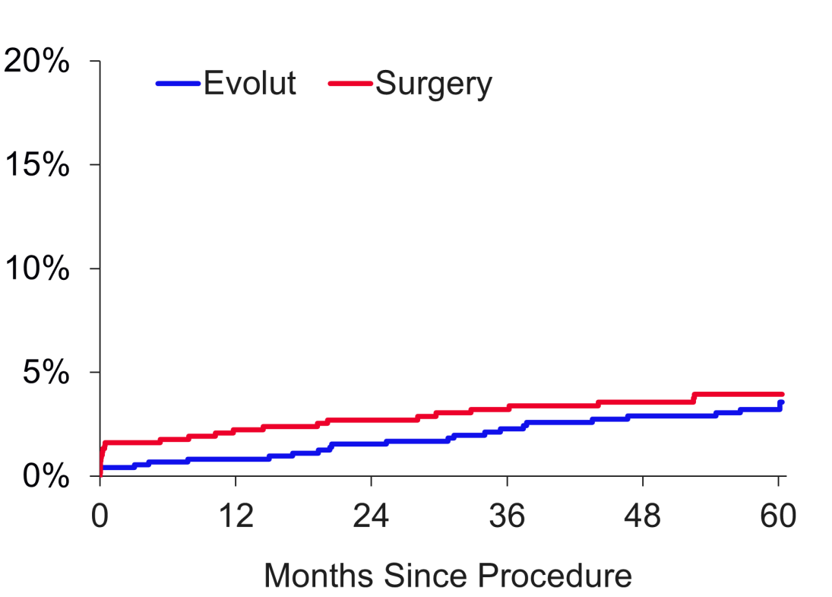
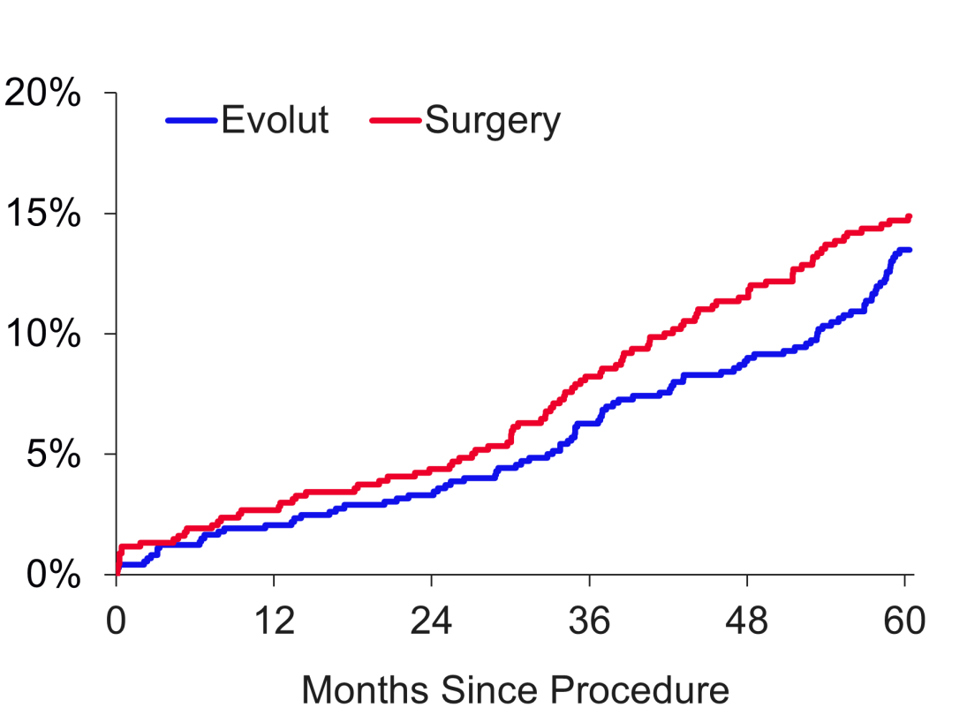
All-cause Mortality And Disabling Stroke
Disabling Stroke
All-Cause Mortality
Log-rank p-value at 5Y = 0.57
Log-rank p-value at 5Y = 0.39
14.9%
Patients
Patients
13.5%
4.0%
3.6%
Evolut | 730 | 715 | 706 | 685 | 651 | 615 | 542
Surgery | 684 | 648 | 627 | 595 | 558 | 520 | 475
Evolut | 730 | 718 | 709 | 691 | 659 | 626 | 555
Surgery | 684 | 656 | 636 | 605 | 569 | 530 | 482

Slide 12
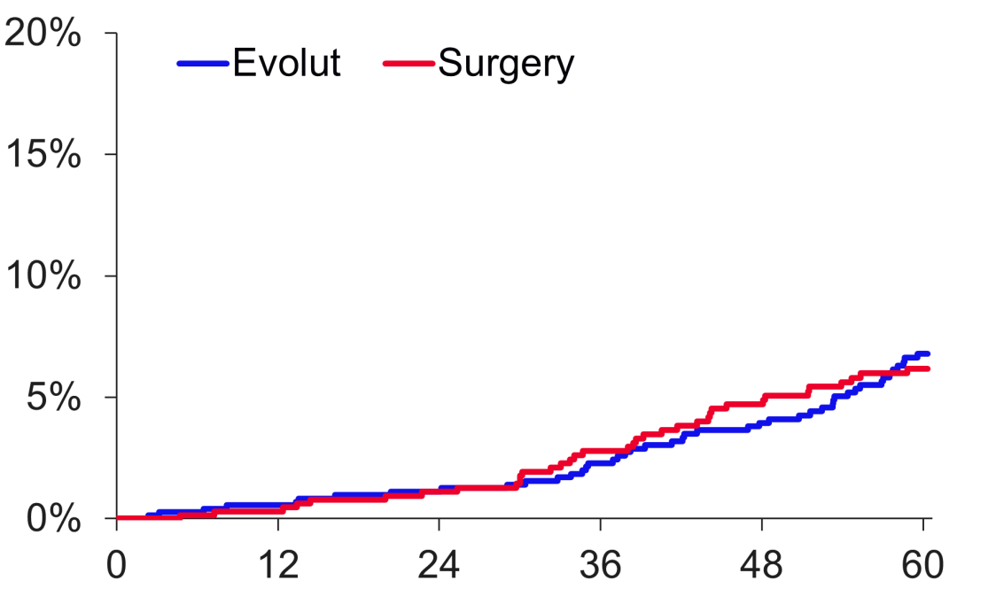
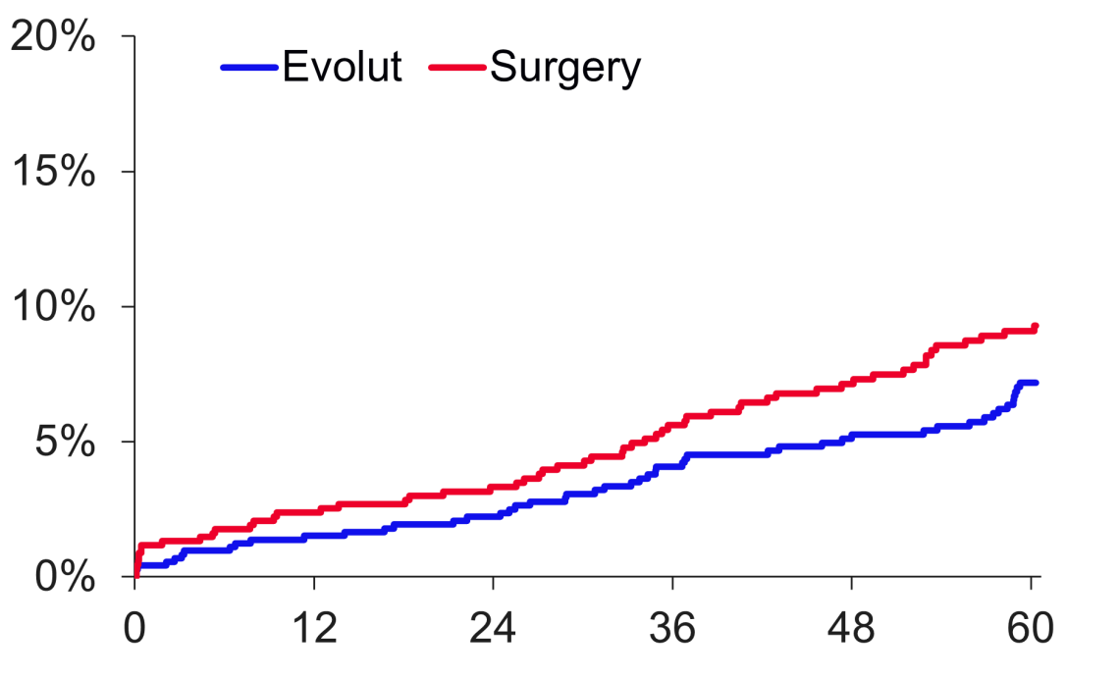
Non-cardiovascular And Cardiovascular Mortality
Non-Cardiovascular Mortality
Cardiovascular Mortality
Log-rank p-value at 5Y = 0.73
Log-rank p-value at 5Y = 0.15
Patients
5 Years
Δ 2.1%
9.3%
Patients
6.8%
6.2%
2 Years
Δ 1.1%
7.2%
Months Since Procedure
Months Since Procedure
Evolut | 730 | 718 | 709 | 691 | 659 | 626 | 555
Surgery | 684 | 656 | 636 | 605 | 569 | 530 | 482
Evolut | 730 | 718 | 709 | 691 | 659 | 626 | 555
Surgery | 684 | 656 | 636 | 605 | 569 | 530 | 482

Slide 13
5-Year Clinical Outcomes
 | Evolut | Surgery | HR (95% CI) | P Value (log-rank)
All-cause mortality or disabling stroke | 15.5% | 16.4% | 0.90 (0.69, 1.18) | 0.47
All-cause mortality | 13.5% | 14.9% | 0.88 (0.66, 1.17) | 0.39
Cardiovascular death | 7.2% | 9.3% | 0.75 (0.51, 1.11) | 0.15
Non-cardiovascular death | 6.8% | 6.2% | 1.08 (0.70, 1.67) | 0.73
Disabling stroke | 3.6% | 4.0% | 0.85 (0.49, 1.49) | 0.57
Aortic valve hospitalization | 13.9% | 15.1% | 0.89 (0.67, 1.19) | 0.44
Myocardial infarction | 6.0% | 3.6% | 1.63 (0.97, 2.75) | 0.06
Total valve thrombosis | 0.9% | 0.6% | 1.36 (0.38, 4.82) | 0.63
New pacemaker implantª | 27.0% | 11.3% | 2.70 (2.04, 3.55) | <0.001
Total pacemaker implant^{b} | 26.3% | 11.0% | 2.68 (2.04, 3.53) | <0.001
Atrial fibrillation | 16.3% | 41.2% | 0.32 (0.25, 0.39) | <0.001
Reintervention^{c} | 3.3% | 2.5% | 1.30 (0.66, 2.56) | 0.44
Clinical outcomes are presented as Kaplan-Meier % with HR (95% CI). ªPatients with pacemaker or ICD at baseline are not included. Not adjudicated by CEC. ^{b}Patients with pacemaker or ICD at baseline are included. Not adjudicated by CEC. ^{c}One crossover patient (randomized to TAVR but received a surgical intervention) included in surgery group.

Slide 14
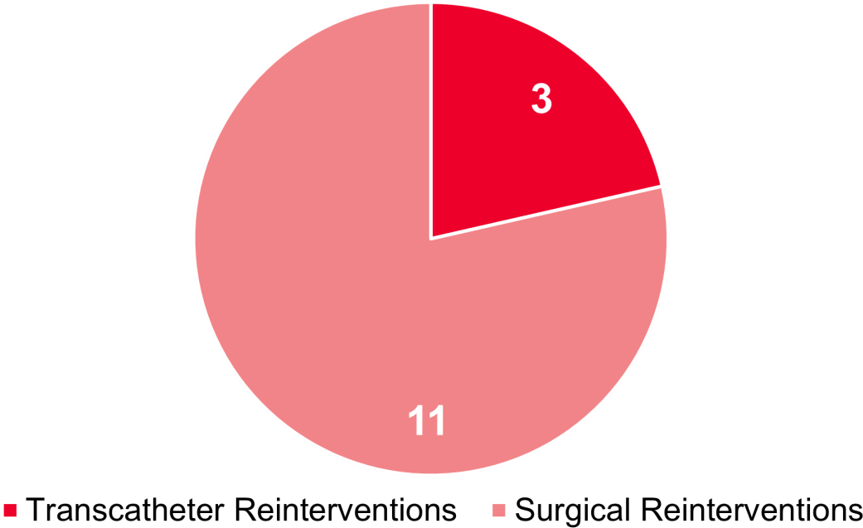
Reinterventions
No difference in reinterventions between Evolut and surgery
 | Evolut | Surgery | P Value (log-rank)
Reintervention | 21 (3.3%) | 14 (2.5%) | 0.44
Surgical | 18 (2.8%) | 11 (2.0%) | 0.34
Transcatheter | 3 (0.5%) | 3 (0.5%) | 0.84
Reinterventions in Evolut arm (N=21)
Reinterventions in surgery arm (N=14)
2 deaths
2/11 (18.2%)
3
2 deaths
2/18 (11.1%)
18
Transcatheter Reinterventions
Surgical Reinterventions

Slide 15
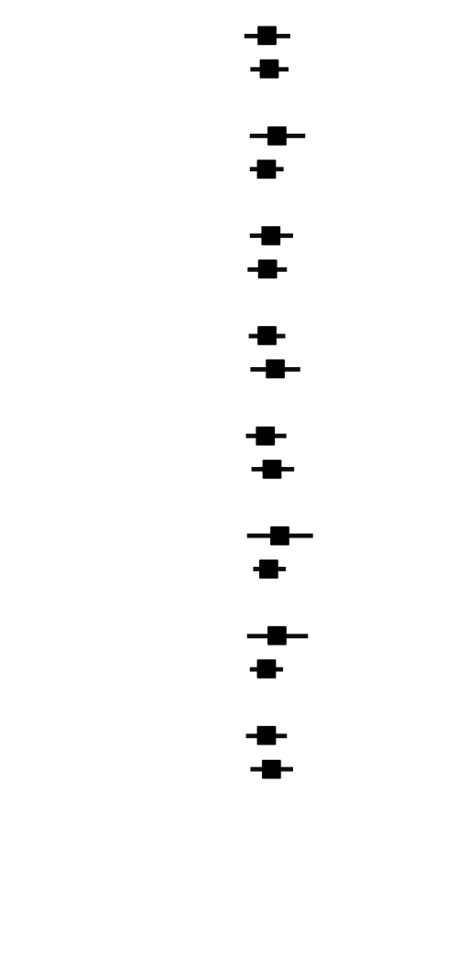
All-cause Mortality Or Disabling Stroke Subgroup Analysis
Variable | Evolut | Surgery |  |  | HR (95% CI) | P Value
 | KM rate, 5 years
Age, years |  |  |  |  |  | 0.8451
<75 | 11.9% | 13.4% |  |  | 0.87 (0.57-1.33)
≥75 | 18.9% | 19.8% |  |  | 0.91 (0.64-1.29)
Sex |  |  |  |  |  | 0.5366
Female | 12.9% | 12.1% |  |  | 1.05 (0.63-1.76)
Male | 17.0% | 18.6% |  |  | 0.86 (0.63-1.18)
STS-PROM, % |  |  |  |  |  | 0.8263
<2.0 | 12.3% | 12.6% |  |  | 0.94 (0.63-1.41)
≥2.0 | 19.5% | 21.4% |  |  | 0.88 (0.61-1.26)
NYHA |  |  |  |  |  | 0.5851
I/II | 13.4% | 15.0% |  |  | 0.87 (0.62-1.22)
III/IV | 22.1% | 20.2% |  |  | 1.02 (0.64-1.61)
Baseline KCCQ Overall Score |  |  |  |  |  | 0.6475
≤72 | 16.1% | 17.7% |  |  | 0.85 (0.59-1.24)
>72 | 14.7% | 15.0% |  |  | 0.96 (0.65-1.43)
COPD |  |  |  |  |  | 0.5460
Yes | 20.9% | 18.8% |  |  | 1.10 (0.60-2.02)
No | 15.1% | 16.0% |  |  | 0.90 (0.67-1.23)
Baseline Atrial fibrillation/flutter |  |  |  |  |  | 0.5177
Yes | 26.4% | 24.5% |  |  | 1.05 (0.60-1.84)
No | 13.4% | 15.0% |  |  | 0.86 (0.63-1.17)
BMI, kg/m² |  |  |  |  |  | 0.7226
≤30 | 15.6% | 17.4% |  |  | 0.86 (0.59-1.25)
>30 | 15.4% | 15.5% |  |  | 0.95 (0.64-1.41)
0.0
0.1
1.0
10.0
Evolut Better
Surgery Better

Slide 16
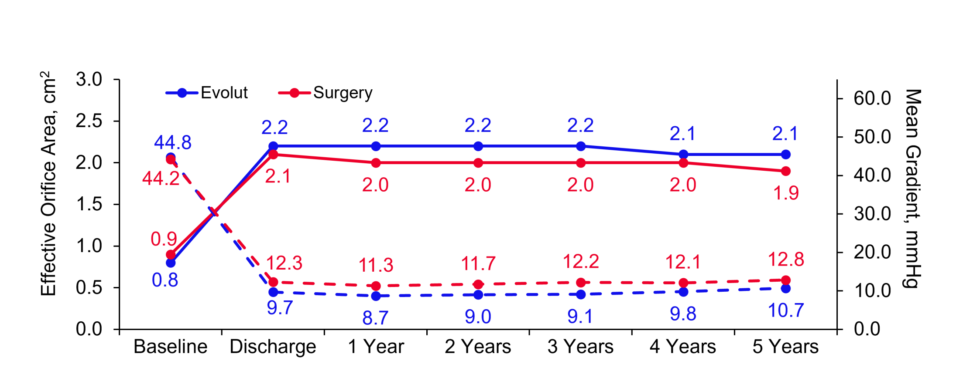
Hemodynamic Valve Performance
EOA and MG P<0.001 at 5 Years
Time Post Procedure
Evolut EOA | 637 | 577 | 565 | 535 | 495 | 439 | 399
Surgery EOA | 596 | 406 | 525 | 435 | 397 | 370 | 313
Evolut MG | 717 | 704 | 662 | 607 | 549 | 498 | 467
Surgery MG | 679 | 632 | 597 | 515 | 457 | 436 | 387

Slide 17
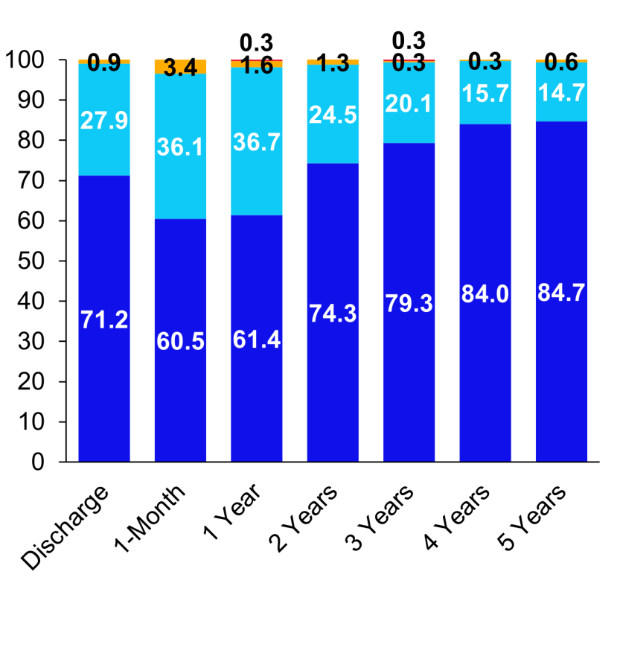
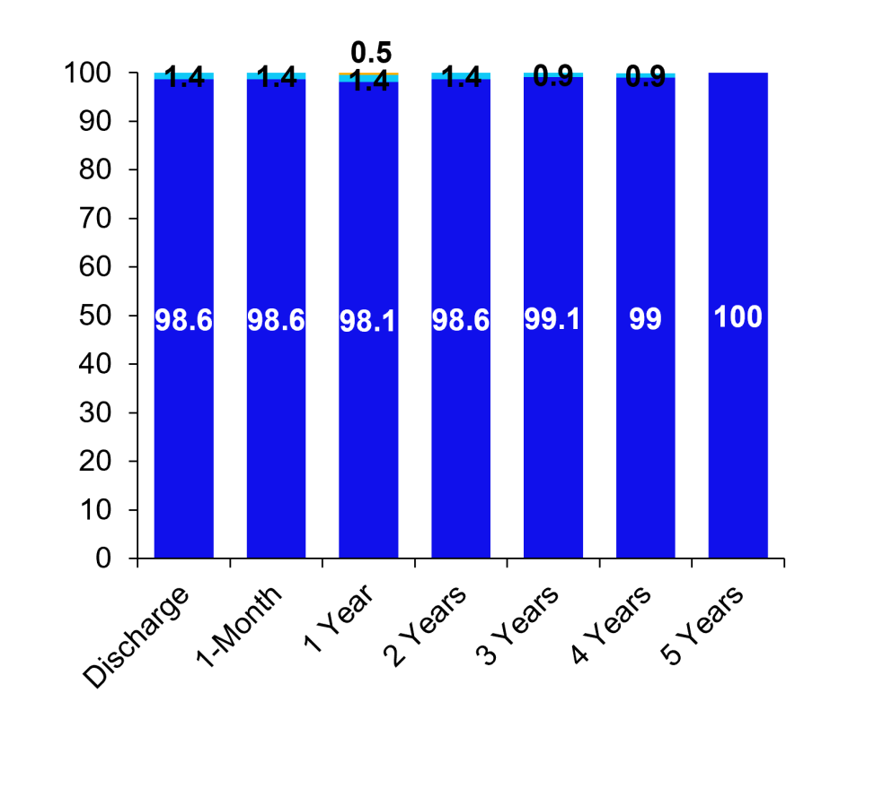
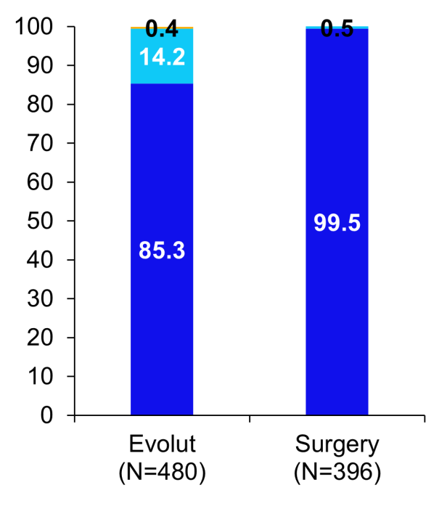
Paravalvular Regurgitation
Patients with PVR data at 5Y
Overall, p < 0.0001
≥ Moderate, p = 0.50
Patients with PVR data at all visits (paired data)
Evolut (N=319)
Surgery (N=211)
Patients, %
Patients, %
Patients, %

Slide 18
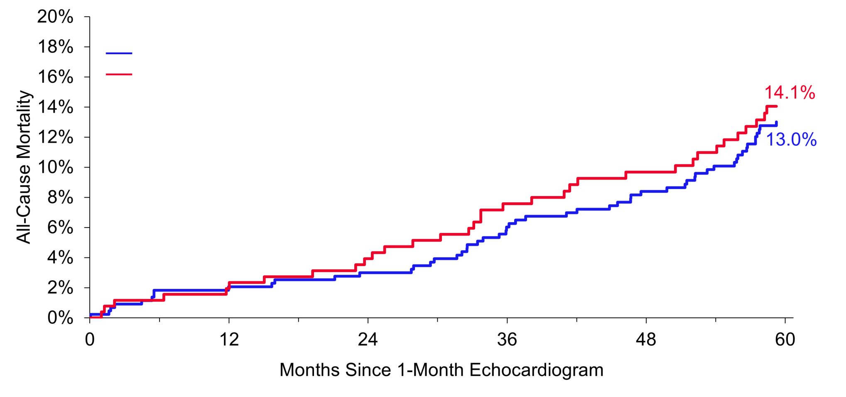
Effect of 1-Month Paravalvular Regurgitation on Mortality in Evolut
Early mild paravalvular regurgitation had no impact on 5-year mortality
KM Rate at 5 Years |  | 95% CI
None/trace PVR at 1 month | 13.0% | 10.1%–16.7%
Mild PVR at 1 month | 14.1% | 10.1%–19.5%
Log-rank p-value = 0.67
PVR at 1 Month
None/trace | 438 | 427 | 424 | 416 | 398 | 384 | 344
Mild | 257 | 254 | 249 | 240 | 221 | 213 | 185

Slide 19
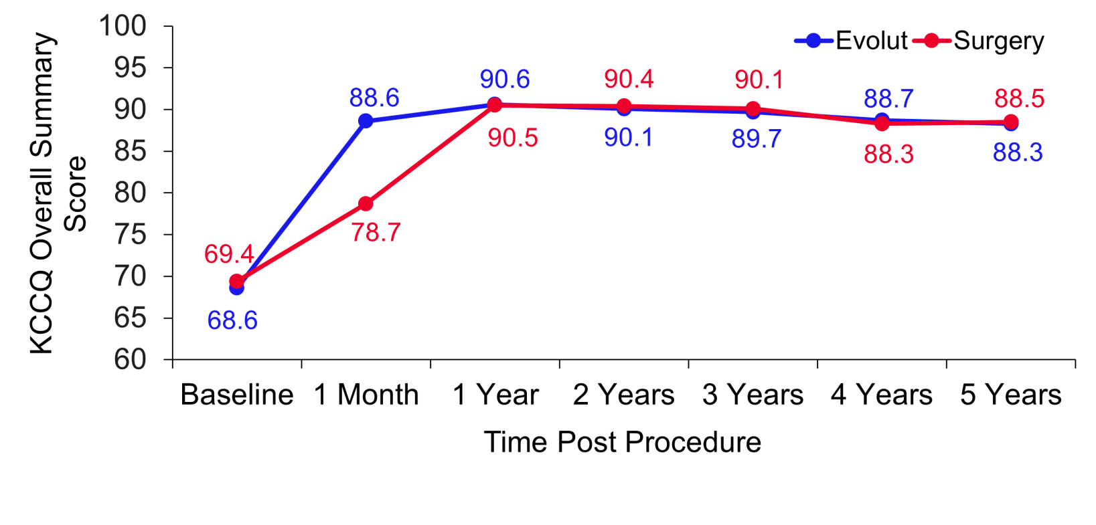
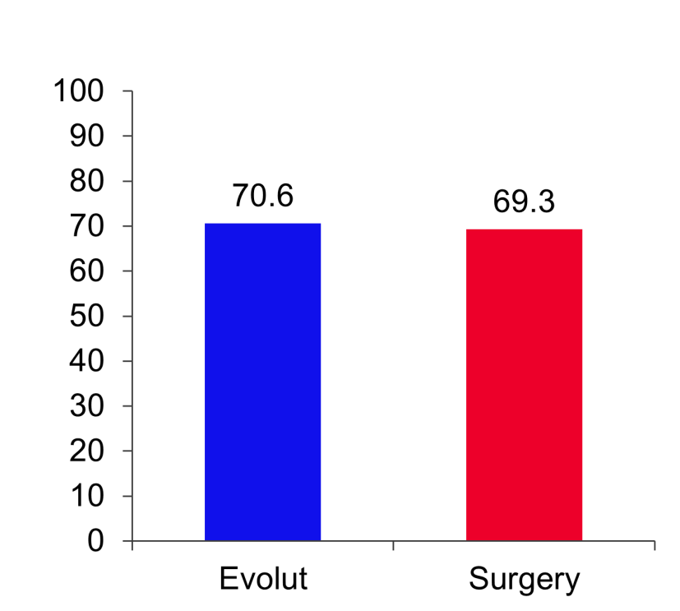
KCCQ Overall Summary Score
Alive and well at 5 Years
(alive and KCCQ summary score >75)
Patients, %
Change from Baseline
n | 720 | 689 | 661 | 617 | 561 | 520
Evolut
Mean ± SD | 20.0 ± 21.1 | 21.6 ± 20.6 | 20.9 ± 20.8 | 20.1 ± 20.6 | 19.3 ± 20.7 | 18.9 ± 21.9
n | 645 | 607 | 565 | 522 | 483 | 445
Surgery
Mean ± SD | 9.2 ± 22.3 | 20.7 ± 20.3 | 20.0 ± 20.0 | 19.3 ± 21.1 | 17.3 ± 20.9 | 17.8 ± 21.7
p-value | <0.001 | 0.42 | 0.44 | 0.53 | 0.13 | 0.45

Slide 20
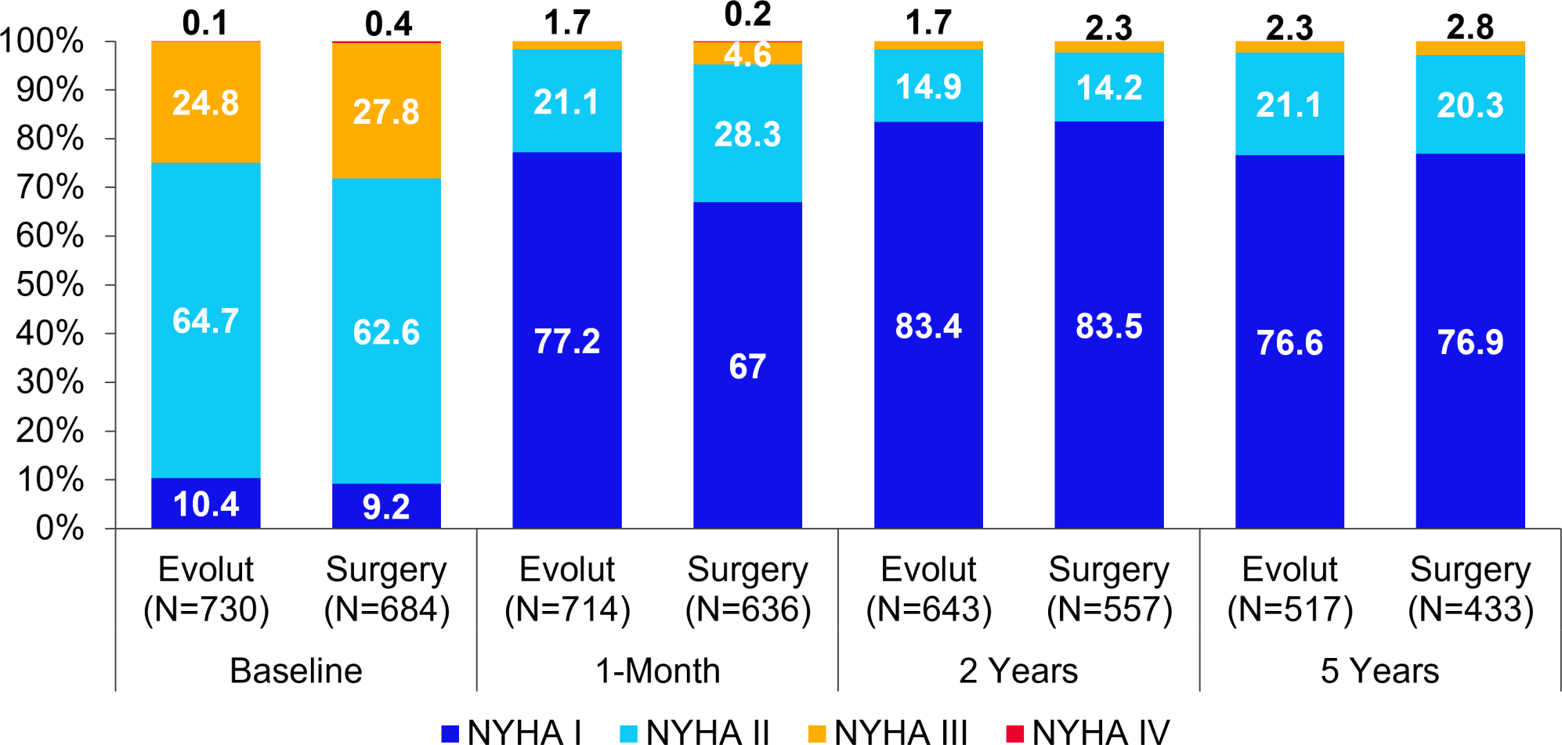
NYHA Classification By Visit
Both Evolut and surgery gave patients good relief from symptoms
Patients, %

Slide 21
Summary
Low surgical risk patients with severe aortic stenosis who were treated with either Evolut or surgery showed comparable rates of all-cause mortality or disabling stroke at 5 years (15.5% Evolut and 16.4% surgery, p=0.47)
Importantly, cardiovascular mortality remains similar for Evolut and surgery at 5 years ( Δ
at 5 years favoring Evolut: 2.1%)
Significantly lower mean gradients and larger EOAs (p<0.001 for both) with Evolut vs
surgery
No difference in valve reintervention rates, moderate or greater PVR, or alive and well status at 5 years
The results of the Evolut Low Risk Trial at five years support Evolut as a safe, effective, and durable alternative to surgery for patients with severe aortic stenosis and low surgical risk

Slide 22
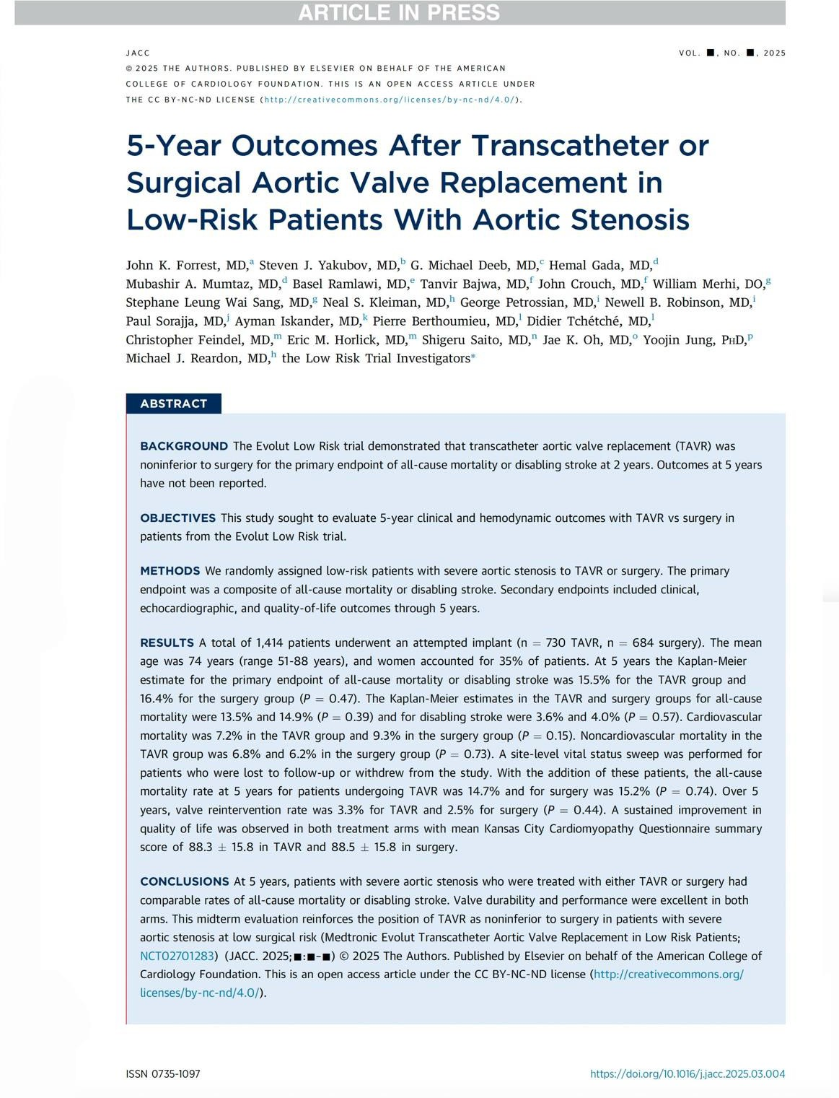


Simultaneously published in JACC

