Slide 1





Multicentric randomized evaluation of a Tricuspid valve Percutaneous Repair System (T-TEER) in the treatment of severe Tricuspid Regurgitation
TRI.Fr
Pr Erwan DONAL, CHU Rennes, Fr on behalf of the Tri-Fr investigators
erwan.donal@chu-rennes.fr @DonalErwan
Academic study Granted by PHRC-N
31 august 2024

Slide 2

Disclosure Statement of Financial Interest
Speaker’s name: Erwan DONAL
I have potential conflict of interest to declare :
Pr E DONAL receive research facilities from GE Healthcare and from Abbott + occasional consulting fees from Pfizer, Astra-Zeneca, Alnylam, Bristol-Myer-Squibb
Pr Erwan DONAL is in charge of The Rennes accredited Imaging CoreLab working for Abbott, academic studies, Novostia, Alnylam, Genscare
2

Slide 3


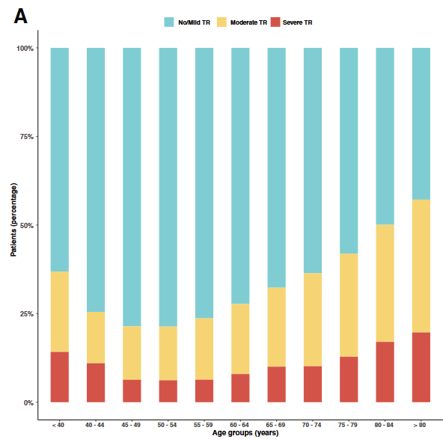
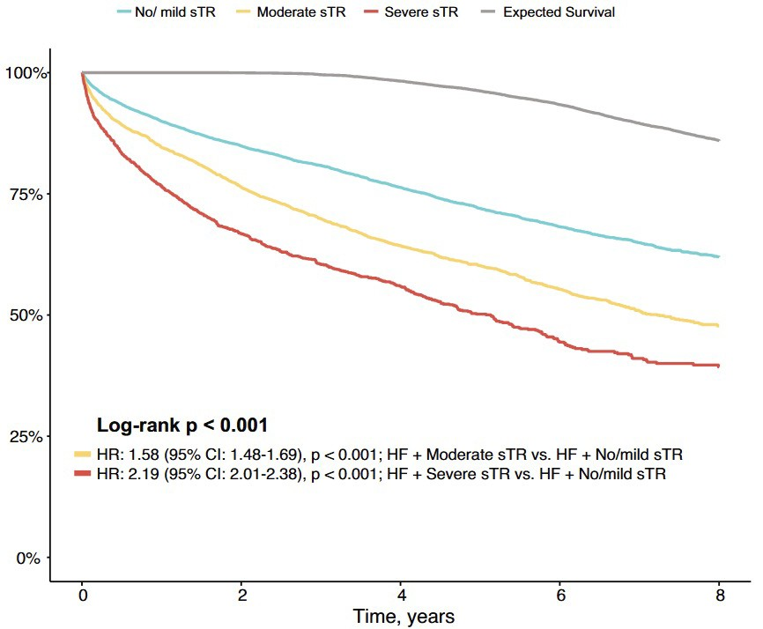
Background
3
Right-sided HF and TR are commun and strongly associated with poor quality of life and an increased risk of HF- hospitalizations and death
Patients who might benefit from tricuspid valve interventions are yet unknown, as is the ideal time for these treatments given the paucity of clinical evidence.
survival
Heitzinger et al. European Journal of Heart Failure (2024) 26, 18–33

Slide 4
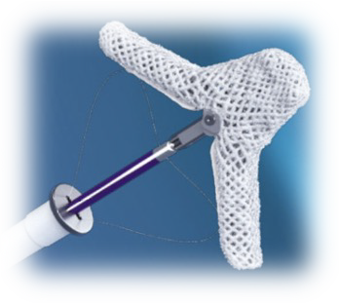
First academic randomized trial about transcatheter correction of TR
4
Main Objective
To assess safety and efficacy of T-TEER + GDMT compared
to GDMT alone
Population
Symptomatic (NYHA functional class II to IV) with ≥ severe TR Signs and symptoms of heart failure in the previous 12-months, Ineligibility for surgery
Percutaneous procedure using the TriClipTM device (T-TEER)
on top of GDMT
Intervention

Slide 5
Primary Endpoint : Clinical Composite Score
5
PGA
Patients were asked how they felt:
Markedly improved
Moderately improved
Mildly improved
No change
Slightly worse
Moderately worse
Markedly worse
The Clinical Composite Score (at 12-month post randomization):
Occurrence of major cardio-vascular events (cardiovascular hospitalization and/or death (MCE)
Changes in the NYHA class, or
Patient global assessment (PGA) and
Randomized patient groups
Improved if no MCE and favorable change in NYHA and/or PGA(<4)
Worsened if MCE or a decrease in PGA(>4): and/or NYHA
Unchanged , if no MCE and no change in NYHA or PGA (4)
Packer M. Circulation 2016;134(21):1664-1678

Slide 6

Secondary and safety enpoints
6
SECONDARY ENDPOINTS
Tricuspid Regurgitation grade
laboratory)
QoL assessed with the KCCQ score
Patient global assessment (PGA)
A hierarchical composite endpoint including all-cause mortality or tricuspid valve surgery,
time-to heart failure hospitalization, and improvement of ≥ 15 points in KCCQ score assessed at 12-month post-randomization
(assessed by an independent echocardiographic core
Major cardiovascular events (MCE): myocardial infarction, or unstable angina, or revascularization, or stroke, or cardiovascular death, or heart failure hospitalization;
Cardiovascular death
SAFETY ENDPOINT
  Major Adverse Events related to the intervention

Slide 7

Primary Endpoint (ITT) (1)
7
At 1-year follow-up, 109 patients (74.1%) in the T-TEER group improved,
compared to 58 patients (40.6%) in the GDMT group The T-TEER group has a probability of a better rank of 0.67;
95% confidence interval, 0.61 to 0.72; P <.0001
%
%
80
74
70
60
50
48
41
40
30
20
20
12
10
5
0
Improved
unchanged
T-TEER GDMT
worsen ^{ed}

Slide 8
Dt8 y
SUMMARY End Points | GDMT N = 148 | T-TEER N = 152 | Effect Estimate (95% CL) | P Value
Primary
Clinical Composite Score* Improved | 58 (40.6) | 109 (74.1)
Unchanged | 17 (11.9) | 8 (5.44) | 0.67 (0.61-0.72) | <.0001
Worse | 68 (47.6) | 30 (20.4)
Secondary listed in hierarchical order
1. TR grade* at 1 yr. Less than 4+ | 59 (46.5) | 124 (93.2)
4+ | 49 (38.6) | 5 (3.76) | 0.73 (0.68-0.78) | <.0001
5+ | 19 (15.0) | 4 (3.01)
2. Change in KCCQ score from baseline to 1 yr. — points | 55.0 ± 2.35 | 70.4 ± 2.33 | 14.5 ± 3.45 | <.0001
3. PGA* at 1 yr. Improved | 51 (39.5) | 100 (74.6)
Unchanged | 36 (27.9) | 19 (14.2) | 0.68 (0.63-0.74) | <.0001
Worse | 42 (32.6) | 15 (11.2)
4. Hierarchical composite endpoint of time to death or tricuspid valve surgery, or heart failure hospitalizations, and improvement of ≥ 15 points in KCCQ score at 1 yr. ‡ |  |  | 2.06 (1.38-3.08) | 0.0004
5. Kaplan–Meier estimate of percentage of patients free from MACE through 1 yr. § | 0.801 | 0.844 | 0.78 (0.45-1.36) | 0.38
6. Kaplan–Meier estimate of percentage of patients free from cardiovascular death at 1 yr. § | 0.942 | 0.966 | 0.60 (0.20-1.84) | 0.37

Slide 9


Conclusions
T-TEER improves safely & significantly, over a period of 12-month after randomization, the composite clinical endpoint, in patients with ≥ severe and symptomatic tricuspid regurgitation
T-TEER was superior to GDMT with a significant reduction of tricuspid regurgitation severity.
Under a strict medical follow-up, the event rate has been, at one-year, much lower than in previous registries and Triluminate Pivotal Trial.

