Slide 1




ACURATE neo2 under-expansion in the ACURATE IDE study
Raj R. Makkar, MD
Cedars-Sinai Medical Center, Los Angeles, CA, USA
Michael J. Reardon, MD
On behalf of the ACURATE IDE Investigators

Slide 2

Potential conflicts of interest
Speaker's name: Raj Makkar
☑ Research grant support from Boston Scientific, Edwards Lifesciences, Medtronic, Abbott, and Jena valve

Slide 3
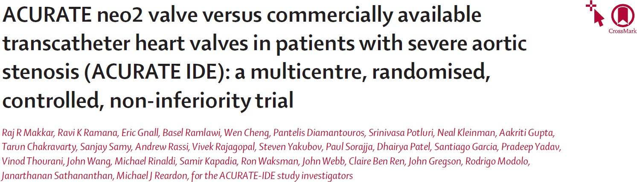
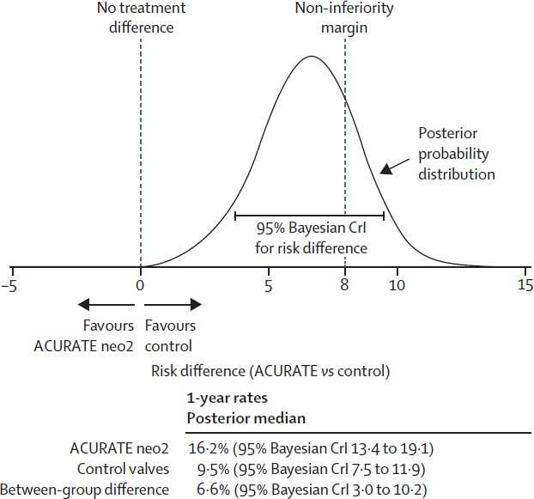


Why this study?
Non-inferiority of ACURATE neo2
vs Control
for the primary endpoint of composite of death or stroke or rehospitalization was not met
N=1500 TAVR patients
Symptomatic severe native aortic stenosis
Operators pre-specify valve type to be used if randomized to Control
1:1 Randomization
Mixed Control
N=748
ACURATE neo2
N=752
Evolut
N=244
SAPIEN
N=504
Makkar R et al. The Lancet. 2025.

Slide 4
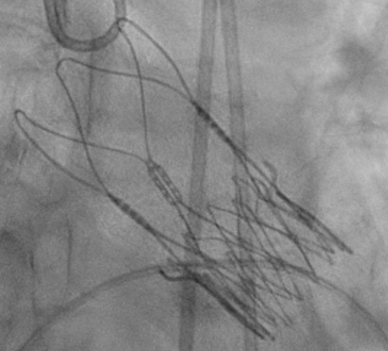
Why this study?
Under-expansion of valve frame may lead to adverse consequences
A comprehensive retrospective investigation was performed to evaluate factors associated with worse clinical outcomes with the ACURATE neo2.
Angulated (non-parallel) commissure posts were observed in some ACURATE neo2 valves, indicating under-expansion of the valve frame.
Valve under-expansion can compromise leaflet mechanics, impair valve hemodynamics¹⁻³ and increase thromboembolic risk⁴⁻⁶
¹Gunning PS, et al. Ann Biomed Eng 2014;42:1195-206. ²Trusty PM, et al. J Thorac Cardiovasc Surg 2020. ³Vahidkhah K, et al. Eur J Cardiothorac Surg 2017;51:927-935.
⁴Nagasaka T, et al. Cardiovascular Interventions 2024;17:2023-2037. ⁵Fukui M, et al. Circulation 2022;146:480-493. ⁶Fuchs A, et al. EuroIntervention 2017;13:e1067-e1075.

Slide 5
What did we study?
Prevalence and predictors of under-expansion of the ACURATE neo2 valves with post-hoc core-lab analysis of fluoroscopy in the ACURATE IDE trial
Association of under-expansion of the ACURATE neo2 valves with clinical outcomes

Slide 6
How was the study executed?
ACURATE IDE RCT N=1500
ACURATE neo2
N=752
ITT Population
Control* N=748
Excluded from analysis (N=126) No TAVR procedure performed: 19 Subject received ≥2 valves: 8
Converted to surgery: 6
Missing final procedural angiogram: 9
Procedural angiogram unevaluable: 84†
Cross-over to Control: 3
EXCLUDED from underexpansion analysis
ACURATE neo2
N=624
Evaluated for Expansion Status by CORRIB Research Centre for Advanced Imaging and Core Laboratory –
Prof. Osama Soliman
*Control devices include CoreValve Evolut R, Evolut PRO, Evolut PRO+, and Evolut FX and SAPIEN 3, SAPIEN 3 Ultra
†Reasons for angiogram unevaluable: Posts not clearly visible, n=46; Implantation view not recorded, n=20; Overlapping object, n=4; Anonymized timestamp, n=4; Post- dilation not recorded, n=4; Poor image quality, n=3; Malposition, n=3

Slide 7
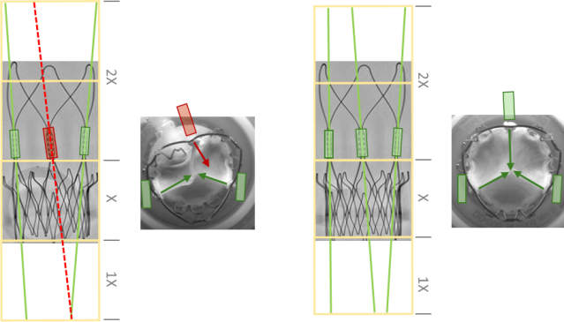
How was the study executed?
Angulated (non-parallel)
Parallel / near-parallel
commissure posts indicate
an under-expanded valve
commissure posts indicate
a properly expanded valve
Establishment of visual criteria to evaluate valve frame under-expansion:
Define assessment “boundary”
Trace commissure posts
Evaluate post angulation

Slide 8
Results – Prevalence of Under-expansion
 | ACURATE neo2 N=624
Evaluated for Expansion Status
Under-expanded ACURATE neo2 N=135
(21.6%)
Expanded ACURATE
neo2 N=489 (78.4%)
Under-expansion observed in ~22% of patients

Slide 9
Baseline Characteristics
 | Under-expanded ACURATE neo2 N=135 | Expanded ACURATE neo2 N=489 | P-value
Age (years) | 77.7±7.2 | 78.0±6.9 | 0.61
Male gender | 66 (48.9) | 225 (46.0) | 0.55
STS Score (%) | 2.6±1.8 | 2.7±1.9 | 0.53
Operative Risk (per Heart Team assessment)
High/Extreme Operative Risk | 33 (24.4) | 122 (24.9) | 0.90
Intermediate Operative Risk | 52 (38.5) | 188 (38.4) | 0.99
Low Operative Risk | 50 (37.0) | 179 (36.6) | 0.93
Diabetes mellitus, medically treated | 48 (35.6) | 148 (30.3) | 0.24
Hyperlipidemia | 120 (88.9) | 412 (84.3) | 0.18
Hypertension | 123 (91.1) | 434 (88.8) | 0.43
Peripheral vascular disease | 9 (6.7) | 55 (11.2) | 0.12
Chronic obstructive pulmonary disease | 13 (9.6) | 62 (12.7) | 0.33
Coronary artery disease | 72 (53.3) | 253 (51.7) | 0.74
Prior myocardial infarction | 14 (10.4) | 41 (8.4) | 0.47
Congestive heart failure | 37 (27.4) | 159 (32.5) | 0.26
Prior percutaneous coronary intervention | 28 (20.7) | 103 (21.1) | 0.94
P rior coronary artery bypass graft | 16 (11.9) | 55 (11.2) | 0.84
Atrial fibrillation/atrial flutter | 35 (25.9) | 109 (22.3) | 0.37
Data are presented as n (%) or mean±SD.

Slide 10
Baseline Echocardiography and CT
 | Under-expanded ACURATE neo2 N=135 | Expanded ACURATE neo2 N=489 | P-value
Echocardiography measures
Aortic valve area (cm²)
0.66±0.14
0.68±0.14
0.15
Mean aortic valve pressure gradient (mmHg)
Doppler Velocity Index LVEF (%)
41.9±12.0
0.23±0.05
53.9±9.5
39.1±10.6
0.24±0.05
56.9±7.0
0.01
0.03
0.005
CT measures
Annulus
Maximum (mm) Perimeter (mm)
26.4±2.1
75.4±5.1
26.2±1.9
74.5±5.1
0.35
0.07
Area (mm²)
442.9±59.2
431.4±58.9
0.05
LVOT
Maximum (mm) | 27.2±2.2 | 26.8±2.2 | 0.04
Perimeter (mm) | 74.7±6.0 | 73.3±6.4 | 0.03
Area (mm²) | 424.3±70.6 | 409.6±73.7 | 0.04
Total volume of leaflet and annulus calcification (mm³) | 556.9±367.1 | 455.1±297.6 | <0.001
Data are core laboratory-assessed and are presented as mean±SD.

Slide 11
Procedural Characteristics
 | Under-expanded ACURATE neo2 (n=135) n (%) | Expanded ACURATE neo2 (n=489) n(%) | P-value
 | Valve size implanted 23 mm (Small) | 22 (16.3) | 113 (23.1) | 0.09
 | 25 mm (Medium) | 50 (37.0) | 181 (37.0) | 1.00
 | 27 mm (Large) | 63 (46.7) | 195 (39.9) | 0.16
 | Frequency of predilation Pre-dilation maximum balloon diameter (mm) | 135 (100.0) 22.2±1.8 | 489 (100.0) 21.9±1.9 | -- 0.11
 | Difference of pre-dilation balloon diameter from annulus-derived diameter 0-1 mm | 19 (14.1) | 79 (16.2)
 | 1-2 mm | 57 (42.2) | 219 (44.8)
 | Post-dilation performed | 36 (26.7) | 123 (25.2) | 0.72
 | Postdilation maximum balloon diameter (mm) | 22.9± 1.9 | 23.1± 1.8 | 0.52
Data are presented as n (%) or mean±SD.

Slide 12
Multivariable Analysis for Predictors of Under-expansion
Odds Ratio 95% CI
Variable
N
Events
P value
Leaflet and annulus calcification total volume: 75th percentile
616
133
1.92[1.27,2.91]
0.002
* Factors from the univariate models with p<=0.20 were selected in the multivariate model using a stepwise procedure in a logistic regression model. The significance level for entry and exit of independent variables into the multivariate model is 0.1.
Calcification burden at baseline was the only significant predictor of under- expansion in multivariable analysis

Slide 13

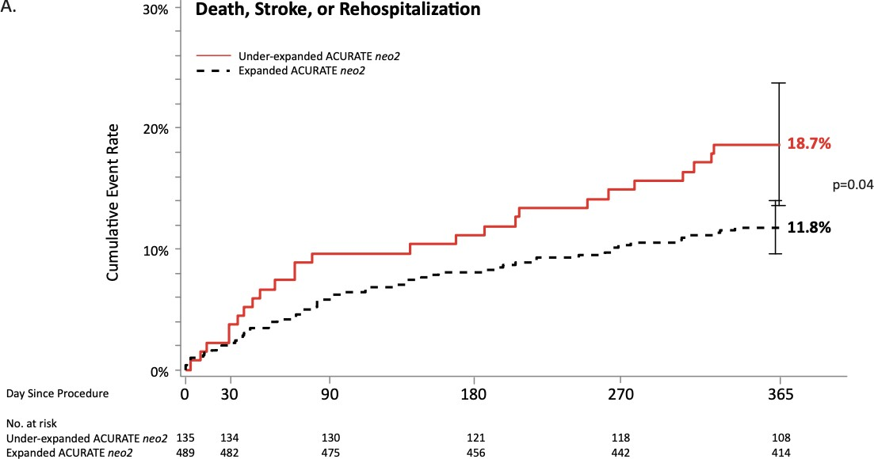
Primary Endpoint

Slide 14
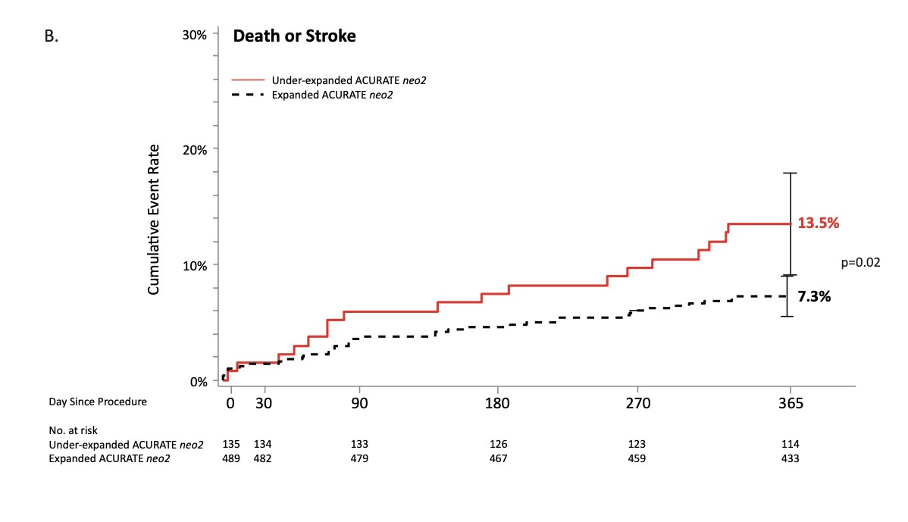
Secondary Endpoint

Slide 15

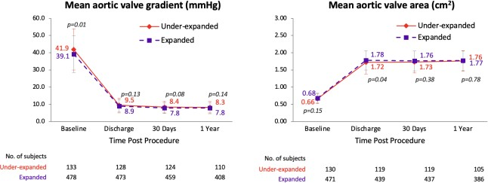
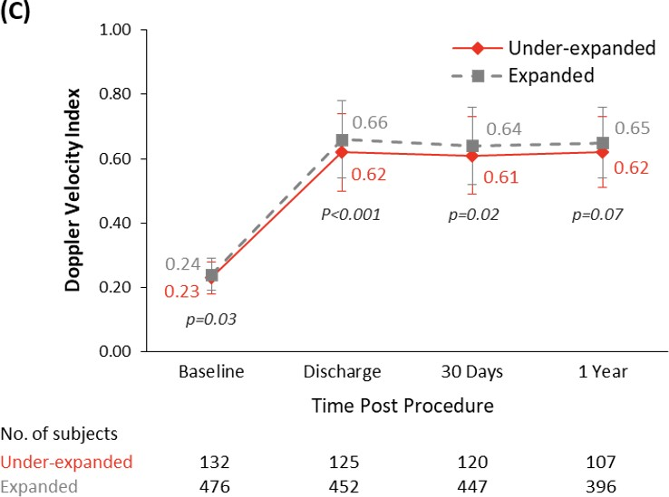
Hemodynamic outcomes by expansion status
Doppler Velocity Index

Slide 16
Paravalvular leak by expansion status
Discharge
p=0.55
1 Year
p=0.16
100%
0.0%
0.8% 0.6%
0.2%
2.6%
0.2%
25.2%
0.9%
3.6%
40.8%
90%
45.5%
22.7%
80%
70%
76.5%
74.0%
60%
50%
56.4%
50.0%
40%
30%
20%
10%
0%
Underexpanded valve group
Expanded valve group
Underexpanded Expanded valve valve group group
None/trivial
Mild
Moderate
Severe

Slide 17
Valve thrombosis at 30 days by expansion status
Clinical valve thrombosis Subclinical leaflet thrombosis
2.5%
35.0%
P=0.08
30.0%
27.8%
2.0%
5.0%
25.0%
1.5%
P=0.16
1.5%
20.0%
 |  | 0.4%
1.0%
15.0%
10.0%
0.5%
5.0%
0.0%
0.0%
Underexpanded valve group
N=135
Expanded valve group
N=489
Underexpanded valve group
N=20
Expanded valve group
N=90

Slide 18
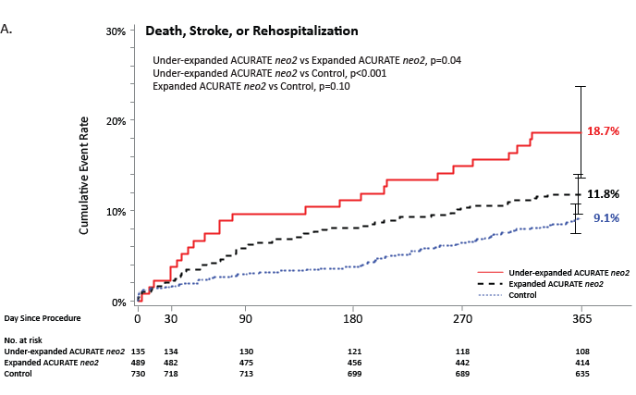
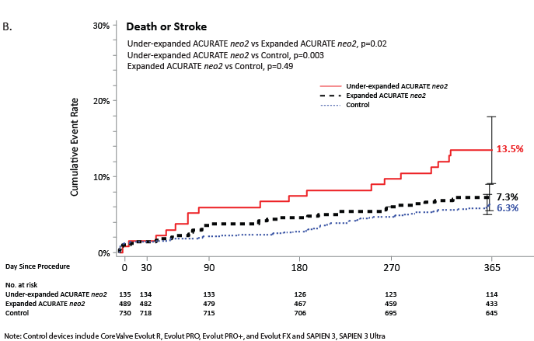
Clinical Outcomes by Expansion Status vs. Control
ACURATE neo2 under-expansion was associated with higher rates of death & stroke at 1 year
Outcomes in patients with expanded ACURATE neo2 valves were comparable with Control valves

Slide 19
Limitations
Post-hoc design → susceptible to bias; 17 % of ACURATE neo2 cases lacked
analyzable final aortograms (missing/poor image quality).
No expansion data for control-arm valves; can’t benchmark ACURATE neo2 vs
fully-expanded controls.
Method requires prospective validation for reliability, reproducibility, and prognostic value across operators/sites before routine adoption.

Slide 20
The essentials to remember
In this post-hoc analysis of the ACURATE IDE study, ACURATE neo2 valve frame under-expansion, as assessed by core-lab analyzed fluoroscopy:
  Was noted in ~22 % of ACURATE neo2 implants
  Was more likely to occur in patients with higher leaflet and/or annular calcification burden—consistent with the valve’s lower radial opening force.
  Was associated with a significantly higher risk of primary endpoint of composite of death, stroke, or rehospitalization at 1 year.

Slide 21
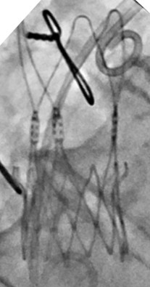
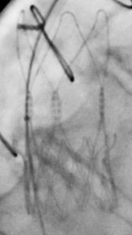
Why is this important?
Valve design modification to increase the radial strength and careful consideration of pre- and post- dilation may improve valve expansion.
Whether optimization of ACURATE neo2 valve frame expansion translates into better patient outcomes deserves further investigation.
Routine use of effective pre-dilation
Peri-procedural imaging assessment in two views
Post-dilation should be performed, when feasible, to improve expansion
Pre-dilation of ACURATE neo2 is recommended using a balloon sized
1 to 1.9mm smaller than the annulus diameter
Under-expansion may be more easily identified through use of
two angiographic views (eg, 3-cusp and cusp overlap)
Before Post-dilation After Post-dilation
Among 137 patients with pre- and post-dilation angiograms, 36 % showed valve under-expansion, of whom 54 % were corrected with post-dilation.

Slide 22
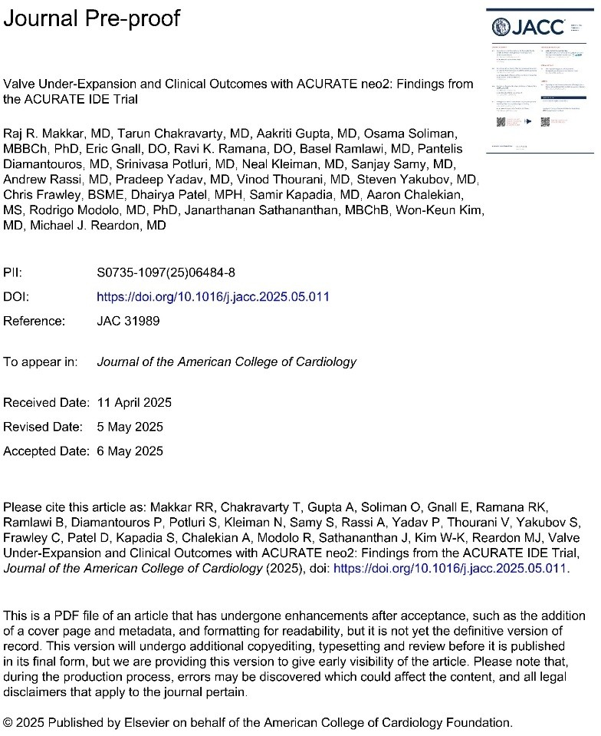


Simultaneously published in JACC
@RajMakkarMD

Slide 23

pcronline.com

Slide 24
Impact of Learning Curve on Underexpansion
30.0%
30.0%
30.0%
P=0.75
P=0.29
P=0.48
25.0%
23.2%
25.0%
23.5%
25.0%
21.6%
22.4%
20.1%
20.0%
19.9%
20.0%
20.0%
20.0%
15.0%
15.0%
15.0%
10.0%
10.0%
10.0%
5.0%
5.0%
5.0%
0.0%
0.0%
0.0%
Enrollment tercile
Early Mid Late
Site volume
Site enrollment
< 5 patients >=5 patients
< Median
>= Median

Slide 25
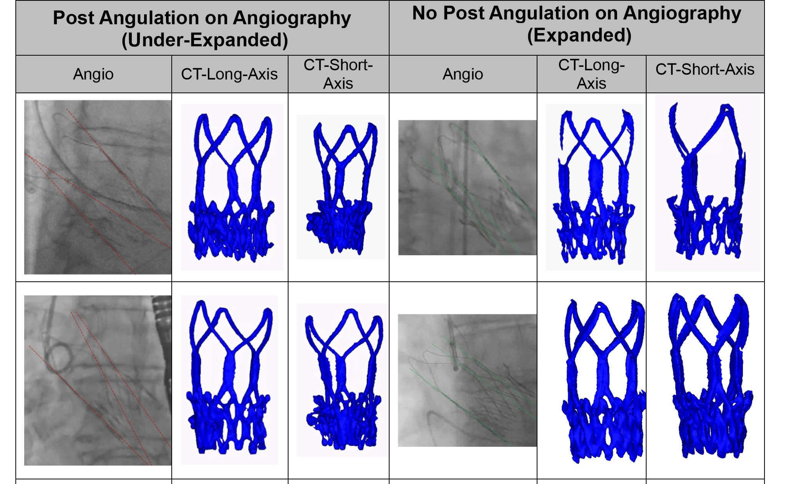
Example images demonstrating underexpansion on 30-day CT

Slide 26
Clinical Outcomes vs. Control Valves
 | Under-expanded ACURATE neo2 N=135 | Expanded ACURATE neo2 N=489 | P-value Under-exp vs Expanded ACURATE neo2 | Control N=730 | P-value Expanded ACURATE neo2 vs Control
Death, stroke, or rehospitalization * | 25 (18.7) | 57 (11.8) | 0.04 | 65 (9.1) | 0.10
Death | 9 (6.8) | 18 (3.7) | 0.14 | 26 (3.6) | 0.90
Cardiovascular death | 7 (5.3) | 14 (2.9) | 0.19 | 12 (1.7) | 0.15
Stroke | 10 (7.7) | 20 (4.2) | 0.11 | 24 (3.4) | 0.46
Disabling | 2 (1.5) | 8 (1.7) | 0.91 | 8 (1.1) | 0.42
Death or stroke | 18 (13.5) | 35 (7.3) | 0.02 | 45 (6.3) | 0.49
Rehospitalization* | 7 (5.3) | 24 (5.0) | 0.89 | 26 (3.7) | 0.23
Myocardial infarction | 4 (3.0) | 11 (2.3) | 0.61 | 6 (0.9) | 0.04
Periprocedural (within 72 h of procedure) | 2 (1.5) | 0 (0.0) | 0.01 | 0 (0.0) | -
Spontaneous (>72 h after procedure) | 2 (1.5) | 11 (2.3) | 0.59 | 6 (0.9) | 0.04
Bleeding | 9 (6.7) | 25 (5.2) | 0.46 | 40 (5.6) | 0.78
Life-threatening or disabling bleeding | 3 (2.2) | 14 (2.9) | 0.70 | 22 (3.1) | 0.88
Major vascular complication | 7 (5.2) | 10 (2.0) | 0.05 | 13 (1.8) | 0.74
Acute kidney injury (Stage 2/3) | 0 (0.0) | 0 (0.0) | - | 0 (0.0) | -
Repeat procedure for valve-related dysfunction | 0 (0.0) | 1 (0.2) | 0.60 | 3 (0.4) | 0.54
New permanent pacemaker implantation | 9 (6.7) | 55 (11.3) | 0.12 | 91 (12.6) | 0.52
Clinical valve thrombosis | 2 (1.5) | 2 (0.4) | 0.16 | 19 (2.7) | 0.004
New onset of atrial fibrillation or atrial flutter | 2 (1.5) | 12 (2.5) | 0.49 | 17 (2.4) | 0.88
Data are time-to-event rates, presented as n (%). *Rehospitalization due to valve-related symptoms or worsening heart failure (classified as New York Heart Association [NYHA] Class III or IV), according to VARC-2 criteria.

