Slide 1
TAVR-Induced LV Dyssynchrony and Response to Resynchronization Therapy Clinical Applications of Myocardial Strain
CRT
Washington DC
March 2-5, 2019

Slide 2
Gordon M Burke MD^{1,2}, Bruna Araujo Silva³, Alexandre A Marum³, Alexandre L Bortolotto³, Bruce D Nearing PhD^{2,3}, Michael J Chen³, Sarah Fostello³, Jeffrey J Popma MD^{2,3}, Richard L Verrier PhD^{2,3}, James D Chang MD^{2,3}
¹VA Boston Healthcare System, ²Harvard Medical School, ³Beth Israel Deaconess Medical Center
The authors have no relevant financial relationships

Slide 3
Learning Objectives
Review
Strain measures
Global longitudinal peak systolic strain (GLPS)
Time to peak longitudinal strain (TPLS)
Strain applications in TAVR complications
Left bundle branch block (LBBB)
Heart block requiring right ventricular pacemaker (RVP)
Changes in strain measures in TAVR-induced LBBB, RVP, and response to chronic resynchronization therapy (CRT)

Slide 4
Case 1
91 year old man, history of
Severe AS
Mod-severe MR
Initial plan for elective TAVR
Presented to ED in acute CHF, received TAVR during hospitalization
Developed LBBB during TAVR
2 hospitalizations for CHF within 1 month post TAVR
Received CRT 1 month after TAVR
No hospitalizations for >1 year

Slide 5
Case 1: Pre TAVR

Slide 6
Case 1: Pre TAVR

Slide 7
Case 1: Post TAVR, LBBB

Slide 8
Case 1: Post TAVR, LBBB

Slide 9
Case 1: Post CRT

Slide 10
Case 1: Post CRT

Slide 11
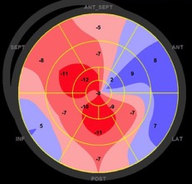
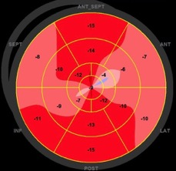
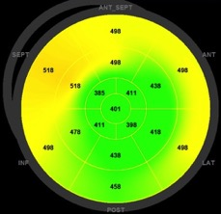
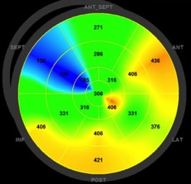
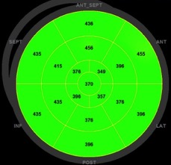
Pre TAVR:
GLPS (top); TPLS (bottom)
New LBBB Post TAVR:
GLPS (top); TPLS (bottom)
Post CRT:
GLPS (top); TPLS (bottom)

Slide 12
Case 2
65 year old man, history of
Severe AS
CAD s/p CABG x3 (LIMA-LAD, SVG-OM, SVG-PDA)
Hypertension
Diabetes mellitus
CKD
Received elective TAVR
During TAVR, developed complete heart block, received dual chamber PPM
Admitted 1 day post discharge from TAVR for acute CHF
Hospitalized for 1 month with difficult to manage CHF
Receives CRT 1 month after TAVR
2 hospitalizations within 1 year after CRT implant for NSTEMI/CHF

Slide 13
Case 2: Pre TAVR

Slide 14
Case 2: Pre TAVR

Slide 15
Case 2: Post TAVR, RVP

Slide 16
Case 2: Post TAVR, RVP

Slide 17
Case 2: Post CRT

Slide 18
Case 2: Post CRT

Slide 19
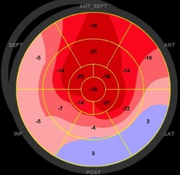
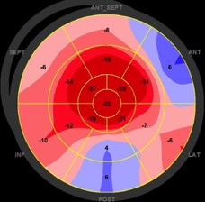
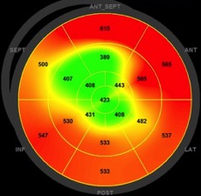
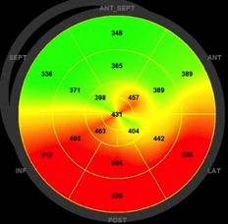
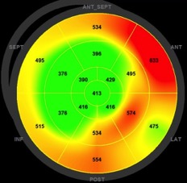
Pre TAVR:
GLPS (top); TPLS (bottom)
New RVP Post TAVR:
GLPS (top); TPLS (bottom)
Post CRT:
GLPS (top); TPLS (bottom)

Slide 20
Take Home Message
Strain measures may provide additional insight into left ventricular systolic function over LVEF in TAVR patients with new conduction abnormalities

