Slide 1
RAPIDx AI RCT
AI based decision-support for the diagnosis of myocardial injury
NHMRC Australia, SA Heath, and Siemens Healthineers Advisory Boards: Novartis, Abbott Vascular, CSL Seqirus
Derek P. Chew
September 2nd, 2024

Slide 2
Your abstract’s conclusion (this is what media will use as a headline)
The availability of 4th UDMI-based AI-driven clinical decision support did not improve clinical outcomes.
It appeared to ‘nudge’ practice to improve uptake of evidence-based pharmacotherapies and discernment in coronary angiography use based on Type 1 MI versus non-Type 1 MI classification.
No increase in early hazards nor negative impacts on ED discharge decisions were observed, establishing the safety of AI-based clinical decision support.

Slide 3
Purpose and key points about methods
We sought to determine if the availability of AI-based decision-support for cardiac assessment using the 4th Universal Definition of MI is superior to routine care in terms of CV death, MI and unplanned CV rehospitalization over 12- months among emergency patients with myocardial injury
Methods
We established a registry embedded in clinical practice using AI to phenotype patients with myocardial injury aligned to the 4th Universal Definition of MI
We then cluster randomized 12 hospitals ((6 metro/6 rural) to receive decision support in the ED versus standard care and evaluated recurrent cardiac outcomes by 6 months (N=14,131).
The primary analysis was conducted in patients with a suspected cardiac presentation (n=3029)

Slide 4
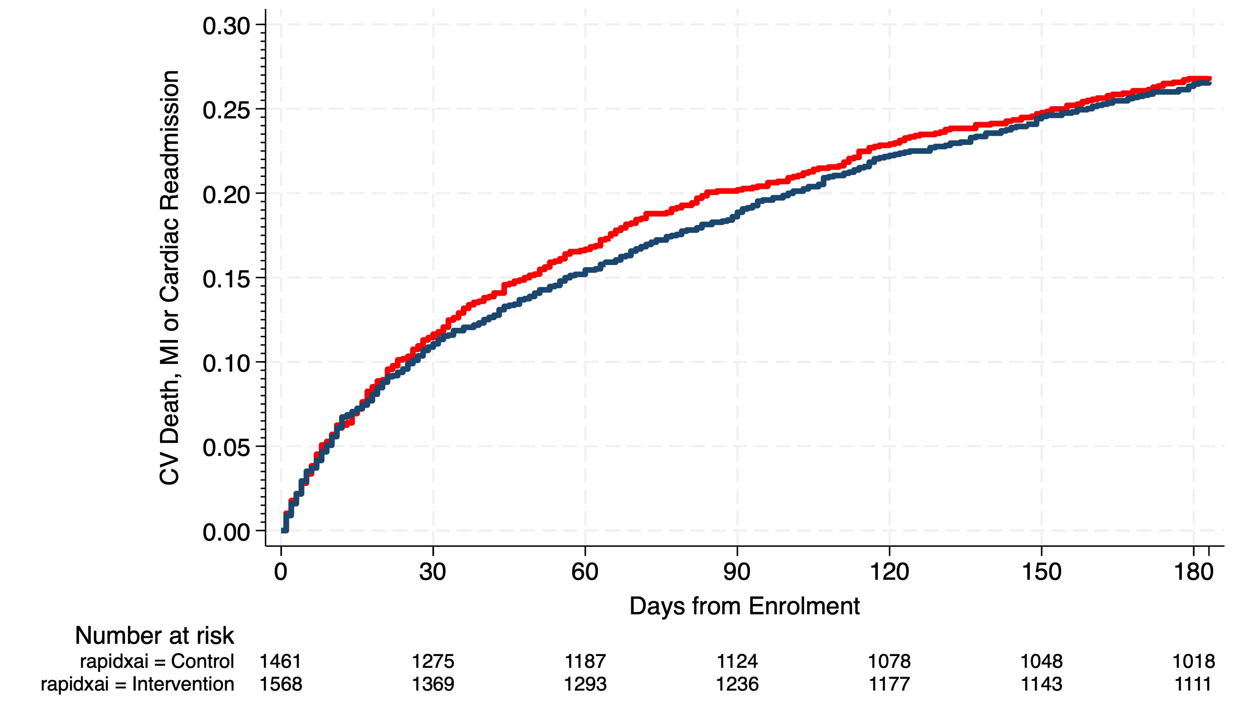
Results: Primary Endpoint by 6 months
Primary analysis population - CV Death, MI and unplanned CV readmission
N = 3,029
Win Ratio 1.04
95% C.I.0.90-1.19
p = 0. 606
Intervention versus Control
Hazard Ratio 0.99, 95% C.I. 0.86-1.14, p_{cluster} = 0.872

Slide 5
Primary Endpoint by 6 months
Myocardial Injury Only and All Patient Cohorts - CV Death, MI and unplanned CV readmission
Myocardial Injury
All Patients
HR: 0.80, 95% C.I. 0.62-1.03,
p_{cluster} = 0.084
Win Ratio 1.09
95% C.I.0.97-1.21
p = 0.156
HR: 0.80, 95% C.I. 0.62-1.03,
p_{cluster} = 0.084
Win Ratio 1.15
95% C.I. 1.04-1.27
p = 0.007
N = 5,466
N = 14,131

Slide 6
Key messages
While AI algorithms can improve the diagnosis of patients with myocardial infarction, this decision-support has not translated to improvements in clinical outcomes within a cluster radmomized study embedded within clinical practice
AI is the disruptive technology of our era, but translation to improving patient outcomes will require further careful integration into health care systems

