Slide 1

Cryoballoon Ablation versus Radiofrequency Ablation in Patients with Persistent Atrial Fibrillation (CRRF-PeAF):
A Prospective, Multicenter, Randomized, Non-inferiority Clinical Trial
National Cerebral and Cardiovascular Center
Kengo Kusano, MD
on behalf of CRRF-PeAF Study Group
National Cerebral and Cardiovascular Center, Suita, Japan

Slide 2
Disclosures
Koji Miyamoto, MD, PhD affiliated with a department endowed by Medtronic outside the submitted work.
Naoya Kataoka, MD, PhD received honoraria/speakers' bureaus from Medtronic.
Yasuhiro Sasaki, MD, received honoraria/speakers' bureaus from Medtronic.
Atsushi Kobori, MD, PhD received honoraria/speakers' bureaus from Medtronic.
Kazuhiro Satomi, MD, PhD received honoraria/speakers' bureaus from Medtronic, Abbott.
Junichi Nitta, MD, PhD received honoraria/speakers' bureaus from Medtronic.
Masato Murakami, MD, PhD received funding/grants received from Medtronic, and Boston.
Hidehira Fukaya, MD, PhD received honoraria/speakers' bureaus from Medtronic, Biosense Webster, Abbott.
Kengo Kusano, MD, PhD received funding/grants from Medtronic and Boston.

Slide 3
INTRODUCTION
Catheter ablation is recommended as a Class I intervention for patients with drug-refractory persistent atrial fibrillation (PeAF) in the recent guidelines. Various energy sources are employed for AF ablation with radiofrequency (RF) and cryoballoon (CR) ablation being widely used worldwide.
Since the FIRE AND ICE trials, multiple studies have demonstrated that pulmonary vein isolation with CR is as effective as RF in treating both PAF/PeAF. However, prospective data specifically evaluating the efficacy and safety of CR ablation in patients with PeAF are limited.
Recently, two prospective, randomized trials comparing the efficacy between CR and RF ablation (CIRCA-DOSE trial and NO-PERSAF study) have reported differences in recurrence patterns between the two ablation technologies, with CR associated with a higher frequency of persistent atrial tachyarrhythmia episodes, even when the overall recurrence rates of atrial tachyarrhythmias are comparable. This suggests that the impact of ablation on atria, so-called reverse remodeling by catheter ablation, may vary by energy source, as the pathophysiology of lesion formation is energy-dependent.

Slide 4
AIMS
The present study aimed to compare the efficacy and safety between cryoballoon (CR) and radiofrequency (RF) ablation in a large cohort of patients with PeAF.
Additionally, we compared the impact of these technologies on the extent of left atrial reverse remodeling post-ablation.

Slide 5
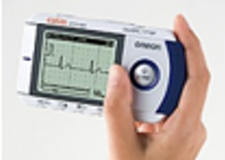
Trial Flow Chart
Subjects
500 Patients with persistent atrial fibrillation
Randomization
Randomization 1:1
Trial Arms
250 Were assigned to
CB ablation group
250 Were assigned to
RF ablation group
1 Withdrew consent
249 Received baseline evaluation and assigned intervention
250 Received baseline evaluation and assigned intervention
Secondary
Endpoints
Procedural time, left atrial dwelling time, fluoroscopy time, complication rate
Follow-up
Electrocardiograms was recorded twice daily for whole 1-year after catheter ablation except for a 90-day blanking period
ECG recorder
OMRON: HCG801
Primary
Endpoint
499 Were included in the primary analysis:
The occurrence of atrial tachyarrhythmias at 1-year with a blanking period of 90 days after catheter ablation
Secondary
Endpoints
Change in left atrial volume index, laboratory data, quality of life, cardiovascular events, and mortality

Slide 6
University of Toyama
CRRF-PeAF Study Group
Naoya Kataoka
Tenri Hospital
Suguru Nishiuchi
Shintaro Yamagami
Sakakibara Heart Institute
Kobe City Medical Center General Hospital
Kansai Medical University
Junichi Nitta
Hiroshi Fukunaga
So Asano
Takahiko Nagase
Atsushi Kobori
Yasuhiro Sasaki
Junichi Ooka
Masahiro Ishikura
Masahiko Takagi
Masue Yoh
Hiroki Takahashi
Tokyo Medical University Hospital
Kazuhiro Satomi
Yoshinao Yazaki
Muryo Terasawa
Takahiro Kusume
Yasuyuki Takada
Ken Takarada
Miyazaki Medical Association Hospital
Keiichi Ashikaga
Shonan Kamakura General Hospital
Masato Murakami
Shigo Mizuno
Japan Red Cross Yokohama City Bay Hospital
Nippon Medical School
National Cerebral and Cardiovascular Center
Kitasato University
Yasuteru Yamauchi
Yuichiro Sagawa
Takatoshi Shigeta
Yu-ki Iwasaki
Wataru Shimizu
Kenji Yodogawa
Yuhi Fujimoto
Kengo Kusano
Koji Miyamoto
Koshiro Kanaoka
Hidehira Fukaya
Jun Kishihara

Slide 7
Sample Size and Statistical analysis
Previous observational studies have reported that the freedom from atrial tachyarrhythmias at 1 year following ablation of PeAF is comparable between the CR and RF ablation, which rates ranging from 50 to 70 %. Based on these findings, we assumed a 60% freedom rate at 1 year in both groups.
The non-inferiority hypothesis was assessed using a log-rank test, with a non-inferiority margin defined as a hazard ratio of 1.5. A sample size of 239 patients per group was calculated to achieve 80% power at a one-sided significance level of 2.5%. To account for cope potential loss to follow-up, a total of 500 patients (250 per group) were enrolled, and no replacements were made for withdrawn patients.
Notes:
When the primary end point was observed in one-third of the total sample size (160 patients), early stopping of the study for futility was considered based on the conditional power at an interim analysis, which was reviewed by the Data and Safety Monitoring Board. A simulation suggested a very limited power loss with a potential early stopping for futility, and the targeted power was expected to be achieved with this sample size.
Analysis of the primary end point was conducted according to modified intention-to-treat principle. This analysis excluded patients who had died or were withdrawn from the trial during the run-in period. The cryoballoon group was considered non-inferior to the RF group if the lower boundary of the between-group difference in the primary end point was within the predefined margin in intention-to-treat analyses. When non-inferiority was demonstrated on the primary end point, the superiority hypothesis was also evaluated. The Kaplan-Meier method and log-rank test were used to estimate survival curves.
Categorical variables were presented as numbers and percentages and analyzed using chi-square or Fisher’s exact tests. Continuous variables were expressed as means ± standard deviations for normally distributed data or as median with the interquartile range (IQR) for skewed data, with comparisons made using the Student’s t-test or Wilcoxon rank-sum test, as appropriate. Statistical significance was defined as P <0.05.

Slide 8
PATIENTS Characteristics at Baseline
 | Cryoballoon Group (N=249) | Radiofrequency Group (N=250)
Age, y | 69 (60-74) | 69 (62-74)
Male, n (%) | 182 (73.1) | 181 (72.4)
Body mass index, kg/m² | 24.4 (22.1-26.4) | 24.3 (22.2-26.7)
The duration of continuous AF, months | 4 (2-6) | 3 (2-6)
Prior direct cardioversion of AF, n (%) | 34 (13.7) | 37 (14.8)
Failed antiarrhythmic drugs, n (%) | 63 (25.3) | 64 (25.6)
AFEQT score‡ | 78 (65-87) | 81 (70-90)
Hypertension, n (%) | 157 (63.1) | 161 (64.4)
Diabetes mellitus, n (%) | 40 (16.1) | 35 (14.0)
Heart failure, n (%) | 43 (17.3) | 40 (16.0)
Stroke/TIA, n (%) | 13 (5.2) | 19 (7.6)
CHADS₂ score | 1 (1-2) | 1 (1-2)
LV ejection fraction, % | 60.0 (55.0-65.4) | 60.0 (53.0-64.3)
LA diameter, mm | 41.5 (37.3-45.0) | 42.0 (38.5-45.0)
LA volume index | 45 (39-54) | 45 (38-55)
BNP, pg/ml | 140.9 (77.8-213.7) | 134.8 (72.3-205.0)

Slide 9
The Catheter Ablation Procedure
 | Cryoballoon Group (N=249) | Radiofrequency Group (N=250) | P Value
Total procedure time, min* | 93 (69-120) | 137 (99-177) | <0.001
LA dwell time, min | 66 (48-87) | 102 (75-138) | <0.001
Fluoroscopic time, min | 18.4 (11.2-24.1) | 11.0 (5.9-18.0) | <0.001
Successful PVI, n (%) | 249 (100.0) | 250 (100.0)
Adjunctive ablation, n (%) | 89 (35.7) | 100 (40.0) | 0.33
Cavo-tricuspid isthmus, n (%) | 34 (13.7) | 57 (22.8) | 0.008
Superior vena cava isolation, n (%) | 12 (4.8) | 26 (10.4) | 0.019
LA posterior wall isolation, n (%) | 20 (8.0) | 39 (15.6) | 0.009
LA roof line, n (%) | 47 (18.9) | 5 (2.0) | <0.001†

Slide 10
Complications of the Catheter Ablation
 | Cryoballoon Group (N=249) | Radiofrequency Group (N=250) | P Value
Patients with any complications, n (%) | 5 (2.0) | 9 (3.6) | 0.42
Phrenic nerve paralysis, n (%) | 1 (0.4) | 0 (0.0) | 0.50
Pericardial effusion not requiring drainage, n (%) | 1 (0.4) | 1 (0.4) | 1.00
Cardiac tamponade requiring drainage, n (%) | 1 (0.4) | 1 (0.4) | 1.00
Severe pulmonary vein stenosis, n (%) | 0 (0.0) | 0 (0.0) | –
Air embolism, n (%) | 1 (0.4) | 0 (0.0) | 0.50
Cerebral infarction, n (%) | 0 (0.0) | 1 (0.4) | 1.00
Transient ischemic attack, n (%) | 0 (0.0) | 0 (0.0) | –
Pseudoaneurysm at the puncture site, n (%) | 0 (0.0) | 1 (0.4) | 1.00
Arteriovenous fistula, n (%) | 0 (0.0) | 0 (0.0) | –
Gastric hypomotility, n (%) | 0 (0.0) | 2 (0.8) | 0.50
Atrio-esophageal fistula, n (%) | 0 (0.0) | 0 (0.0) | –
Others, n (%) | 1 (0.4) | 3 (1.2) | 0.62
Death, n (%) | 0 (0.0) | 0 (0.0) | –

Slide 11
RESULTS

Slide 12
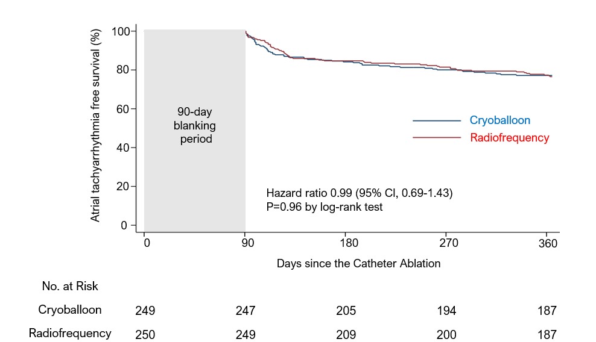
Event-free Survival for the Primary End Point
(1-year Freedom from Any Atrial Tachyarrhythmias)

Slide 13
Primary and Secondary End Points
End Point | Cryoballoon Group (N=249) | Radiofrequency Group (N=250) | Hazard Ratio (95% CI) | P Value
 | Number (percent)
Primary end point* | 56 (22.5) | 58 (23.2) | 0.99 (0.69-1.43) | 0.96
Secondary end points
AF recurrence, n (%) | 51 (20.5) | 50 (20.0) | 1.05 (0.71-1.55) | 0.81
Paroxysmal AF, n (%) | 39 (15.7) | 33 (13.2) | 1.23 (0.77-1.96) | 0.38
Persistent AF, n (%) | 12 (4.8) | 17 (6.8) | 0.71 (0.34-1.48) | 0.36
Atrial tachycardia recurrence, n (%) | 2 (0.8) | 3 (1.2)
Atrial flutter recurrence, n (%) | 3 (1.2) | 5 (2.0)
AF burden after CA, %, mean ± SD | 4.8±19.6 | 6.4±22.2 |  | 0.62
Cardiovascular events, n (%) | 5 (2.1) | 3 (1.2)
Death from any cause, n (%) | 1 (0.4) | 1 (0.4)

Slide 14
Subgroup Analyses of the Primary End Point
Subgroup | Cryoballoon Group | Radiofrequency Group |  | HR (95% CI) | P for interaction
 | Number of events/no of patients
Sex |  |  |  |  | 0.65
Male | 41/182 | 40/181 |  | 1.05 (0.68-1.62)
Female | 15/67 | 18/69 |  | 0.87 (0.44-1.72)
Age |  |  |  |  | 0.61
≤70 years | 32/137 | 32/140 |  | 1.08 (0.66-1.76)
>70 years | 24/112 | 26/110 |  | 0.89 (0.51-1.55)
Left atrial volume index |  |  |  |  | 0.31
≤50 ml/m² | 27/142 | 33/132 |  | 0.74 (0.45-1.24)
>50 ml/m² | 20/75 | 19/77 |  | 1.14 (0.61-2.13)
Hypertension |  |  |  |  | 0.30
No | 23/92 | 19/89 |  | 1.29 (0.70-2.36)
Yes | 33/157 | 39/161 |  | 0.85 (0.54-1.36)
Diabetes Mellitus |  |  |  |  | 0.99
No | 48/209 | 51/215 |  | 1.00 (0.67-1.48)
Yes | 8/40 | 7/35 |  | 0.99 (0.36-2.73)
Adjunctive ablation |  |  |  |  | 0.50
No | 42/160 | 38/150 |  | 1.06 (0.68-1.64)
Yes | 14/89 | 20/100 |  | 0.80 (0.40-1.58)
0.5
1
5
Cryoballoon better
Radiofrequency better

Slide 15
Left Atrial Volume Index
at Baseline and 1-year post Ablation in Both Group
mL/m²
P<0.001
P<0.001
P=0.728
P<0.001

Slide 16
Change in Left Atrial Volume Index
from Baseline to 1-year post Ablation in Both Group
mL/m²
P<0.001
Change from Baseline

Slide 17
SUMMARY of results
The final analysis included 499 patients, with a median age of 69 years, including 136 women (27.3%); 249 patients were allocated to the CR group, while 250 were assigned to the RF group. All 499 patients received and completed the assigned treatment.
The median duration of PeAF was 4 (2-6) and 3 (2-6) months in CR and RF group, respectively. The median left atrial volume index was 45 (39-54) and 45 (38-55) ml/m² in the CR and RF group, respectively.
In the ITT analysis, the primary end point, defined as the occurrence of atrial tachyarrhythmias at 1-year after the 90-day blanking period, was observed in 56 patients (22.5%) in the CR group and 58 (23.2%) in the RF group, and the CR group demonstrated non-inferiority compared to the RF group (hazard ratio 0.99 [95% confidence interval, 0.69–1.43]; P = 0.96).
The left atrial volume index was significantly reduced at 1-year post-ablation in both groups; however, the RF group demonstrated a greater reduction of left atrial volume index at 1-year compared to the CR group (RF: -11 mL/m2 [IQR: -19, -4], CR: −4 mL/m2 [IQR: -13, 3], P<0.001).

Slide 18
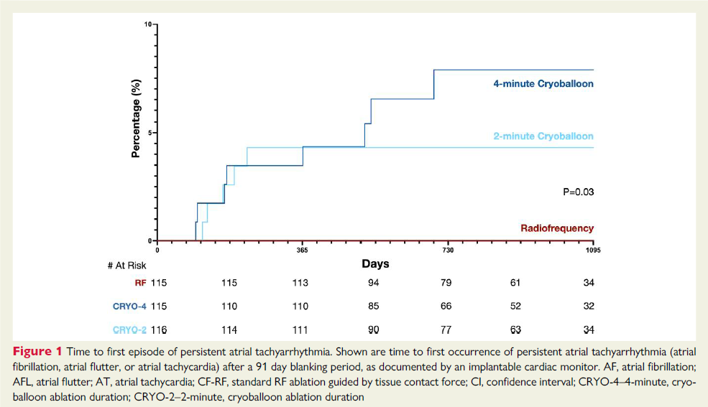
DISCUSSION
The strengths of the present CRRF-PeAF study
1) a prospective, multicenter, randomized design with a large sample size that ensured well-balanced baseline characteristics between the two groups; 2) rigorous follow-up methods, including twice-daily electrogram recordings throughout the 1-year period after ablation; and 3) comprehensive evaluations of trans thoracic echocardiography, laboratory data, and QOL before and after ablation.
Comparative Impact of CR and RF Ablation on Left Atrial Structural Changes
Recently, two prospective, randomized trials comparing the efficacy between cryoballoon and radiofrequency ablation (CIRCA-DOSE trial and NO-PERSAF study) have reported differences in recurrence patterns of atrial fibrillation (paroxysmal or persistent) between the two ablation technologies, with cryoballoon associated with a higher frequency of persistent atrial tachyarrhythmia episodes, even when the overall recurrence rates of atrial tachyarrhythmias are comparable.
These findings suggest that difference in the impact on structural reverse remodeling including the reduction of left atrial volume between the cryoballoon and radiofrequency ablation, that we have reported in the present study, could account for differences in recurrence pattern atrial fibrillation patterns, even though no difference in recurrence type was observed in the present study with a one-year follow-up.
Given that the pathophysiology of lesion formation, as well as lesion size, depth, and durability, varies by ablation energy source, the degree of reverse remodeling may also differ depending on the technology used. However, few studies have directly compared the impact of different energy sources on reverse remodeling.
The wider, more continuous lesions created by cryoballoon ablation have been shown to improve procedural and clinical outcomes compared to earlier generation of cryoballoon. However, this benefit may be associated with an increased risk of tissue injury. Indeed, in the current study, myocardial injury, as measured by post-ablation creatine kinase and creatine kinase myocardial band levels, was higher with cryoballoon ablation, consistent with previous findings.

Slide 19
DISCUSSION
The strengths of the present CRRF-PeAF study
1) a prospective, multicenter, randomized design with a large sample size that ensured well-balanced baseline characteristics between the two groups; 2) rigorous follow-up methods, including twice-daily electrogram recordings throughout the 1-year period after ablation; and 3) comprehensive evaluations of trans thoracic echocardiography, laboratory data, and QOL before and after ablation.
Comparative Impact of CR and RF Ablation on Left Atrial Structural Changes
Recently, two prospective, randomized trials comparing the efficacy between cryoballoon and radiofrequency ablation (CIRCA-DOSE trial and NO-PERSAF study) have reported differences in recurrence patterns of atrial fibrillation (paroxysmal or persistent) between the two ablation technologies, with cryoballoon associated with a higher frequency of persistent atrial tachyarrhythmia episodes, even when the overall recurrence rates of atrial tachyarrhythmias are comparable.
These findings suggest that difference in the impact on structural reverse remodeling including the reduction of left atrial volume between the cryoballoon and radiofrequency ablation, that we have reported in the present study, could account for differences in recurrence pattern atrial fibrillation patterns, even though no difference in recurrence type was observed in the present study with a one-year follow-up.

Slide 20
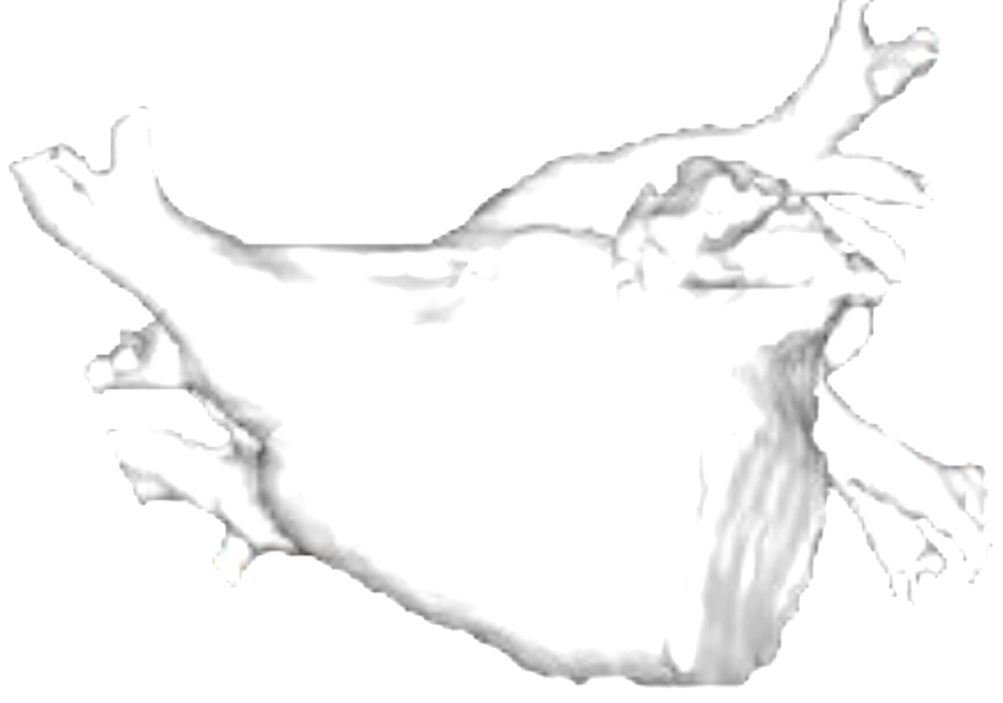
A Possible Reason for different impact on reverse remodeling after ablation between Cryoballoon and radiofrequency ablation
Wider,
more continuous lesions
Narrower,
less continuous lesions
Myocardial injury: ++
Myocardial injury: +
Cryoballoon
Radiofrequency
Reverse remodeling: +
(Left atrial volume↓)
Reverse remodeling: ++
(Left atrial volume: ↓↓)
Similar recurrence rate, but
More episode of persistent form of atrial fibrillation in cryoballoon ablation

Slide 21
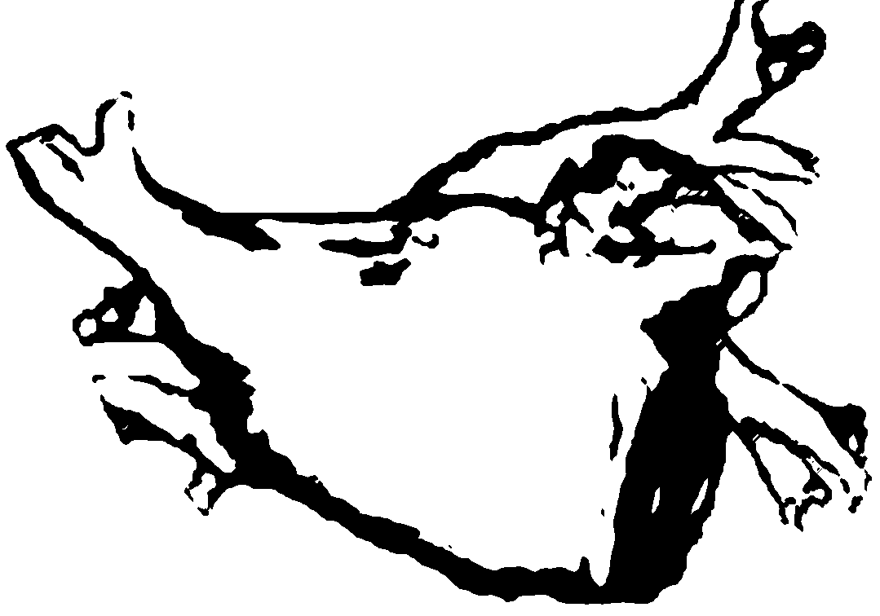
Another Possible Reason for different impact on reverse remodeling after ablation between Cryoballoon and radiofrequency ablation
Post-procedural increase of the left atrial pressure which was associated with an acute increase in left atrial stiffness in radiofrequency ablation, but not in cryoablation.
Cryoballoon
Left atrial pressure↑
Left atrial stiffness↑
Radiofrequency
The fact that left atrial volume reduction was greater in the RF group may indicate that RF can cause left atrial stiffness, and it may prevent the left atrium from spreading as much as it should be.
Karanasos A et a. Front Cardiovasc Med 2022; 9: 830055.
Notes:
On the other hand, it is not yet known whether the greater the extent of left atrial volume reduction after ablation, the greater the reverse remodeling effect of ablation in patients with atrial fibrillation.
Karanasos A. et al investigated changes in the left atrial function by volume-pressure loops after ablation for atrial fibrillation and explored potential differences between the radiofrequency and cryoballoon ablation. They found that there was a decrease in the left atrial booster pump function and trend for increase in the reservoir function in both 2 technologies, however, there was a post-procedural increase of the left atrial pressure which was associated with an acute increase in left atrial stiffness in radiofrequency ablation, but not in cryoablation.
Therefore, the fact that left atrial volume reduction was greater in the radiofrequency group in the present study may indicate that radiofrequency can cause left atrial stiffness, and it may prevent the left atrium from spreading as much as it should be. This issue demands further investigation.

Slide 22
STUDY LIMITATIONS
The present study had several limitations.
First, although we implemented rigorous follow-up methods with electrocardiogram recordings twice daily over the entire one-year follow-up (except during the blanking period) in addition to 24-hour Holter electrocadiogram at three and twelve months post-ablation, the intermittent yet frequent recordings of electrocardiogram, while effective for detecting recurrences of atrial tachyarrhythmias, may overestimate the success rate compared with continuous monitoring via an implantable loop recorder. Optimal post-ablation monitoring requires a balance between practicality, cost, and invasiveness to ensure clinical trial feasibility. Additionally, continuous detection of atrial fibrillation may have limited clinical relevance, as a reduction in the burden of atrial fibrillation, even without complete elimination, generally suffices to improve patient quality of life, reduce hospitalizations, and enhance cardiac function.
Second, the recurrence pattern (paroxysmal or persistent) was similar between the two groups in this study. Previous research has shown differences in recurrence mode with longer follow-up, suggesting that extended follow-up may reveal such differences, and this is planned for the current study.
Third, additional ablation lesions targeting sites outside the pulmonary veins were performed at the operator's discretion. However, there was no difference in the frequency of adjunctive ablation between the two groups, and recurrence rates were comparable between the two groups in patients both with and without extra-pulmonary ablation in the sub-group analyses.
Finally, regarding the morphological change in the left atrium, this study focused on the impact of CR and RF ablation. Future studies should also assess reverse remodeling effects, including morphological changes, with various energy sources including the pulsed-field ablation technology using electroporation.

Slide 23
Conclusions
In a prospective, multicenter, randomized, parallel-group, open-label study, cryoballoon ablation demonstrated non-inferiority to radiofrequency ablation for the occurrence of atrial tachyarrhythmias 1-year after the 90-day blanking period in patients with persistent atrial fibrillation.
Cryoballoon ablation could be performed with a shorter procedure.
Cryoballoon ablation demonstrated less atrial structural change compared with radiofrequency ablation despite the similar recurrence rate and atrial fibrillation burden after ablation between the two groups.

Slide 24
Thank you!
Kengo Kusano, MD
on behalf of CRRF-PeAF investigators

