Slide 1
KAYSHAV
The ATTENUATE Trial
The Impact of the RADPAD in
Reducing Radiation Exposure in a
Contemporary Cardiac Cath Lab
Giorgio A. Medranda, MD, FACC, FAHA, FSCAI
NYU Langone Hospital – Long Island
NGIO
A

Slide 2
Disclosures
I, Giorgio A. Medranda, do not have a financial interest/arrangement or affiliation with one or more organizations that could be perceived as a real or apparent conflict of interest in the context of the subject of this presentation.

Slide 3
Background
As the field of interventional cardiology continues to expand, highlighted by the meteoric rise of transcatheter structural interventions, radiation exposure and its associated risk is expected to increase.
Repeated and prolonged ionizing radiation exposure to operators, even at low levels, can lead to increased risks of radiation-induced injuries and chronic health problems, such as cancer and cardiovascular diseases.
Medranda, Gogo. Radiation Safety in the Contemporary Cardiac Catheterization Laboratory. Cardiac Interventions Today. 2023 Digital Exclusive No. 1.

Slide 4
Background
As a result, there has been a renewed interest in establishing a culture of radiation safety in many cardiac catheterization laboratories (CCL) across the country.
Developing evidence-based strategies aimed at lowering radiation exposure to patients, CCL staff, and physicians, fueled by advances in the field of radiation safety, is of paramount importance to promote longevity and accomplish this endeavor.
Medranda, Gogo. Radiation Safety in the Contemporary Cardiac Catheterization Laboratory. Cardiac Interventions Today. 2023 Digital Exclusive No. 1.

Slide 5
Background
Medranda, Gogo. Radiation Safety in the Contemporary Cardiac Catheterization Laboratory. Cardiac Interventions Today. 2023 Digital Exclusive No. 1.

Slide 6
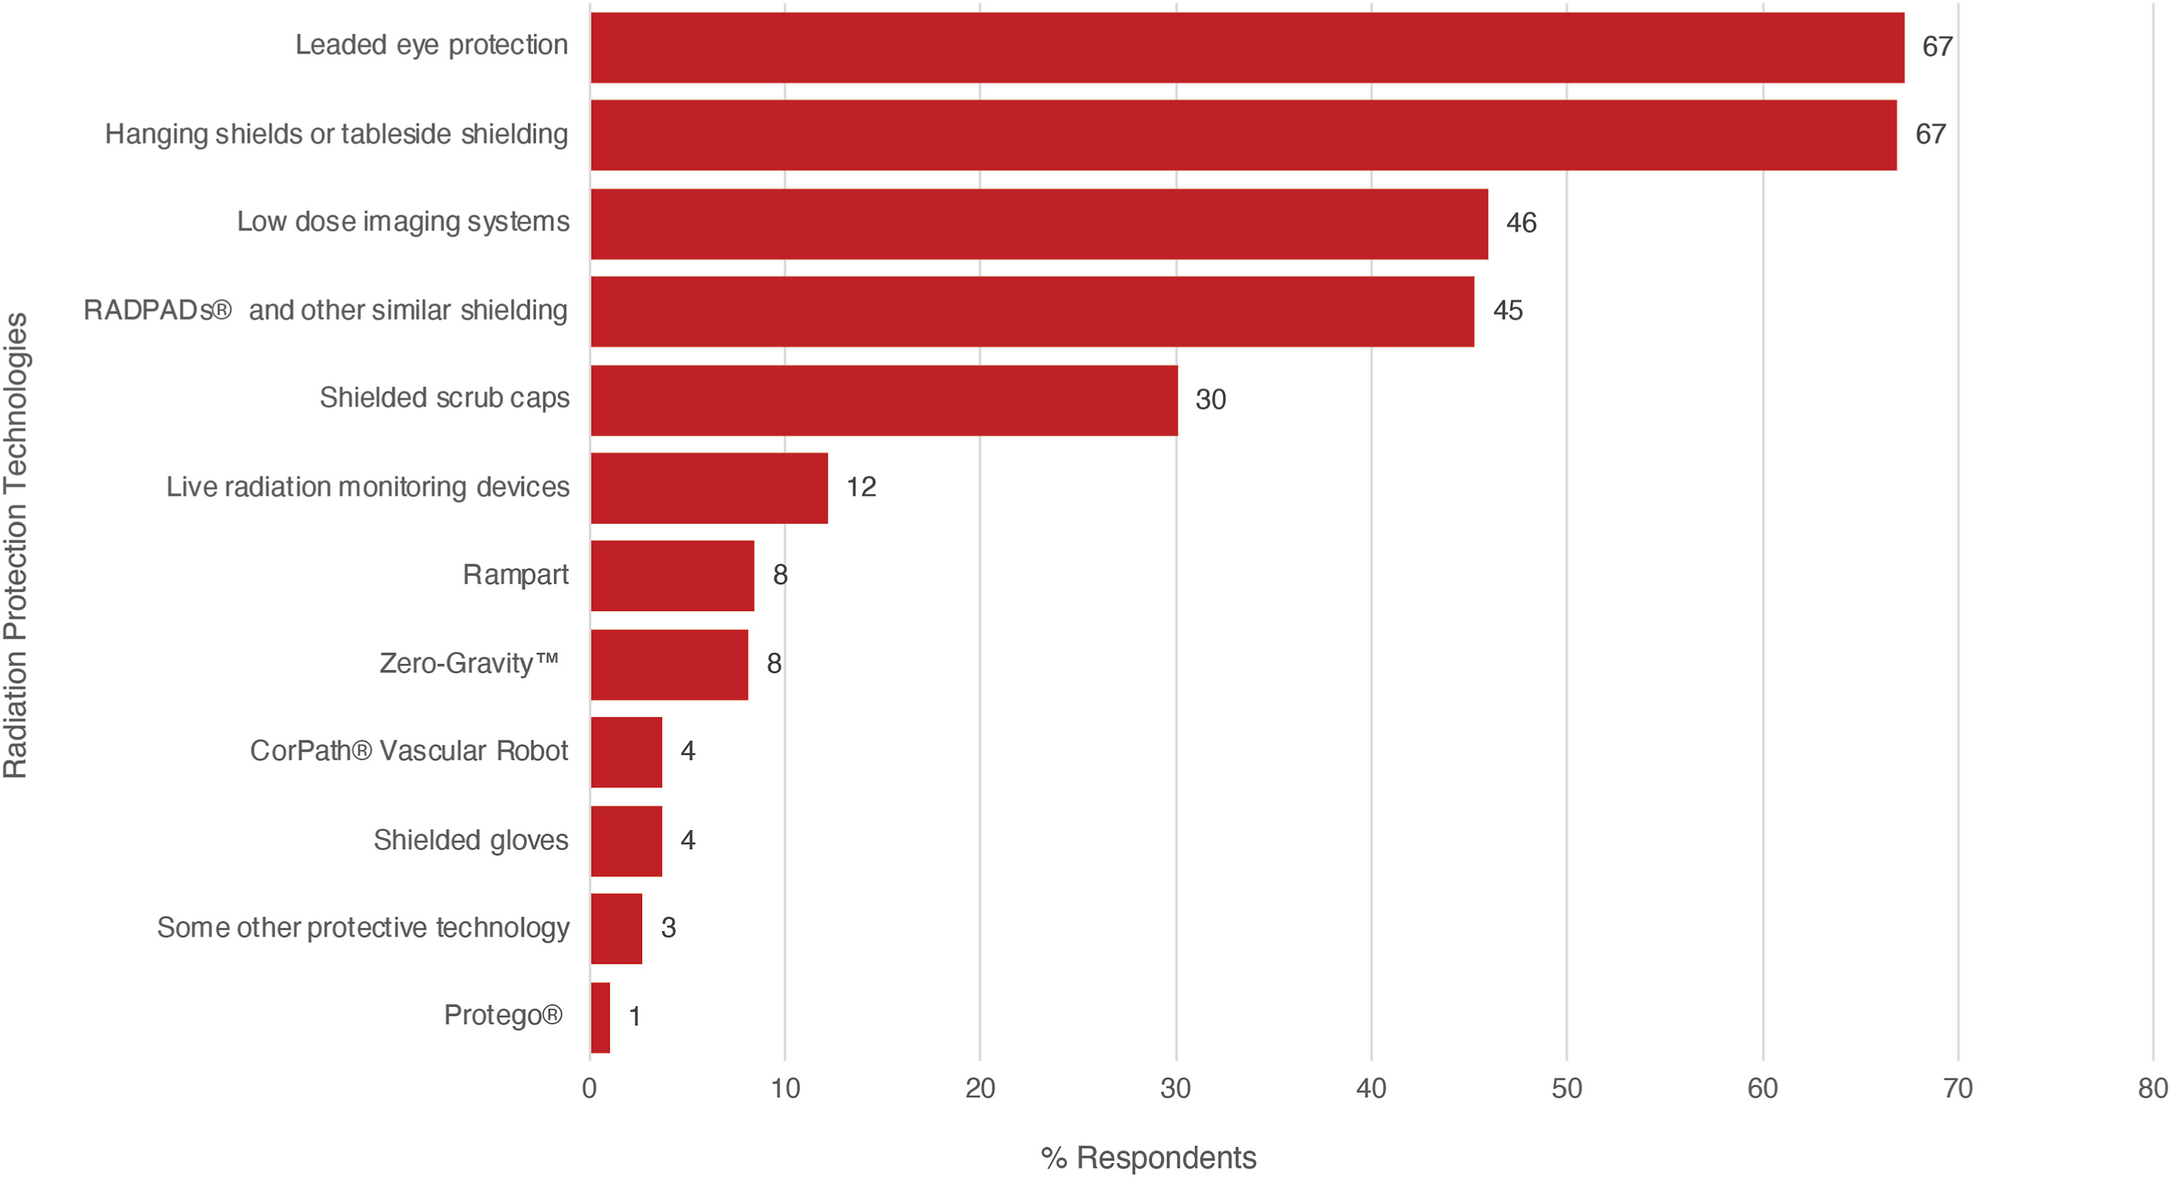
Background
SCAI, among other major medical societies, has sought to shed light on the occupational hazards in the CCL led by the current SCAI president James B. Hermiller, MD, MSCAI.
Occupational Health Hazards in the Cardiac Catheterization Laboratory: Results of the 2023 SCAI Survey Abudayyeh, Islam et al. Journal of the Society for Cardiovascular Angiography & Interventions, Volume 0, Issue 0, 102493

Slide 7
Background
Medranda, Gogo. Radiation Safety in the Contemporary Cardiac Catheterization Laboratory. Cardiac Interventions Today. 2023 Digital Exclusive No. 1.

Slide 8
Background
Well-established shielding methods are used commonly by most operators.
However, use of relatively inexpensive scatter absorbing pads such as the RADPAD remains infrequent.
Occupational Health Hazards in the Cardiac Catheterization Laboratory: Results of the 2023 SCAI Survey Abudayyeh, Islam et al. Journal of the Society for Cardiovascular Angiography & Interventions, Volume 0, Issue 0, 102493

Slide 9
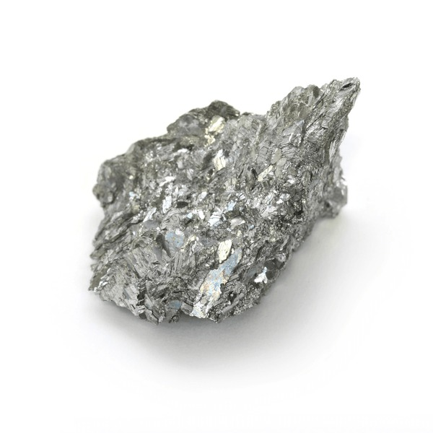
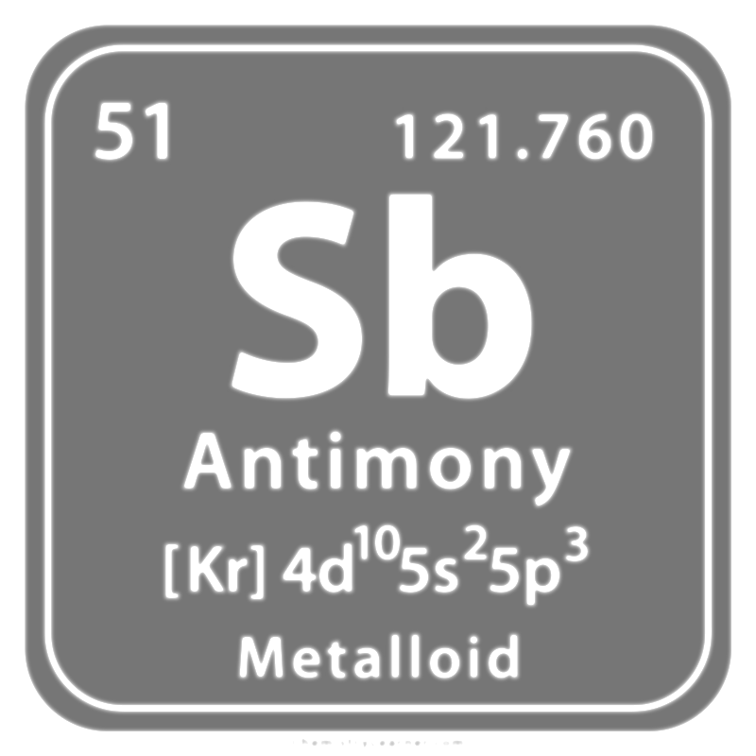
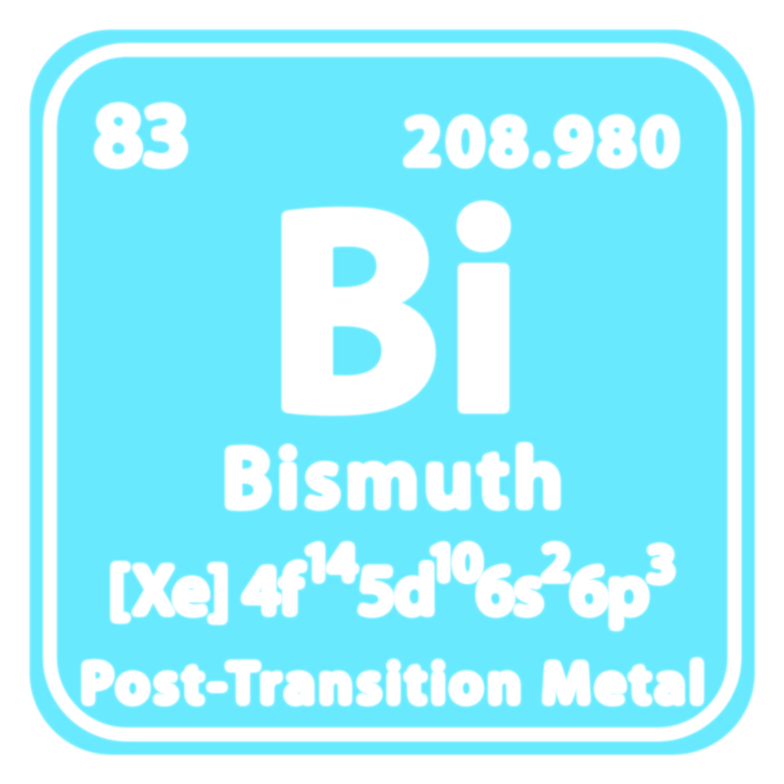
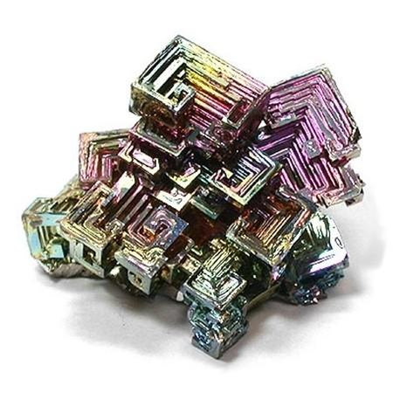
Background
The RADPAD was designed as a protective scatter-radiation absorbing shield placed on the patient with the goal of reducing scatter radiation to all.
Comprised of antimony + bismuth (both high-atomic numbers and non-toxic).
+

Slide 10
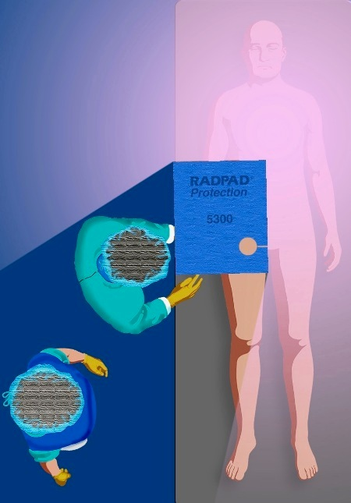
Background
Early small studies demonstrated a 20-62% reduction.

Slide 11
Objective
The purpose of this study was to examine the impact of the RADPAD in a large randomized controlled trial in a contemporary CCL which performs a wide range of procedures including structural interventions.

Slide 12
The ATTENUATE Trial
(rAdpad proTecTion drapE iN redUcing rAdiaTion Exposure)
(NCT06233578)
NCT06233578
Single-center study
Investigator-initiated
CCL Procedure
(n=1,000)
1:1 Randomization
RADPAD
(n=500)
No RADPAD
(n=500)

Slide 13
Methodology
Every CCL procedure was performed using standard radiation safety protocols with a dosimeter placed at the level of the chest of the most proximal operator at the beginning of each case.
RADPAD® ORANGE Peripheral Shield (11”x 34”)
Affordable, single-use (~$50 per pad, not ~$100,000)
Among the most used in other CCLs
Currently approved and used in procedures at NYU Langone Health
Placed prior to the start of the procedure according to instructions for use.

Slide 14
Methodology
Key Inclusion Criteria
Proximal operator of a CCL procedure as defined by the individual performing the procedure closest to the source of radiation at the start of the procedure.
This may be either physician assistants of the CCL, fellows of cardiovascular disease, interventional cardiology fellows or attending interventional cardiologists.

Slide 15
Methodology
Key Exclusion Criteria
Anyone unable or unwilling to give informed consent.

Slide 16
Methodology
Primary Outcome
Dose-area product-normalized operator dose
Operator Dose (E) in uSv / Dose Area Product (DAP) in mGycm²
Secondary Outcomes
Operator Dose (E) in uSv
Fluoroscopy Time (FT) in minutes
Dose Area Product (DAP) in mGycm²

Slide 17
Statistical Methodology
Continuous variables are presented as mean±standard deviation, categorical variables as n/N (%).
Student’s t-test (two-sided) or chi-squared and Fisher’s exact test were performed as appropriate.
All p-values <0.05 were considered statistically significant.
All analyses were performed with SAS version 9.4 (SAS Institute, Cary, North Carolina).

Slide 18
The ATTENUATE Trial
(rAdpad proTecTion drapE iN redUcing rAdiaTion Exposure)
(NCT06233578)
CCL Procedure
(n=1,000)
1:1 Randomization
No RADPAD
(n=500)
Age 66 years, 44% female, BMI 27kg/m²
RADPAD
(n=500)
Age 67 years, 42% female, BMI 28kg/m²

Slide 19
Results – CCL Case Mix
TF/SC/TC TAVR
Mitral TEER
BAV
TMVR
PFO/ASD
PVL Closure
Pericardiocentesis
RHC
PEI
TVP
Biopsy
IABP/Impella

Slide 20
Primary Endpoint
DAP-Normalized Operator Dose
(uSv/mGycm2 x 10,000)
50.7% Reduction
p<0.0001

Slide 21
Secondary Endpoint
p<0.0001
Operator Exposure
(uSv)

Slide 22
Secondary Endpoint
Fluoroscopy Time
(minutes)
p<0.0001

Slide 23
Secondary Endpoint
Dose Area Product
(mGycm²)
p<0.0001

Slide 24
Subgroup Analysis – Radial Coronary Cases
DAP-Normalized Operator Dose
(uSv/mGycm2 x 10,000)
29.9% Reduction
p<0.0001

Slide 25
Subgroup Analysis – Femoral Coronary Cases
DAP-Normalized Operator Dose
(uSv/mGycm2 x 10,000)
39.6% Reduction
p<0.0001

Slide 26
Subgroup Analysis – Femoral Structural Cases
DAP-Normalized Operator Dose
(uSv/mGycm2 x 10,000)
17.7% Reduction
p<0.0001

Slide 27
Subgroup Analysis – Non-Radial/Femoral Cases
DAP-Normalized Operator Dose
(uSv/mGycm2 x 10,000)
62.2% Reduction
p<0.0001

Slide 28
Discussion
This study represents the largest randomized control trial of the RADPAD protection drape in a contemporary CCL practice.
Demonstrating a significant reduction in the exposure to the most proximal operator during contemporary CCL procedures regardless of procedure type across a wide range of cases.
Often times representing either a fellow of cardiovascular disease or interventional cardiology fellow.

Slide 29
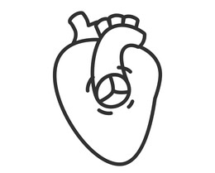
Discussion
50.7% Relative Reduction in DAP-Normalized Operator Dose
p<0.0001
Coronary Structural
Intervention Interventional

Slide 30
Discussion
Early small studies demonstrated a 20-62% reduction.

Slide 31
Discussion
These studies were modest (predominantly <200 subjects enrolled) and older, with very few structural interventional cardiology cases.
Often times including just coronary cases (diagnostic and intervention).
Not representative of a complete and contemporary coronary/structural fellowship/training program or practice.
Several trials included blinding techniques towards the operator/staff with a sham pad.

Slide 32
Discussion
ATTENUATE Trial confirmed the RADPAD’s utility in a contemporary practice.

Slide 33
Discussion
The ATTENUATE Trial: the largest RCT, coronary and structural

Slide 34
Discussion
Benefits:
Ease of use and affordability
Benefit across case type
Complementary towards any case and any other radiation safety initiative.
Costs:
Additional cost
Training to place for staff

Slide 35
Limitations
Limited to the experience of a single center
One type of RADPAD studied
Heterogeneity of the population examined with regards to procedure types
Focused on the most proximal operator at the start of each case, not the remainder of CCL staff
Very few purely peripheral/endovascular cases included
No sham arm included in the randomization

Slide 36
Conclusions
In a contemporary CCL, including diagnostic, coronary and structural interventions, the use of the RADPAD protective scatter-radiation absorbing shield continues to significantly reduce proximal operator radiation exposure compared with no use of the RADPAD.
It is time to take a more aggressive stance and approach towards protecting ourselves and our future!

Slide 37
KAYSHAV
The ATTENUATE Trial
Brian C. Case, MD
Anthony T. Gambino, MD
Richard K. Schwartz, DO
Dimitrios Briagos, MD
All CCL Staff at NYU Langone Hospital – Long Island!
NGIO
★
A

Slide 38
KAYSHAV
NGIO
★
A
Thank you to my Family!
Dr. Srivastava and Kayshav!

Slide 39
KAYSHAV
Thank You!
Giorgio A. Medranda, MD, FACC, FAHA, FSCAI
Structural Interventional Cardiologist, NYU – Long Island
Clinical Assistant Professor, Department of Medicine
@GiorgioMedranda
NGIO
★
A

