Slide 1
Tuesday 20 May 2025
Room 241
18:10 - 18:14
One-year outcomes of contemporary TAVI valves
– a randomised, non-inferiority LANDMARK trial
Patrick W. Serruys
Department of Cardiology, School of Medicine, University of Galway, Galway, Ireland

Slide 2
Potential conflicts of interest
Speaker's name: Patrick Serruys
I have the following potential conflicts of interest to report: SMT, Novartis, Meril Life Sciences
europcr.com

Slide 3
Title & Objectives
Transcatheter aortic valve implantation (TAVI) is an established treatment option for patients with severe aortic stenosis.
Myval transcatheter heart valve (THV) series demonstrated the non-inferiority compared to the contemporary standard THVs (Sapien and Evolut series) with respect to 30-day early safety endpoint in the LANDMARK trial.¹
The current study aims to report the 1-year clinical and hemodynamic outcomes from the trial.
1 A Baumbach, PW Serruys et al. Lancet. 2024 Jun 22;403(10445):2695-2708.
europcr.com

Slide 4


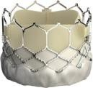
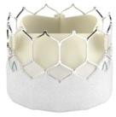
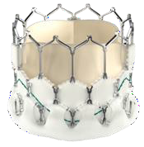
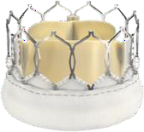
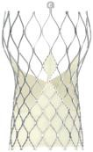
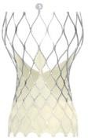
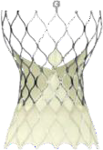

Methods & Design
Open-label, multicentre, non-inferiority trial
Patients with symptomatic severe native aortic stenosis were enrolled from 31 centres in 16 countries (Europe, New Zealand and Brazil)
1:1 Randomization (N=768)
Myval THV Series
(n=384)
Contemporary THV Series (n=384) [Sapien (n=192) + Evolut (n=192)]
S3
S3 Ultra
Myval
Myval
Octacor
Index TAVI Procedure
Evolut R Pro/Pro+
FX
Primary Combined Safety and Effectiveness Endpoint as per VARC-3 at 30 days (Non-inferiority achieved)
Clinical Efficacy Endpoint (death, stroke or procedure/valve-related hospitalization) as per VARC-3 at 1 year
Kawashima H. Am Heart J. 2021;232:23-38. Tobe A. Am Heart J. 2024;270:162-163. Tobe A, et al. Am Heart J. 2025:S0002-8703(25)00124-3.
europcr.com

Slide 5
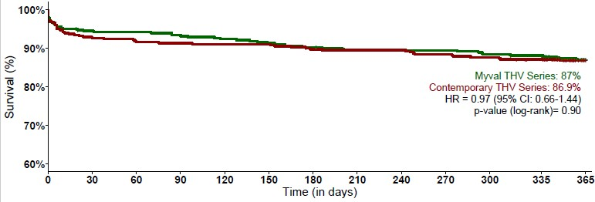
Key results
Clinical Efficacy (Composite of death, stroke or
procedure/valve-related hospitalization)
Clinical event rate, (KM%) | Myval THV Series (n=384) | Contemporary THV Series (n=384) | Risk Difference % (95% CI) | P-value
Clinical efficacy | n=49 (13.0%) | n=50 (13.1%) | -0.1 ( NA, 3.9) | Pnoninferiority <0.0001*
All-cause mortality | n=27 (7.2%) | n=27 (7.1%) | 0.1 (-3.5, 3.7) | 1.00
All stroke | n=21 (5.7%) | n=13 (3.4%) | 2.3 (-0.6, 5.2) | 0.22
Procedure- /valve-related hospitalization | n=16 (4.3%) | n=20 (5.4%) | -1.1 (-4.1, 1.9) | 0.61
Myval THV Series: 49 (13.0%)
Contemporary valve: 50 (13.1%)
* Assumed event rate of 27.23%, non-inferiority margin of 10.89% and one-sided alpha of 5%.
Myval THV series achieved the noninferiority to the contemporary THV series with respect to the 1-year clinical efficacy composite endpoint.
europcr.com

Slide 6
Importance/Relevance of the trial
For the treatment of patients with symptomatic severe native aortic stenosis, the Myval THV series at one year was non- inferior to the contemporary THVs (Sapien and Evolut THV series) with respect to the clinical efficacy endpoint.
Echocardiographic outcomes as well as quality-of-life outcomes were comparable between the two arms.
The LANDMARK trial implemented the recommendations of VARC-3.
Follow-up of patients is planned for up to 10 years to evaluate
the long-term performance and durability of the device.
europcr.com

Slide 7
pcronline.com

