Slide 1
Two-year Outcomes Of Transcatheter Tricuspid
Valve Edge-to-edge
Repair For Tricuspid Regurgitation:
The TRILUMINATE Pivotal Trial
Saibal Kar, MD, FACC
Program Director, Cardiovascular Disease Fellowship
Los Robles Regional Medical Center, Thousand Oaks, CA Physician Director, Interventional Cardiology. HCA Healthcare

Slide 2
Disclosures
Grants and institutional research support: Abbott, Boston Scientific, and Edwards Lifesciences
Consulting fees/honoraria: Abbott, Boston Scientific, W.L. Gore, and Medtronic
Steering committee member: TRILUMINATE Pivotal study (Abbott)
National principal investigator: EXPAND, REPAIR MR (Abbott)
The TRILUMINATE Pivotal trial was funded by Abbott; ClinicalTrials.gov number, NCT03904147.

Slide 3
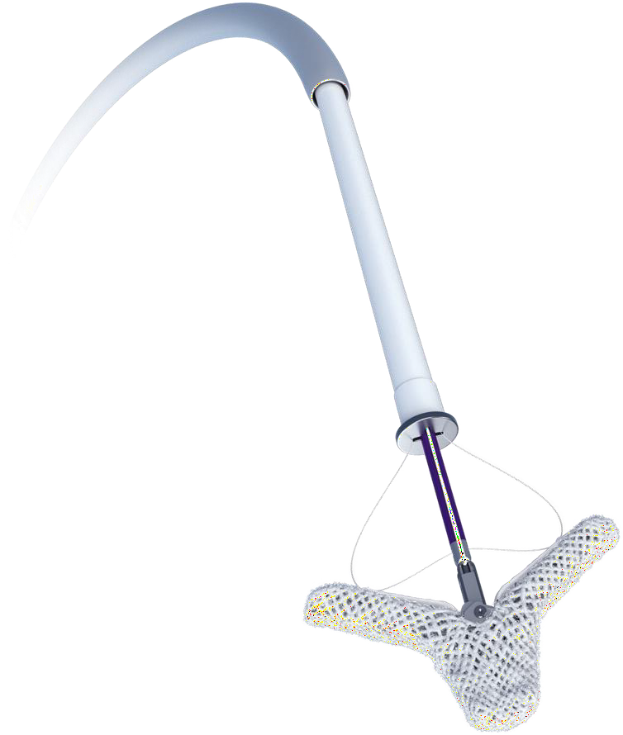
The TRILUMINATE Pivotal trial
The first randomized controlled trial to evaluate tricuspid TEER in subjects with symptomatic, severe TR despite optimized medical therapy.
The primary endpoint (evaluated at 1 year follow-up) of the TRILUMINATE Pivotal trial showed tricuspid TEER with the TriClip device was superior to medical therapy alone, driven by improvements in health status with no differences in mortality or heart failure hospitalization (HFH).¹
However, a significant reduction in HFH was seen in the later enrollment for TEER at 1 year.²
The TriClip device (Abbott)
¹ Sorajja P, Whisenant B, Hamid N, et al. Transcatheter Repair for Patients with Tricuspid Regurgitation. N Engl J Med. 2023;388(20):1833-1842.
² Tang GHL, Hahn RT, Whisenant BK, et al. Tricuspid Transcatheter Edge-to-Edge Repair for Severe Tricuspid Regurgitation: 1-Year Outcomes From
the TRILUMINATE Randomized Cohort. J Am Coll Cardiol. 2025;85(3):235-246.

Slide 4
Study Design and Endpoints
Design
Prespecified 2-year Endpoints
1:1 randomization between TriClip device and medical therapy
Total of 572 subjects randomized
Primary endpoint met¹
Crossover to device treatment allowed after 1-year follow-up if trial inclusion criteria still met
Recurrent HF hospitalizations at 24 months
Freedom from all-cause mortality, tricuspid valve surgery, and tricuspid valve intervention at 24 months
¹ Sorajja P, Whisenant B, Hamid N, et al. Transcatheter Repair for Patients with Tricuspid Regurgitation. N Engl J Med. 2023;388(20):1833-1842.

Slide 5
Study Design and Endpoints
Design
Prespecified 2-year Endpoints
1:1 randomization between TriClip device and medical therapy
Total of 572 subjects randomized
Primary endpoint met¹
Crossover to device treatment allowed after 1-year follow-up if trial inclusion criteria still met
Recurrent HF hospitalizations at 24 months
Freedom from all-cause mortality, tricuspid valve surgery, and tricuspid valve intervention at 24 months
Aim: To report 2-year outcomes from the TRILUMINATE Pivotal trial
¹ Sorajja P, Whisenant B, Hamid N, et al. Transcatheter Repair for Patients with Tricuspid Regurgitation. N Engl J Med. 2023;388(20):1833-1842.

Slide 6
Baseline Characteristics
Characteristic | Device N=285 | Control N=287
Age (years) | 78.1 ± 7.9 | 78.1 ± 7.6
Female | 58.9% | 58.9%
Atrial Fibrillation | 82.8% | 92.7%
CRT, CRT-D, ICD, or Permanent Pacemaker | 16.5% | 16.4%
Previous Aortic and/or Mitral Intervention | 37.9% | 34.5%
HFH Within 1 Year Before Enrollment | 24.9% | 22.6%
NYHA Class III/IV | 56.1% | 54.0%
KCCQ Score | 55.6 ± 22.9 | 54.6 ± 23.8
6-minute Walk Distance (m) | 240.5 ± 116.4 | 249.6 ± 125.5
Functional TR Etiology | 95.7% | 93.9%
Torrential TR^{1,2} | 48.7% | 51.5%
Left Ventricular Ejection Fraction (%) | 59.4 ± 9.0 | 59.7 ± 9.2
Based on 5-grade scale from ¹Hahn RT, Badano LP, Bartko PE, et al. Tricuspid regurgitation: recent advances in understanding pathophysiology, severity grading and outcome. Eur Heart J Cardiovasc Imaging 2022;23:913-29. ²Hahn RT, Zamorano JL. The need for a new tricuspid regurgitation grading scheme. Eur Heart J Cardiovasc Imaging 2017;18:1342-3. Data shown as % or mean±standard deviation.; CRT, cardiac resynchronization therapy; CRT-D, CRT device; HFH, heart failure hospitalization; ICD, implantable cardiac defibrillator; KCCQ, Kansas City Cardiomyopathy Questionnaire; NYHA, New York Heart Association; TR, tricuspid regurgitation.

Slide 7
INTENTION-TO-TREAT
Tricuspid Regurgitation Severity (Paired)
Device (N=172) Control (N=155)
100%
2%
1%
2%
3%
11%
42%
84%
moderate or
less
42%
9%
9%
10%
18%
34%
29%
80%
46%
48%
38%
58%
Patients (%)
60%
17%
40%
22%
16%
51%
20%
29%
34%
21%
0%
3%
1%
4%
Baseline
1 year
2 year Moderate
Baseline Massive
1 year
2 year
Mild
Severe
Torrential
Paired data shown. Patients with tricuspid valve surgery are excluded.

Slide 8
INTENTION-TO-TREAT
Tricuspid Regurgitation Severity (Paired)
Device (N=172)
Control (N=155)
Includes patients who crossed over before 2-year follow- up (60% of control patients)
100%
2%
1%
2%
9%
3%
9%
11%
10%
80%
46%
48%
18%
38%
58%
Patients (%)
60%
42%
84%
moderate or
less
17%
34%
40%
22%
16%
51%
42%
20%
29%
34%
21%
29%
0%
3%
1%
4%
Baseline
1 year
2 year Moderate
Baseline Massive
1 year
2 year
Mild
Severe
Torrential
Paired data shown. Patients with tricuspid valve surgery are excluded.

Slide 9
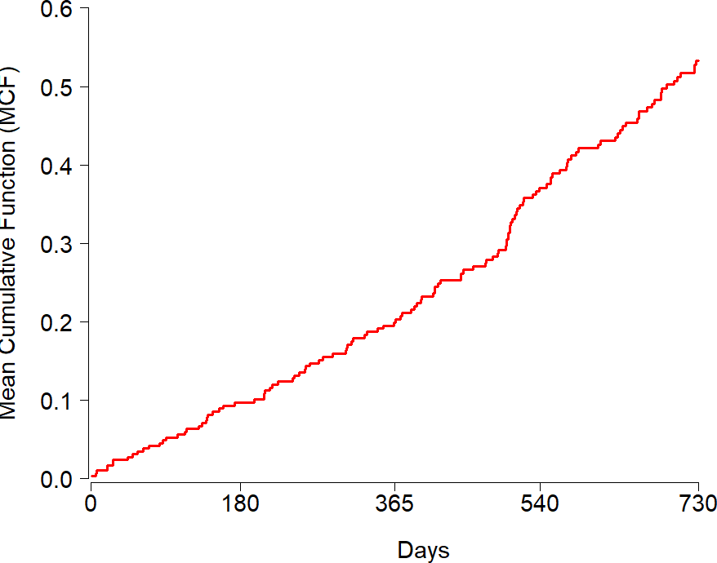
INTENTION-TO-TREAT
Prespecified Endpoint: Recurrent Heart Failure Hospitalizations
0.40
Mean Cumulative Function
(Average number of events/patient)
0.26
Annualized HFH Rate
(events/patient year)
0.30
0.20
0.10
0.00
Control
2 Years
At risk
Control 287
Days
247
261
226
190
Prespecified secondary endpoint from joint frailty model; intention-to-treat (ITT) analysis shown. HFH, heart failure hospitalization.

Slide 10
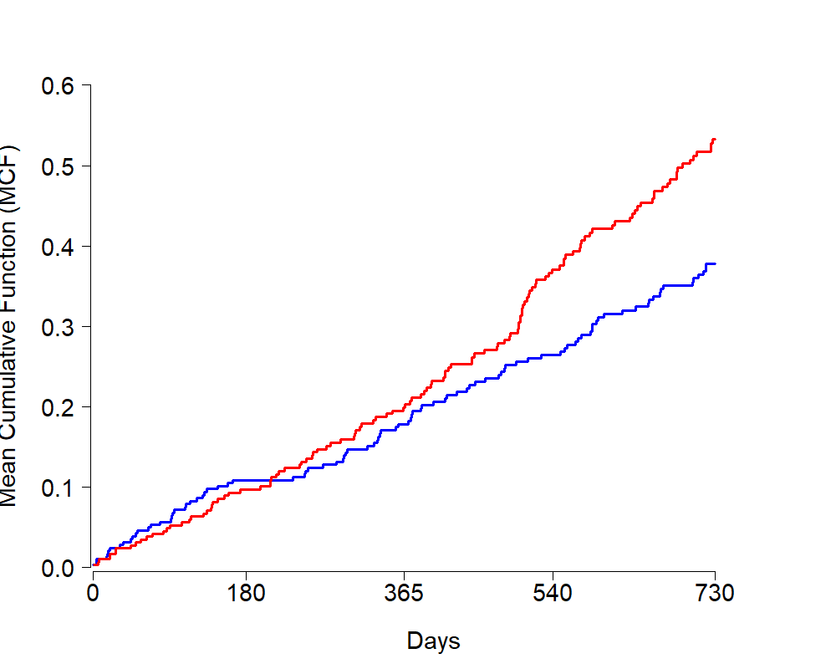
INTENTION-TO-TREAT
Prespecified Endpoint: Recurrent Heart Failure Hospitalizations
0.40
p=0.02
0.26
Mean Cumulative Function
(Average number of events/patient)
Annualized HFH Rate
(events/patient year)
0.30
0.19
0.20
0.10
0.00
Device Control
2 Years
At risk |  | Days
Control 287 | 261 | 247 | 226 | 190
Device 285 | 265 | 253 | 238 | 205
Hazard ratio=0.72 (one-sided upper confidence limit of 0.93, p=0.02), indicating a relative risk reduction of 28% with device treatment.
Prespecified secondary endpoint from joint frailty model; intention-to-treat (ITT) analysis shown. HFH, heart failure hospitalization.

Slide 11
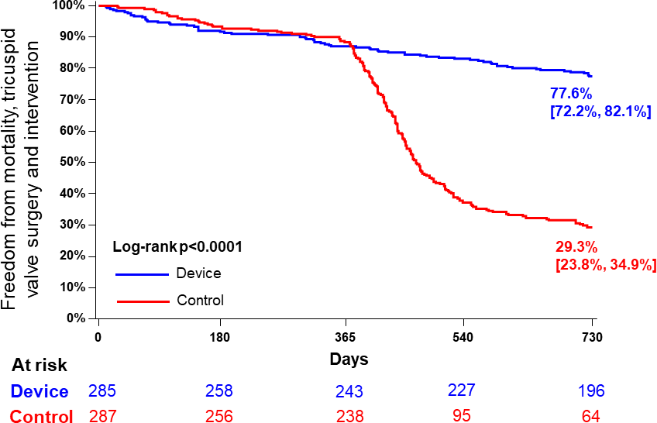
INTENTION-TO-TREAT
Prespecified Endpoint: Freedom from All- cause mortality, TV Surgery, TV Intervention
Difference driven by tricuspid valve intervention (crossover) after 1 year. Rates of all-cause mortality and tricuspid valve surgery were similar between groups.
Component | Device N=285 | Control N=287 | p-value
Composite All-cause mortality TV surgery (TVS) TV intervention (TVI) | 22.4% (62) 17.9% (49) 2.3% (6) 3.8% (10) | 70.7% (185) 17.1% (45) 4.3% (11) 61.5% (142) | <0.0001
Prespecified secondary endpoint; intention-to-treat (ITT) analysis shown. TV, tricuspid valve; TVS, tricuspid valve surgery; TVI, tricuspid valve
intervention (transcatheter).

Slide 12
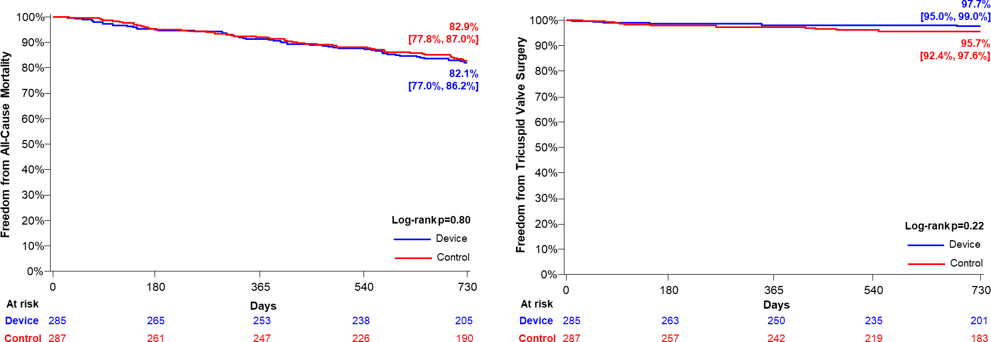
INTENTION-TO-TREAT
All-cause Mortality and Tricuspid Valve Surgery
All-cause Mortality
Tricuspid Valve Surgery
Prespecified secondary endpoint; intention-to-treat (ITT) analysis shown. TVS, tricuspid valve surgery.

Slide 13
Both 2-year Prespecified Endpoints Met
INTENTION-TO-TREAT
Reduction in recurrent HF hospitalizations at 24 months in Device group (p=0.02).
Higher freedom from all-cause mortality, tricuspid valve surgery, and tricuspid valve intervention at 24 months in Device group, driven by tricuspid valve intervention in the Control group (p<0.0001).

Slide 14
INTENTION-TO-TREAT
Safety Through Two Years
Adverse Event through 2 Years | Device N=285 | Control N=287
Stroke | 1.9% | 2.5%
Transient ischemic attack | 1.7% | 1.0%
Tricuspid valve intervention | 3.8% | 61.5%
Tricuspid valve surgery | 2.3% | 4.3%
Cardiogenic shock | 0.4% | 1.3%
New conduction disturbance requiring permanent pacemaker | 5.5% | 4.2%
Single leaflet device attachment | 6.5% | 3.9%
Device embolization | 0% | 0%
Device thrombosis | 0% | 0%
Data shown as Kaplan Meier time-to-event (%). Intention-to-treat (ITT) analysis shown. All single leaflet device attachment (SLDA) events in the Device group were noted at discharge or 30-day follow-up.

Slide 15
INTENTION-TO-TREAT
Safety Through Two Years
Adverse Event through 2 Years | Device N=285 | Control N=287
Stroke | 1.9% | 2.5%
Transient ischemic attack | 1.7% | 1.0%
Tricuspid valve intervention | 3.8% | 61.5%
Tricuspid valve surgery | 2.3% | 4.3%
Cardiogenic shock | 0.4% | 1.3%
New conduction disturbance requiring permanent pacemaker | 5.5% | 4.2%
Single leaflet device attachment | 6.5% | 3.9%
Device embolization | 0% | 0%
Device thrombosis | 0% | 0%
Crossover to device treatment after 1- year follow-up
Data shown as Kaplan Meier time-to-event (%). Intention-to-treat (ITT) analysis shown. All single leaflet device attachment (SLDA) events in the Device group were noted at discharge or 30-day follow-up.

Slide 16
Crossover Analysis
Crossover to device treatment permitted after 1-year follow-up if original inclusion criteria still met

Slide 17
Timing of Crossover Procedure
Of the 241 Control patients eligible for crossover after 1-year follow-up, 142 (59%) patients crossed over prior to 2-year follow-up
Within 6 months of eligibility to crossover
1.0
0.9
Percent of Control Patients with Crossover Procedure (%)
0.8
0.7
r
e
v
o
s
s
o
r
C
0.6
0.5
0.4
0.3
92% (130/142) of crossover procedures occurred within 6 months of the 1-year visit
0.2
0.1
0.0
0
Days Since Eligible for Crossover

Slide 18
Characteristics Prior to Crossover
Variable at 1 Year (Prior to Crossover) | Patients who Crossed Over N=142 | Patients who did not Crossover N=94
Torrential TR | 65.2% | 41.5%
NYHA III/IV | 47.5% | 30.4%
KCCQ Change (baseline to 1 year) | 0 ± 18 | 7 ± 18
6MWD Change (baseline to 1 year) | -22 ± 103 | -1 ± 90
HFH (events/patient-year) | 0.17 | 0.07
Diuretic Dose Change (baseline to 1 year) | +22 mg | +5 mg
Patients who crossed over were more symptomatic with a higher prevalence of torrential TR and more HFH prior to crossover.
Includes patients eligible for crossover (completed 1-year follow-up), patients with tricuspid valve surgery are excluded. TR, tricuspid regurgitation; NYHA, New York Heart Association; KCCQ, Kansas City Cardiomyopathy Questionnaire; 6MWD, 6-minute walk distance; HFH, heart failure hospitalization.

Slide 19
Safety of Procedure at Crossover
Adverse events through 30 days | Device Group N=281 | Crossover N=142
Major Adverse Event through 30 Days Cardiovascular mortality New-onset renal failure Non-elective cardiac surgery Endocarditis requiring surgery | 0.4% 0.7% 0% 0% | 0.7% 1.4% 0% 0%
Other Adverse Events through 30 Days Major bleeding Single leaflet device attachment Device embolization Device thrombosis Myocardial infarction Stroke New conduction disturbance requiring permanent pacemaker | 3.2% 5.7% 0% 0% 0% 0.4% 0.9% | 2.8% 5.6% 0% 0% 0% 0% 0%
Discharge to Home | 97.9% | 97.2%
All-cause Mortality | 0.4% | 1.4%
Heart Failure Hospitalization | 2.5% | 3.5%
Data shown as %.

Slide 20
Tricuspid Regurgitation Grade After Crossover
Device (N=172) Crossover (N=111)
“Pure” Control (N=44)
(crossovers excluded)
p=0.55 p=0.68
p<0.0001
p=0.38
p=0.65
p<0.0001
100%
2%
1%
2%
3%
1%
9%
3%
51%
43%
11%
16%
30%
80%
46%
43%
38%
64%
Patients (%)
60%
42%
40%
25%
27%
84%
moderate or less
18%
81%
moderate or less after crossover
14%
40%
22%
13%
23%
23%
51%
42%
43%
20%
29%
30%
21%
3%
41%
21%
moderate or less
7%
2%
21%
0%
3%
2%
Baseline
1 year
2 year
Baseline
1 year
2 year
Baseline
1 year
2 year
Mild
Moderate
Severe
Massive
Torrential
Paired data shown. “Pure” control includes patients who remain on medical therapy alone. Patients with tricuspid valve surgery are excluded
from all groups.

Slide 21
Health Status Through 2 Years
20
18.2
17.4
15.4
Device (N=201)
Change in KCCQ Score (Follow-Up –Baseline)
15
Control, Crossover (N=117)
"Pure" Control (Non-
crossover, N=50)
12.9
10
7.0
10.3
5.9
5
4.0
0
0.1
-5
1 Year
Control eligible for crossover
after 1-year follow-up visit
Baseline 30 Days
2 Years
Mean and 95%CI and paired data shown. Patients with tricuspid valve surgery are excluded.

Slide 22
Conclusions
Improvements in TR severity and quality of life were sustained through 2 years in Device patients.
Treatment with the TriClip device reduced HFH compared to medical therapy (despite crossovers in the Control group).
TriClip continues to be safe and effective, including for Control patients who crossed over after 1-year follow-up.
Treatment of Control patients with TriClip improved health status following crossover; however, delaying treatment resulted in symptom progression and recurrent HFH.

