Slide 1

The EARTH-STEMI
IPD meta-analysis
Complete vs. Culprit-Only Revascularization in Older STEMI Patients
Gianluca Campo, MD
University Hospital of Ferrara (Italy)
on behalf of the EARTH-STEMI Investigators

Slide 2
Disclosures
Research grants and/or personal fees from SMT, Medis, Abbott Vascular, GADA, Siemens Helthcare, GE Healthcare, Menarini, Amgen, Daichii-Sankio

Slide 3

Background
The COMPLETE trial showed the superiority of complete
revascularization in STEMI patients¹
The FIRE trial confirmed its benefit in older MI patients² However:
The FIRE trial mixed STEMI and NSTEMI patients²
The FIRE follow-up was limited to 1-year²
The recent FULL-REVASC trial questioned long-term benefit of complete revascularization³
1. Mehta S, NEJM 2019. 2. Biscaglia S, NEJM 2023. 3. Bohm F, NEJM 2024.

Slide 4
Research question
To investigate with an individual patient data meta- analysis from RCTs whether, in older patients (75+ years) with STEMI and multivessel disease, complete revascularization is superior to a culprit- only strategy at follow-up longer than 1 year

Slide 5
Methods
The EARTH-STEMI protocol was registered on PROSPERO with the id CRD42022367898¹ and followed PRISMA guidelines
We searched for RCTs comparing complete vs. culprit-only revascularization in MI patients
From original database, data of STEMI patients aged
≥75 years were extracted and analyzed
1. https://www.crd.york.ac.uk/prospero/display_record.php?RecordID=367898

Slide 6
Endpoints (at longest available follow-up)
Primary
Death, any MI, or ID-revascularization
Key secondary
Cardiovascular death or MI
Safety
CA-AKI, stroke, ST or major bleeding

Slide 7



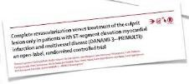



Results - Population
Trial PI Pts 75+
7 RCTs, 19% of pts
COMPLETE¹
S Metha
4041 554
FIRE²
S Biscaglia 1445 509
FULL REVASC³
F Bohm
1542 318
DANAMI 3⁴
T Engstrom 627 110
COMPARE ACUTE⁵ | P Smits | 885 | 108
Hamza et al.⁶ | I Elgendy | 100 | 76
CvLPRIT⁷ | G McCann | 296 | 58
917
culprit
816
complete
1. NEJM 2019. 2. NEJM 2023. 3. NEJM 2024. 4. Lancet 2015. 5. NEJM 2017. 6. J Int Card 2016. 7. JACC 2015.

Slide 8

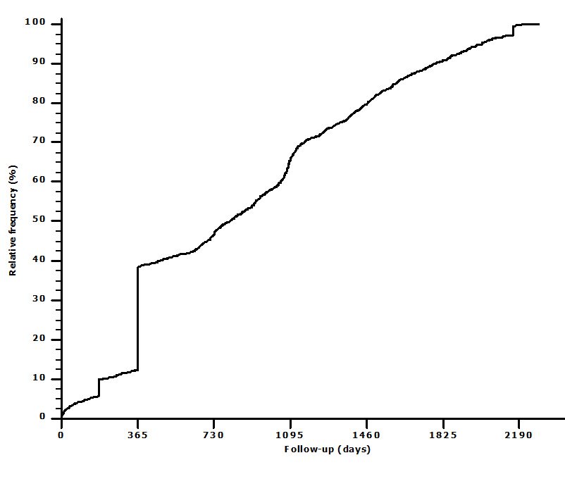























Results – Follow-up
Trial | Median Longest
COMPLETE¹ | 2.8 |  | 5.6
FIRE² | 1 |  | 1
FULL REVASC³ | 4.4 |  | 6.2
DANAMI 3⁴ | 1.9 |  | 3.7
COMPARE ACUTE⁵ | 2.9 |  | 3.2
Hamza et al.⁶ | 0.5 |  | 0.5
CvLPRIT⁷ | 6 |  | 6
 |  | (years)
20%
4-year
34%
3-year
53%
2-year
62%
1-year
1. NEJM 2019. 2. NEJM 2023. 3. NEJM 2024. 4. Lancet 2015. 5. NEJM 2017. 6. J Int Card 2016. 7. JACC 2015.

Slide 9



















Baseline Characteristics
Characteristic | Culprit (N=917) | Complete (N=816)
Age (IQR) – yr | 79 (77-83) | 79 (77-83)
Female sex * | 336 (37) | 259 (32)
Comorbidities
Hypertension | 611 (67) | 552 (68)
Diabetes | 193 (21) | 198 (24)
Prior MI | 79 (9) | 77 (9)
Culprit artery
LM | 9 (1) | 8 (1)
LAD | 343 (37) | 332 (40)
LCx | 134 (15) | 116 (14)
RCA | 431 (47) | 360 (45)
Characteristic | Culprit-Only (N=917) | Complete (N=816)
Killip class ≥2 | 164 (18) | 135 (17)
Radial access | 697 (76) | 612 (75)
≥2 NCLs | 277 (31) | 243 (31)
Physio-guided |  | 487 (57)
Medication at discharge
Aspirin | 879 (96) | 792 (97)
Clopidogrel | 359 (39) | 329 (40)
Ticagrelor | 496 (55) | 453 (56)
Prasugrel | 55 (6) | 31 (4)
ACEi or ARB | 665 (73) | 609 (83)
Statin | 856 (93) | 772 (95)

Slide 10
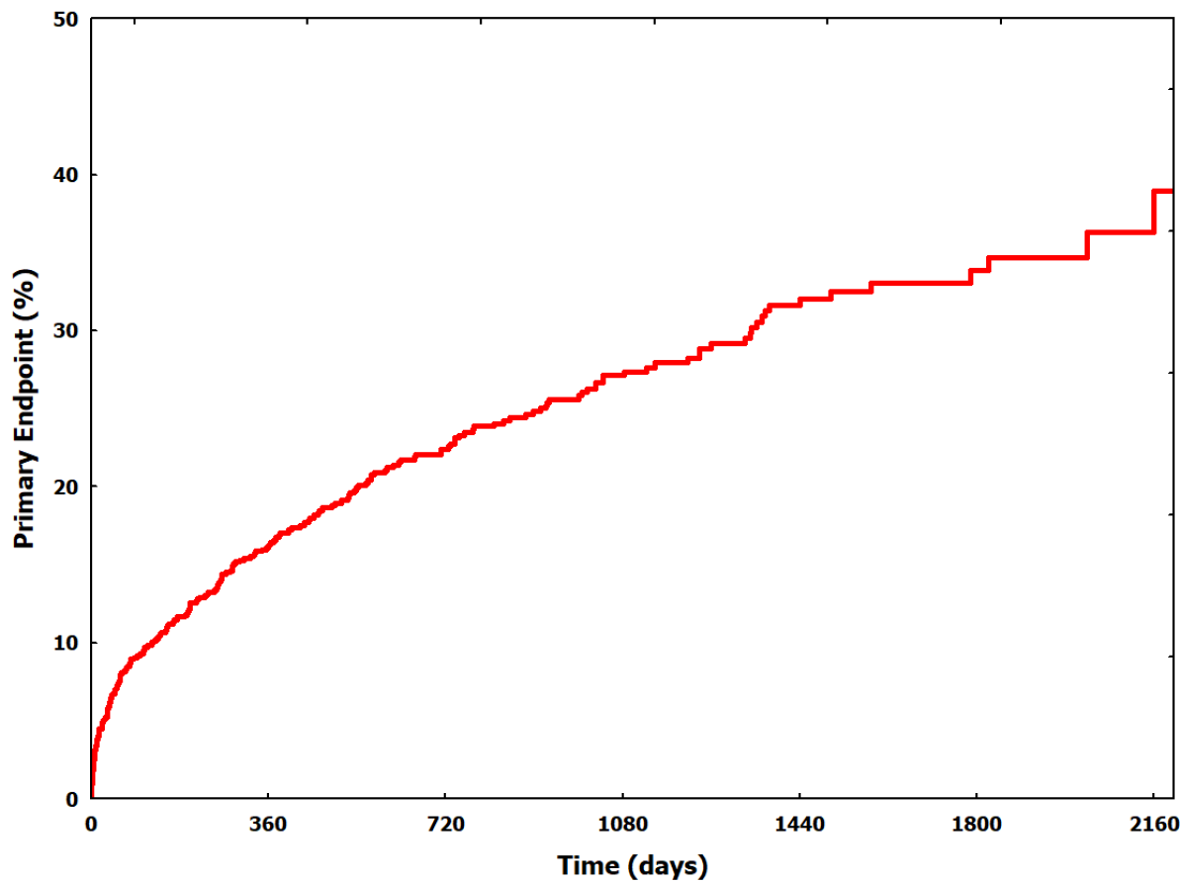
Primary endpoint
(Death, MI or ID-revascularization)
Pts
532
434
283
161
Culprit-only
Complete

Slide 11
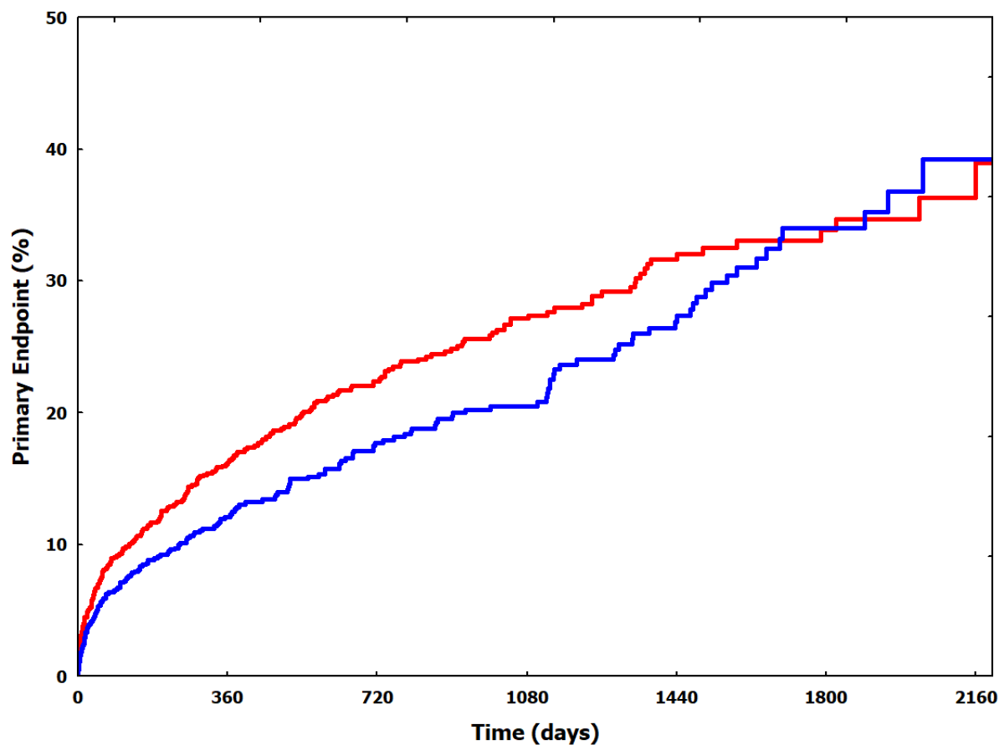



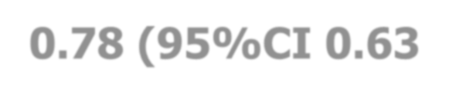



Primary endpoint
(Death, MI or ID-revascularization)
Pts | 532 | 434 | 283 | 161
 | 460 | 397 | 250 | 153
0.76 0.73
(0.60-0.95) (0.59-0.91)
0.74
(0.57-0.95)
adjHR 0.78 (95%CI 0.63-0.96)
P=0.005
Culprit-only
Complete

Slide 12




Primary endpoint
(Death, MI or ID-revascularization)
Pts | 532 | 434 | 283 | 161 | 77
 | 460 | 397 | 250 | 153 | 63
adjHR 0.83 (95%CI 0.69-1.01)
P=0.063
Culprit-only
Complete

Slide 13
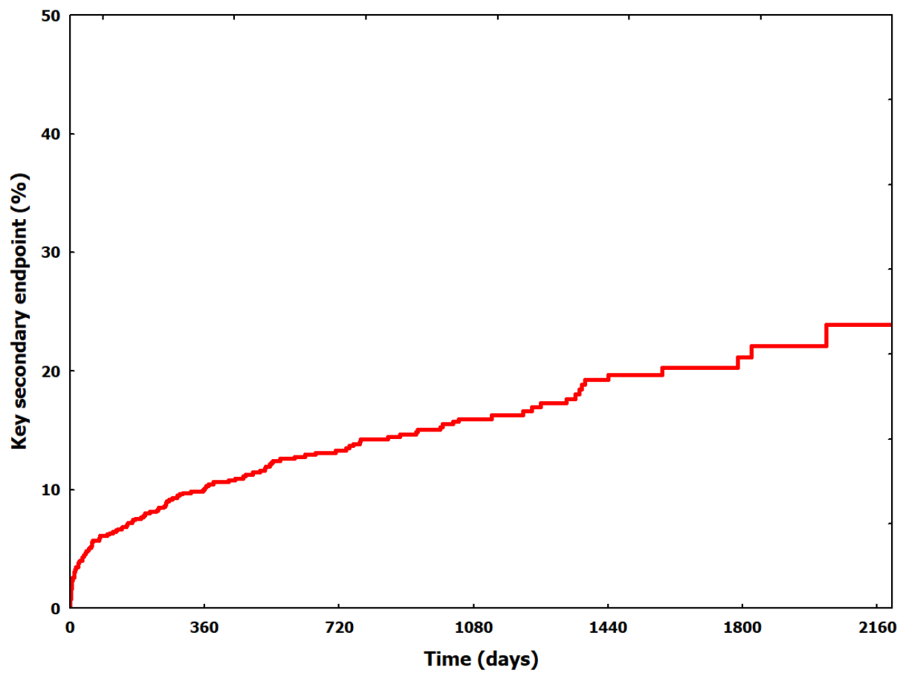
Key secondary endpoint
(CV Death or MI)
Culprit-only
Complete

Slide 14
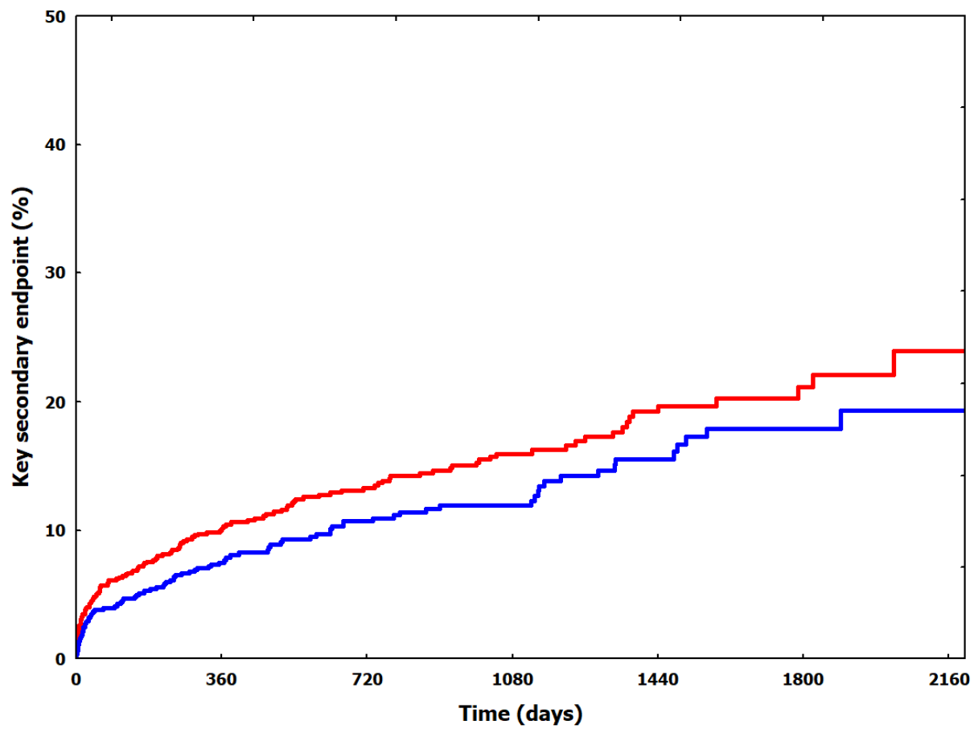







Key secondary endpoint
(CV Death or MI)
0.74
(0.56-0.98)
0.73
(0.54-0.97)
0.75
(0.56-1.02)
adjHR 0.76 (95%CI 0.58-0.99)
0.72
(0.51-0.99)
P=0.046
Culprit-only
Complete

Slide 15

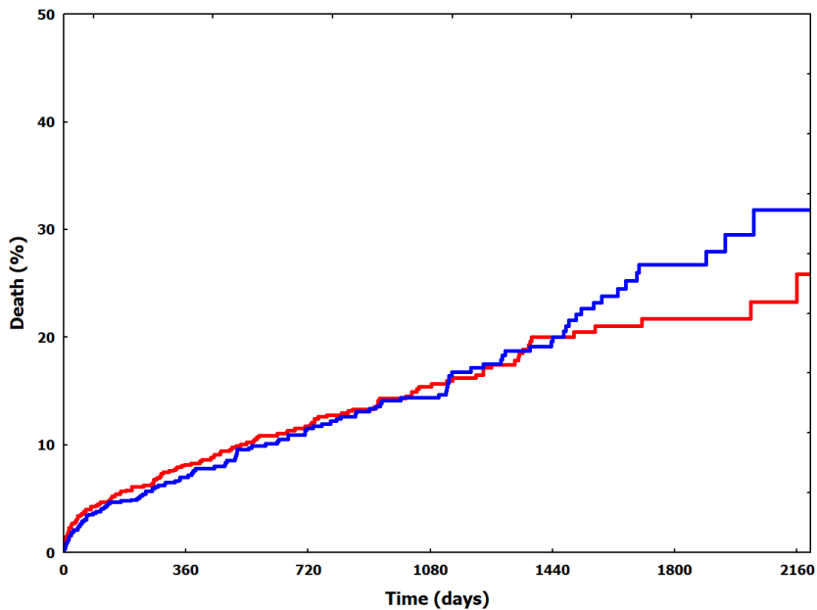
Secondary Endpoints
Outcome
 | Hazard Risk (95% CI) | P
Death | 1.03 (0.80-1.32) | 0.818
Cardiovascular death | 0.79 (0.56-1.02) | 0.184
Non-cardiovascular death | 1.40 (0.97-2.02) | 0.115
Myocardial infarction | 0.73 (0.47-1.13) | 0.161
ID-revascularization | 0.52 (0.34-0.85) | 0.002
Pts | 588 | 501 | 323 | 187 | 89
 | 481 | 423 | 267 | 167 | 72
No signal until 4-year
The early reduction in cardiac events is subsequently balanced by an increase in non-cardiovascular death

Slide 16
Safety Endpoints
E v e n t s ( % )
1 5
2 7 2 1
( 3 . 2 8 ) ( 2 . 8 3 )
1 2 1 0
( 1 . 4 5 ) ( 1 . 3 4 )
3 3 3 8
( 4 . 0 1 ) ( 5 . 1 2 )
5 5 6 9
( 1 0 . 8 ) ( 1 2 . 3 )
p = 0 . 6 0 5 p = 0 . 8 5 3 p = 0 . 2 8 9 p = 0 . 1 1 6
No concerns regarding safety endpoints in patients undergoing complete revascularization
1 0
%
5
0
S t r o ke
S t e n t t h r o m b o s is
M a jo r B le e d in g
C A - A KI
C u lp r i t - o n ly
C o m p le t e

Slide 17
Limitations
FIRE population represented 29% of patients and its follow-up is
limited to 1 year
Follow-up ≥4 years was available in 20% of patients
The sample size is limited to draw definitive conclusions regarding
death
Our data cannot be generalized to younger STEMI patients

Slide 18
Conclusions
The EARTH STEMI analysis, focused on STEMI patients aged ≥75 years with multivessel disease, shows that complete revascularization
Is safe
Reduces ischemic events up to 4 years
Reduces CV death or MI over time
Does not affect long-term mortality

Slide 19
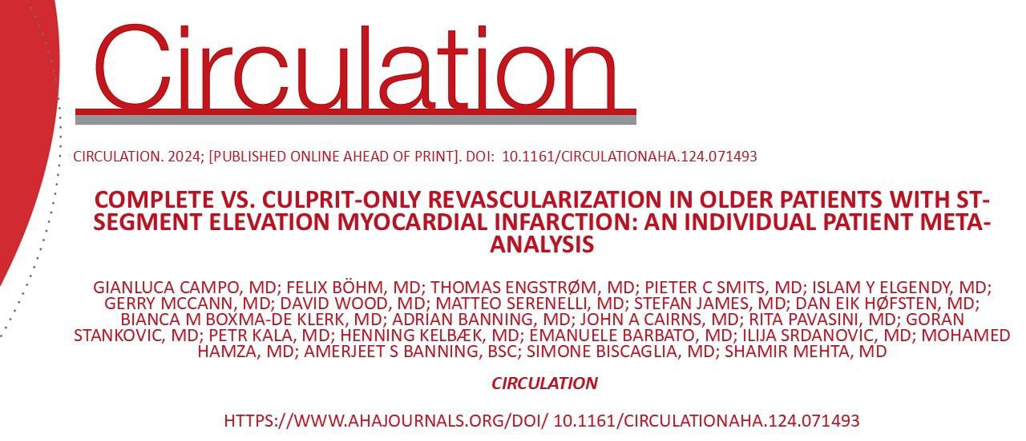


For more details…
https://elementrials.org
@GianlucaCampo78

