Slide 1
MATTERHORN trial
Transcatheter versus surgical mitral valve repair in patients with heart failure and
secondary mitral regurgitation
Sources of funding: unrestricted research grant by Abbott Vascular
Declaration of Interest:
research grants (Abbott Vascular, Edwards Lifesciences, Boston Scientific) consulting fees (Abbott Vascular, Edwards Lifesciences [to institution])
honoraria (Abbott Vascular, Astra Zeneca, Bristol Myers Squibb, Boston Scientific, Edwards Lifesciences [to institution])
Volker Rudolph, MD Aug 31, 2024

Slide 2
Main take home message
In patients with heart failure and secondary mitral regurgitation, transcatheter edge-to-edge repair is non-inferior to surgery regarding clinical efficacy, and has a better safety profile.

Slide 3
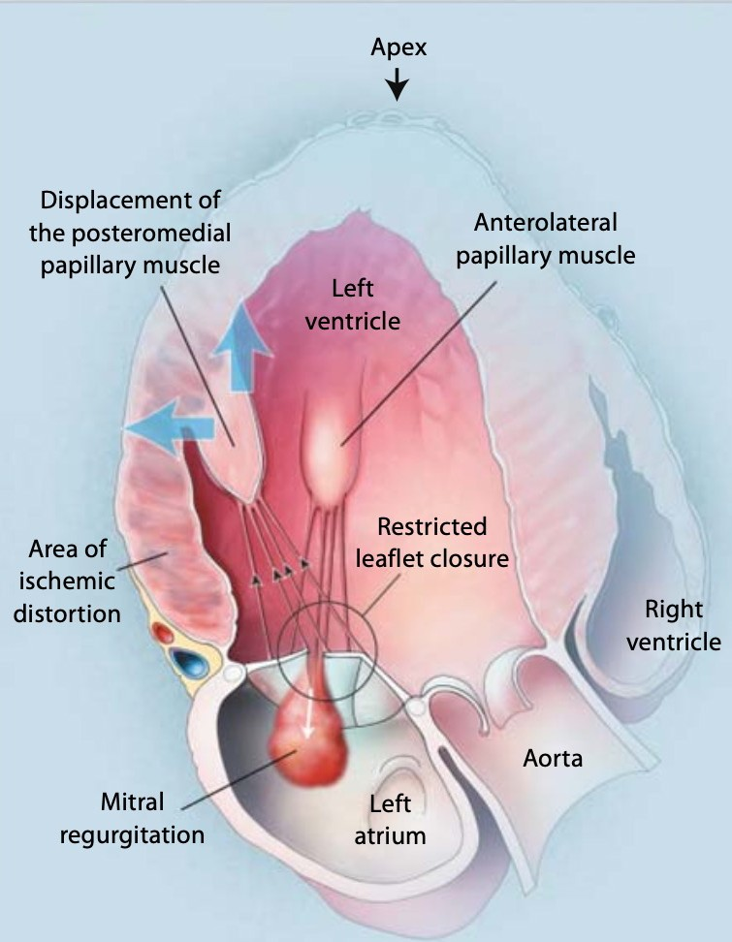
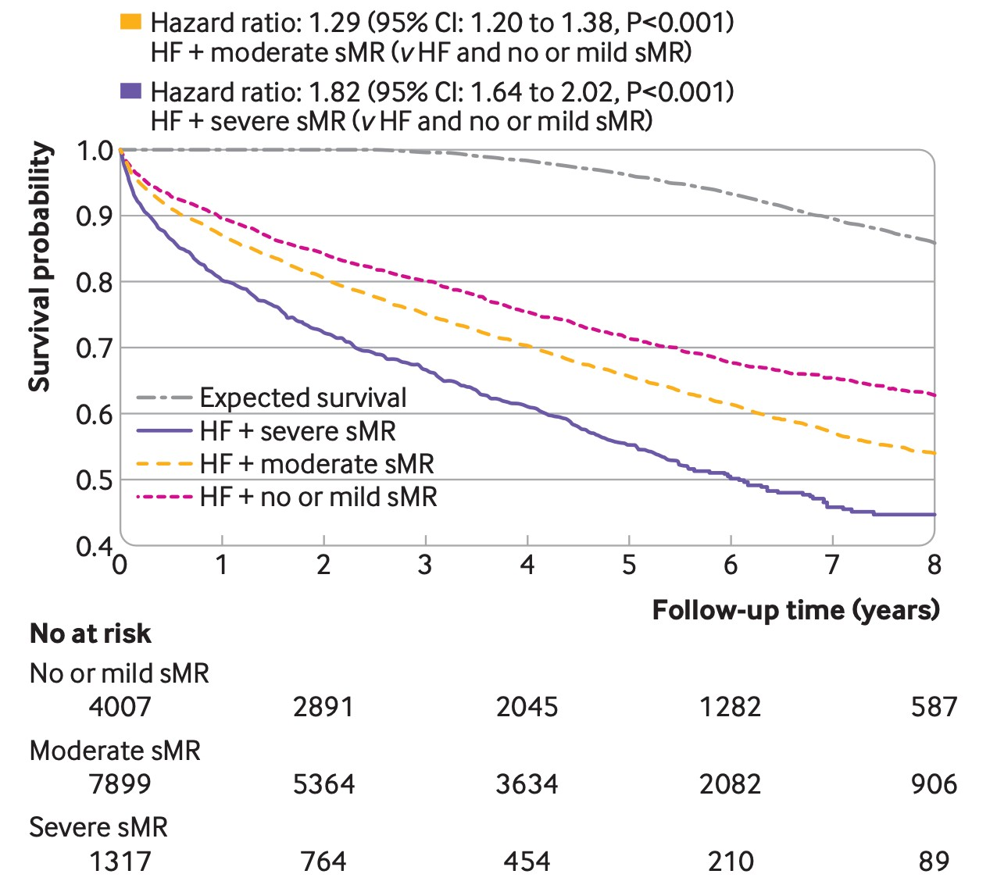
Secondary mitral regurgitation
Magne et al. Cardiology 2009
Bartko et al. BMJ 2021

Slide 4

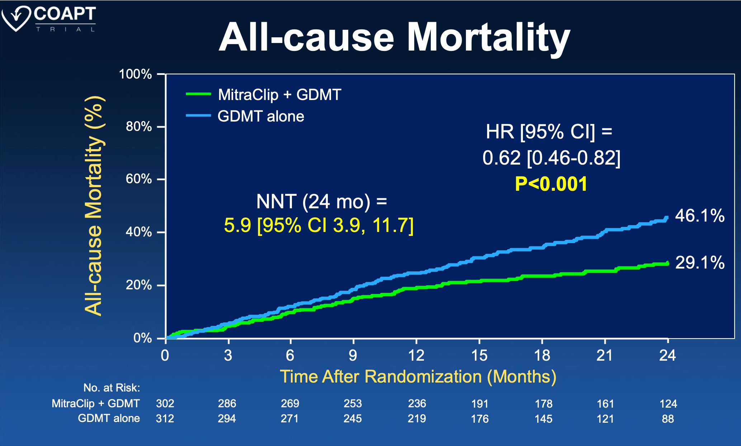

Transcatheter mitral repair
Stone et al. NEJM 2018

Slide 5
Key points about methods
Investigator-initiated, multicentric controlled non-inferiority trial
Mitral Transcatheter Edge-to-Edge Repair
N = 104
1:1-randomization
Surgical Mitral Valve Repair or Replacement
(ablation, tricuspid repair at discretion of operator)
N = 104

Slide 6
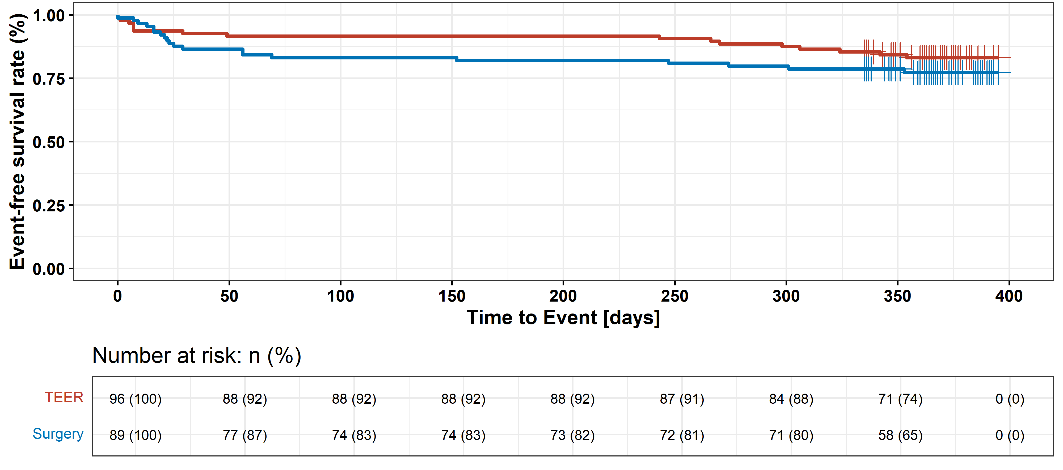
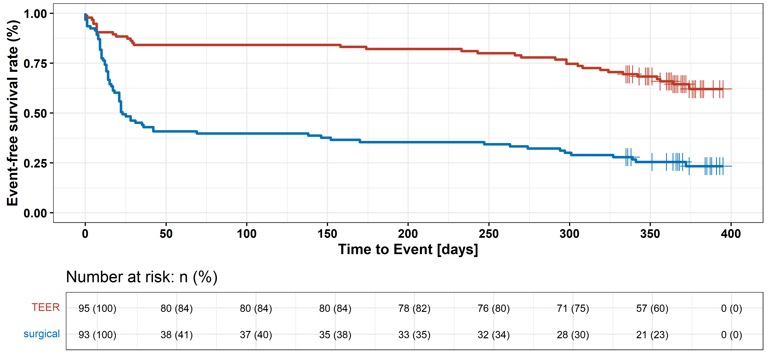
Results
Primary efficacy endpoint
16.7% of patients
22.5% of patients
OR 0.69 (95% CI 0.33-1.44), p_{non-inferiority} <0.001
Primary safety endpoint
14.9% of patients
p<0.001
54.8% of patients
Combination of death, heart failure rehospitalization, mitral reintervention, assist device implantation, stroke
Major Adverse Events (death, MI, major bleeding, stroke or TIA, rehospitalization, reintervention, non-elective cardiovascular surgery, renal failure, deep wound infection, mechanical ventilation >48 hours, gastrointestinal complication requiring surgery, new-onset atrial fibrillation, septicemia or endocarditis )

Slide 7
Key messages
In patients with heart failure and secondary mitral regurgitation, transcatheter edge-to-edge repair is non-inferior to surgery regarding clinical efficacy, and has a better safety profile.
Results may extend indication for interventional mitral repair to patients with secondary mitral regurgitation who are eligible for surgery.

